Slide 1



Career Development Series 2022
How to Build a Research Budget
Presentation will begin at 12:00 PM (PT)
Thank you

Slide 2



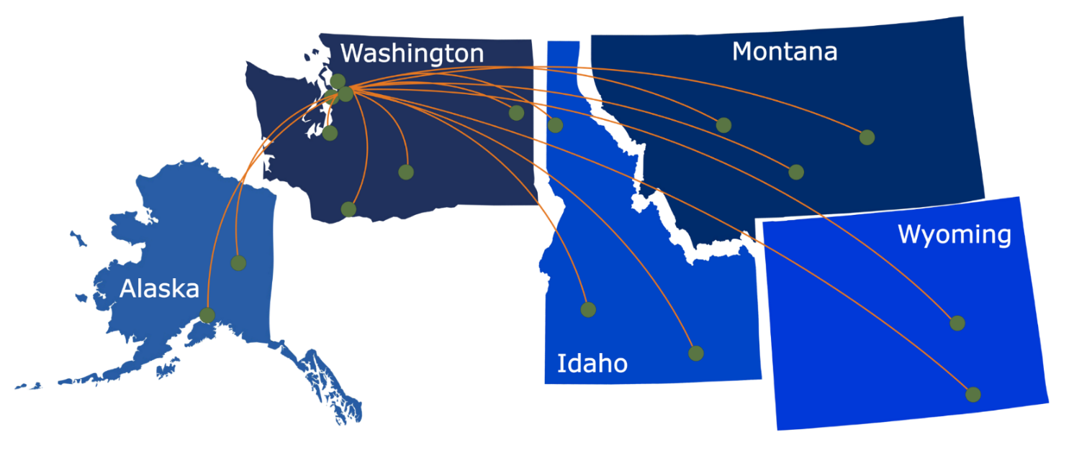
Notes:
Aric:
ITHS is a partnership between University of Washington, Fred Hutch, and Seattle Children's. We work across the 5 state WWAMI (Washington, Wyoming, Alaska, Montana, and Idaho) region. We have both clinical and academic partners throughout the region.

Slide 3
What We Offer:
1
Research Support Services: Members gain access to the different research services, resources, and tools offered by ITHS, including the ITHS Research Navigator.
2
Community Engagement: Members can connect with regional and community based practice networks
3
Education & Training: Members can access a variety of workforce development and mentoring programs and apply for formal training programs.
4
Funding: Members can apply for local and national pilot grants and other funding opportunities. ITHS also offers letters of support for grant submissions.
Notes:
Aric:
ITHS has a lot of different resources that are available across the spectrum of clinical and translational research.
Research Support Services
Community Engagement – really focuses on regional and community based practice networks along with some opportunities to interact with patients and community based organizations
Education and Training through career development, structured training programs
Funding awards that are available

Slide 4
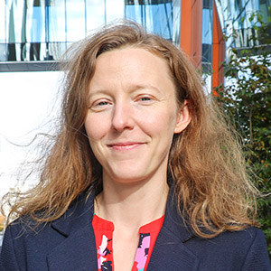
Contact our Director of Research Development
Project Consultation
Strategic Direction
Resources and Networking
Melissa D. Vaught, Ph.D.
ithsnav@uw.edu
206.616.3875
Notes:
Aric:

Slide 5
Career Development Series 2022
Feedback
Thank you
At the end of the seminar, a link to the feedback survey
will be sent to the email address you used to register.

Slide 6
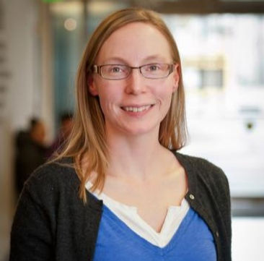
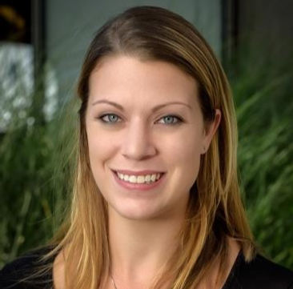

Career Development Series 2022
How to Build a Research Budget
Presented by:
Denise Cecil and Lauren Corulli
Thank you

Slide 7
Learning Objectives
At the end of the session, attendees will be able to:
1
Break down any written research aim into a list of specific, cost-driving component categories
2
Identify at least two of the federal Cost Principles

Slide 8



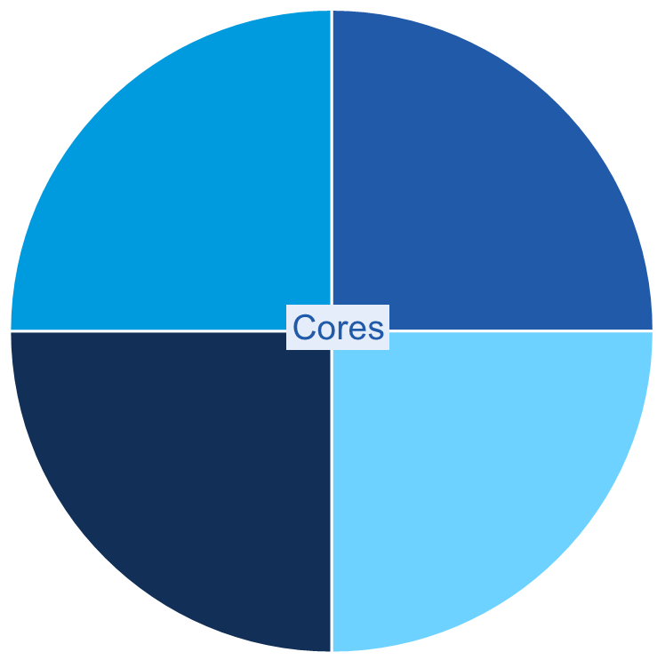

About the Cancer Vaccine Institute (CVI)
Igniting the immune system to end cancer
CVI Director
DR. NORA DISIS
Mother of Cancer Vaccines
$27million
in grants, last 5 years
30
members
6
faculty
>250
papers published
Clinical
Animal
www.uwcvi.org
Immune
Monitoring
Admin

Slide 9
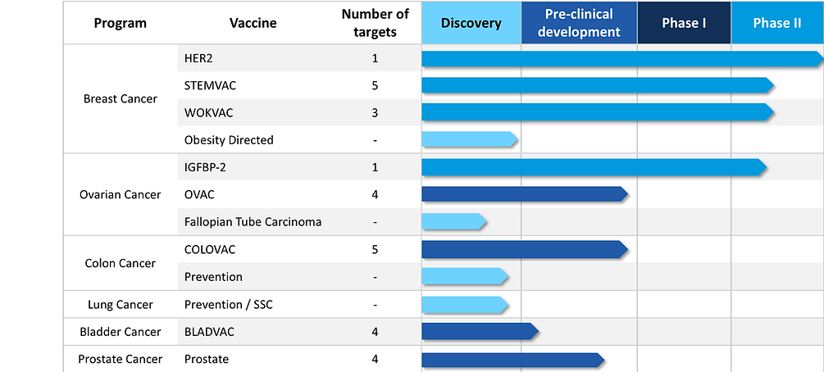
CVI Research
www.uwcvi.org

Slide 10
Who are we?
Denise Cecil, PhD
  Principle scientist at the CVI; Oversees Dr. Disis’ wet lab
  Interim director of the CVI clinical immune monitoring lab
  Expert in immunology, assay development
Lauren Corulli, MS
  Director of Research Operations at the CVI
  Oversees the CVI mouse core
  Former research scientist; now hybrid research/admin
  Expert in time-coursed budgets, project management

Slide 11
Your career is a series of interrelated projects
Success is many projects being conducted simultaneously -
driving team development

Slide 12

The impossible role of the Principle Investigator
Clinician
Researcher
Fundraiser
Recruiter
Data analyst
Creative genius
HR manager
Mentor
Fiscal specialist
Regulatory expert
Significant other
Parent
Project Manager

Slide 13

At the end of the day, YOU are the one responsible...
To the FDA…
To the NIH…
To the sponsor…
To your department…
To your institute…
To IACUC and IRB…
To your team members…
To the patients…
What happens if you go broke?

Slide 14
Crash course: project management
Schedule
Scope
Expanded Scope
Crashed schedule
Project Management
Cost
Higher Cost!
Each of these is not mutually exclusive. Project Management is a balancing act of monitoring, controlling, and reacting to changes in the three items. How will one change impact another?
Notes:
Not everyone has a PM on their team – but again, every PI is expected to be a project manager, and that expectation similarly trickles down to our senior scientists, research coordinators, and administrators. Many do not have formal training in project management.
Project management is understanding how these items will impact one another – and being prepared with a plan for when those things can – and WILL – occur. You can’t be prepared for every scenario, but you can be prepared to address every scenario

Slide 15
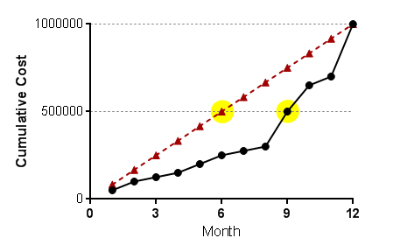
Basic project management principles of budgeting
The PM balancing act should start before a grant is submitted
It is more than tracking progress or schedules…
  Developing time-coursed budgets
  Managing Deliverables: Feasibility, logistics, resource availability
  Ongoing risk, resource, stakeholder & cost management
Cost and time do not have a linear relationship

Slide 16







Project life cycle (commonly…)
Write Scope
Create Budget
Project Execution
Project Reporting
Publish papers, New grant scope/budget
Awarded!
Notes:
Remember: Success is many projects being conducted simultaneously. You can survive on one project at a time. But how to build a system that you can support a team? How to manage a project portfolio, not just a project?

Slide 17

The “ideal” project life cycle
Create Budget
Monitoring
Publish papers, New Grant
Write Scope
Establish Baseline
KICK
OFF!
Project Execution
Close-out & Lessons Learned
Submit
Estimate Schedule
Improve Estimates
Reporting
Notes:
Establish Baseline:
Fine-tuning. Create, estimate, edit, adjust, balance – and on, and on, until it’s right.
Kick-off:
With entire project team, review the SOW, experiments (high level) and schedule of events
Set expectations for spending.
Things change! Address issues. Get ahead of it!
Project Execution:
Monitoring = make ongoing adjustments as needed, within sponsors confines. Measure project progress vs. expenditures, time expended vs. budgeted.
Lessons Learned:
Drive your new grants by your lessons learned. Better estimates, better predictions

Slide 18
How to build a research budget
How to build a research budget
Knowing your sponsor
Project Scope → Budget Components
  Breakout groups - Activity 1
  Budgeting tangible items: supplies/consumables
  Budgeting for intangible items: personnel/effort
The federal cost principles
Breakout groups - Activity 2
Ongoing management

Slide 19
Polls
How to build a research budget
How much budgeting experience do you have?
What are your main concerns with budgeting?

Slide 20
Knowing your sponsor
Understand your RFA
  Lean on your administrative support system
  Does the sponsor expect travel? Where are you going?
  What indirect rate is allowed?
  Is the budget limit on the total cost – or the direct cost?
  Understand the rules on subcontractors and indirect rates (e.g. DOD vs NIH)
Consider the size of your grant when budgeting
  Don’t estimate the cost for every pipette on a $5M grant – and don’t overlook the cost of a box of tips on a $25k pilot
  How large of a team is appropriate for the award size?

Slide 21
Project scope → Budget components
Your project scope is a descriptive narrative of quantifiable items, including…
  Supplies/Consumables
  Effort (salary and benefits)
  Subcontracts
  Equipment
  Travel
  Other: Consulting services, Software/licenses, Animal housing fees, etc.
  Patient Care (not covered here)
  Indirects
The first step to building your budget is to divide your narrative into individual cost-driving components

Slide 22
ACTIVITY 1 – Breakout Groups
5 minutes
Objective: Working in teams, outline the components you need to budget for to accomplish the following sub-aim:
  We have previously identified 10 candidate antigens which were significantly (p<0.05) upregulated in donor tissue by at least 2-fold. We will assess for the presence of Th2 via an IL-10 ELISPOT assay using three to four peptides from each antigen. Peptides will also be screened for immunogenicity using an IL-17 ELISPOT assay. A positive response will be defined as a response significantly greater than the mean of no antigen (negative control) wells for each IL-10 and IL-17 assay, using PMA/ionomycin and tetanus as a positive control. We will collect PBMC from 20 donors to be screened in this assay.
What various tangible components (supplies/consumables) do you need to budget for?
How many of each component should you include?
What types of personnel (scientist, assistant, technician, etc.) should you include for this work?
Bonus: What is NOT written, but may need to be considered?

Slide 23
ACTIVITY 1 - Discuss
  We have previously identified 10 candidate antigens which were significantly (p<0.05) upregulated in donor tissue by at least 2-fold. We will assess for the presence of Th2 via an IL-10 ELISPOT assay using three to four peptides from each [of my 10 previously identified] antigen. [These same 30-40] Peptides will also be screened for immunogenicity using an IL-17 ELISPOT assay. A positive response will be defined as a response significantly greater than the mean of no antigen (negative control) wells for each IL-10 and IL-17 assay, using PMA/ionomycin and tetanus as a positive control. We will collect blood from 20 donors and process it to PBMC to be used in these assays.
What various tangible components do you need to budget for?
  ELISPOT assay: Peptides, other reagents, IL17/IL10
  Blood collection supplies
  Processing supplies for blood to PBMC
How many of each tangible component should you include?
  2 ELISPOT types x <=40 peptides + 3 controls x 20 specimens
  20 blood collection supplies & processing supplies
What types of personnel (scientist, assistant, technician, etc.) should you include for this work?
Bonus: What is NOT written, but may need to be considered?
Notes:
Remember: if you can determine how much you need for the smallest component of work, you can use your multipliers to determine the cost. This is significantly easier than trying to multiply it all out up front.
What types of personnel (scientist, assistant, technician, etc.) should you include for this work?
These answers will vary greatly by how your lab functions and how your institute titles people. It will also depend on the end-goal of the project! Is this for future clinical use? IND enabling? Or pilot study to generate data for a potential R01? Maybe… PI (oversight), Research scientist (with a lot of experience in this assay), What about: Lab manager? Student assistant or research assistant?
Bonus: What is NOT written, but may need to be considered?
What about analysis? Statistician or biostat consultant? Do you, as the PI, have the qualifications or skills to analyze these data?
What if an assay doesn’t work? Always build in a fudge factor for repeat work! We usually do 10-20%.
Can you order in bulk for the reagents needed? Are there shelf-life considerations?
Can you outsource the preparation of these reagents? For example, can you ask for peptide vialing services for additional fee?

Slide 24
Budgeting: The tangible
supplies and consumables
Using the defined scope components, build your budget:
What components comprise each aim?
  E.g. ELISPOT on X peptides for Y patients
Determine the supply cost of ONE of each of those components.
  One ELISPOT plate – one peptide – one patient.
  How much of each reagent do you need?
Use formulas to multiply out. Example next slide.
Calculate. Are you over the limit?
Reduce aim quantities, then reduce budget. Repeat as needed.

Slide 25
Budgeting: The tangible
Example
Stimulants per subject |  | 0
# subjects |  | 0
ELISPOT assay cost (supplies/consumables)
Item | Units |  | Cost/unit |  |  | Units per Stimulant * Subject |  | Cost per 4-well rep
96-well ELISPOT plates | 10 x 96-well plates |  | $ 353.00 |  |  | 4 wells |  | $ 1.47
Monoclonal antibody | 1,000 grams |  | $ 710.00 |  |  | 3.5 grams |  | $ 2.49
Monoclonal Ab, biotinylated | 1,000 grams |  | $ 885.00 |  |  | 3.5 grams |  | $ 3.10
Streptavidin-AP | 500 uL |  | $ 77.00 |  |  | 0.32 uL |  | $ 0.05
AP conjugate substrate kit | 1000 mL |  | $ 155.00 |  |  | 0.32 mL |  | $ 0.05
48 well plates | 50 x 48-well plates |  | $ 95.81 |  |  | 1 well |  | $ 0.04
IL-2 | 10,000 units |  | $ 172.00 |  |  | 20 units |  | $ 0.34
cryovials | 1,000 vials |  | $ 333.00 |  |  | 4 vials |  | $ 1.33
Tcell media | 555 mL prepared |  | $ 38.00 |  |  | 16 mL |  | $ 1.10
 | COST per subject * stimulant |  |  |  |  |  |  | $ 9.97
 | Subject * stimulants |  |  |  |  |  |  | (calculated above)
 | Total, plus 10.1% tax = |  |  |  | (Cost per subject * stimulant) x (# subjects) x (stimulants per subject)
Notes:
For our “workhorse” assays – the ones we know through and through – we take our developed SOP and we itemize each step out to a tangible component. We derive the number of items we’ll need for each of those divided up components – and then ask a fiscal specialist (or personnel available to you) to provide quotes for the cost of each of those items. From this we can determine our cost per smallest-cost-driving component.
We then develop a formula that will multiply out the cost per subject/stimulant for us – this way, we can multiply as needed for a huge variety of conditions. Maybe we’re using mice – and we have 400 samples instead of 20, but we have only 4 stimulants per subject.
It took a LOT to develop this sheet initially. It is likely not worth the time to develop a worksheet this involved if you’ll only do the assay once. If the assay is something you plan to do time and time again, or if a large portion of your grant depends on this work – and it is liable to change based on the cap of this award – OR if you plan to put this scope in to multiple sponsors, with varying degrees of complexity, then developing a good tool will save you a lot of time in the long run.

Slide 26
Budgeting: The tangible
Example
Stimulants per subject |  | 40
# subjects |  | 20
ELISPOT assay cost (supplies/consumables)
Item | Units |  | Cost/unit |  |  | Units per Stimulant * Subject |  | Cost per 4-well rep
96-well ELISPOT plates | 10 x 96-well plates |  | $ 353.00 |  |  | 4 wells |  | $ 1.47
Monoclonal Ab | 1,000 grams |  | $ 710.00 |  |  | 3.5 grams |  | $ 2.49
Monoclonal Ab, biotinylated | 1,000 grams |  | $ 885.00 |  |  | 3.5 grams |  | $ 3.10
Streptavidin-AP | 500 uL |  | $ 77.00 |  |  | 0.32 uL |  | $ 0.05
AP conjugate substrate kit | 1000 mL |  | $ 155.00 |  |  | 0.32 mL |  | $ 0.05
48 well plates | 50 x 48-well plates |  | $ 95.81 |  |  | 1 well |  | $ 0.04
IL-2 | 10,000 units |  | $ 172.00 |  |  | 20 units |  | $ 0.34
cryovials | 1,000 vials |  | $ 333.00 |  |  | 4 vials |  | $ 1.33
Tcell media | 555 mL prepared |  | $ 38.00 |  |  | 16 mL |  | $ 1.10
 | COST per subject * stimulant |  |  |  |  |  |  | $ 9.97
 | Subject * stimulants |  |  |  |  |  |  | 800.00
 | Total, plus 10.1% tax = |  |  |  | $8,784.13
x

Slide 27
Budgeting: The intangible (time)
The same components that you defined earlier will similarly draw effort. There are a myriad of ways to estimate time. Your approach will depend on your unique research environment.
  Option 1: The “cost-center” approach
  Determine the hours each person requires to perform one workable component. Multiply as needed.
  Option 2: The “days per week” approach
  If you must/can only support XX percent, is the scope feasible within that confine?
  Option 3: Aims-driven, “hybrid” approach
  Determine if each sub-aim requires a cost-center approach or a days per week approach. Normalize (hours or percentages), then sum all aims over time.

Slide 28
Budgeting: The intangible (time)
Option 1: The “cost-center” approach
Better for predictable scopes with clear components
More accurate; based on a 2,080h work year corrected for meetings, sick/vacation, and thinking time (you decide what’s appropriate – 1,950h?)
Time consuming – and we often underestimate ourselves
Remember: RS1 time ≠ RS4 time
Sponsor’s interpretation on variable staff may vary
Option 2: The “days per week” approach
Option 3: Aims-driven, “hybrid” approach

Slide 29
Budgeting: The intangible (time)
Option 1: The “cost-center” approach
Option 2: The “days per week” approach
Good for larger applications
Better where work components are not as predictable
Best when work is primarily, or entirely, effort
Good for a team that isn’t yet established
Generally less accurate
Option 3: Aims-drive, “hybrid” approach

Slide 30
Budgeting: The intangible (time)
Option 1: The “cost-center” approach
Option 2: The “days per week” approach
Option 3: Aims-driven, “hybrid” approach
Good for larger applications with mixed work components
Allows diverse teams greater autonomy in predictions
Aim | Role | Q1 | Q2 | Q3 | Q4 | Y1 effort
Aim 1a | Technician | 25% | 50% | 25% | 0% | 25%
 | Post-doc | 10% | 25% | 25% | 0% | 15%
Aim 1b | Post-doc |  | 100h | 50h | 58h | 10%
 | Technician | 104h |  |  |  | 5%
Aim 2a | Post-Doc |  |  | 10% | 10% | 5%
Aim 2b | Grad Student | 100h | 100h | 100h | 100h | 20%

Slide 31
Budgeting: The intangible (time)
Common mistakes & assumptions
Reducing staff effort is not a cost-saving solution if not associated with a reduced scope.
Shortening the project duration does not necessarily reduce cost. Risks: staff burnout, less reliable work (mistakes).
Decide what you can and cannot live without
if you have to cut back on scope.
Extended schedule
Same Scope
Reduced Cost
(lowered effort)
Shortened schedule
Same Scope
Higher Cost
(rework, higher effort to meet schedule)

Slide 32
Monitoring the intangible (time)
Learn from your mistakes!

Slide 33
The federal cost principles
  Reasonable: Would a prudent person agree that this item is necessary?
  Allocable: Does this expense directly contribute to advancement of the work?
  Consistency: Do you charge this the same way on other grants?
  Conformance: Does this expense adhere to the terms and conditions of this award?
Budgeting for an item that is not reasonable/necessary, allocable to the work described, consistently treated, or in conformance with the award terms could tank your application.
Approved/Granted ≠ Allowable
https://grants.nih.gov/grants/policy/nihgps/HTML5/section_7/7.2_the_cost_principles.htm

Slide 34
ACTIVITY 2 – Breakout Groups
5 minutes
PERSONNEL | Effort | Salary | Benefits | SUBTOTAL
PI | 10% | $ 120,000 | $ 30,000 | $ 15,000
Research Scientist | 29% | $ 58,000 | $ 17,400 | $ 21,895
Research Assistant | 10% | $ 42,000 | $ 12,600 | $ 5,460
SUPPLIES | Unit | Unit Cost | Quantity | SUBTOTAL
ELISPOT Reagents | pool | $ 10.98 | 1720 | $ 18,886
Peptides | 90mg | $ 900.00 | 40 | $ 36,000
Blood collection kits | patient | $ 8.00 | 20 | $ 160
Blood processing | patient sample | $ 120.00 | 20 | $ 2,400
Misc. Consumables | $0.05/$1 | $ 0.05 | 57,446 | $ 2,872
OTHER | Unit | Unit Cost | Quantity | SUBTOTAL
Donor stipends | patient | 30 | 20 | $ 600
Stat consult | hrs | 150 | 4 | $ 600
TRAVEL | Unit | Unit Cost | Quantity | SUBTOTAL
Conference | event | 898 | 1 | $ 898
 |  |  | TOTAL | $ 104,771
The RFA has a direct cost limit of $75,000. For this pilot project, attendance at one conference is required.
Your first draft budget is shown here.
Look at the budget together.
  How can you adjust?
  What is now at risk by making these changes?

Slide 35
ACTIVITY 2 – Breakout Groups
5 minutes
The RFA has a direct cost limit of $75,000. For this pilot project, attendance at one conference is required.
No “right” or “wrong” answer here!
PERSONNEL | Effort | Salary | Benefits | SUBTOTAL
PI | 10% | $ 120,000 | $ 30,000 | $ 15,000
Research Scientist | 29% | $ 58,000 | $ 17,400 | $ 21,895
Research Assistant | 5% | $ 42,000 | $ 12,600 | $ 2,730
SUPPLIES | Unit | Unit Cost | Quantity | SUBTOTAL
ELISPOT Reagents | pool | $ 10.98 | 920 | $ 10,102
Peptides | 90mg | $ 900.00 | 20 | $ 18,000
Blood collection kits | patient | $ 8.00 | 20 | $ 160
Blood processing | patient sample | $ 120.00 | 20 | $ 2,400
Misc. Consumables | $0.05/$1 | $ 0.05 | 30,662 | $ 1,533
OTHER | Unit | Unit Cost | Quantity | SUBTOTAL
Donor stipends | patient | 30 | 20 | $ 600
Stat consult | hrs | 150 | 4 | $ 600
TRAVEL | Unit | Unit Cost | Quantity | SUBTOTAL
Conference | event | 898 | 1 | $ 898
 |  | TOTAL DIRECT |  | $ 73,918

Slide 36
ACTIVITY 2 – Breakout Groups
5 minutes
The RFA has a direct cost limit of $75,000. For this pilot project, attendance at one conference is required.
No “right” or “wrong” answer here!
PERSONNEL | Effort | Salary | Benefits | SUBTOTAL
PI | 10% | $ 120,000 | $ 30,000 | $ 15,000
Research Scientist | 17% | $ 58,000 | $ 17,400 | $ 12,833
Research Assistant | 5% | $ 42,000 | $ 12,600 | $ 2,730
SUPPLIES | Unit | Unit Cost | Quantity | SUBTOTAL
ELISPOT Reagents | pool | $ 10.98 | 740 | $ 8,125
Peptides | 90mg | $ 900.00 | 34 | $ 30,600
Blood collection kits | patient | $ 8.00 | 10 | $ 80
Blood processing | patient sample | $ 120.00 | 10 | $ 1,200
Misc. Consumables | $0.05/$1 | $ 0.05 | 40,005 | $ 2,000
OTHER | Unit | Unit Cost | Quantity | SUBTOTAL
Donor stipends | patient | 30 | 10 | $ 300
Stat consult | hrs | 150 | 4 | $ 600
TRAVEL | Unit | Unit Cost | Quantity | SUBTOTAL
Conference | event | 898 | 1 | $ 898
 |  | TOTAL DIRECT |  | $ 74,366

Slide 37
Have you considered everything?
Development Costs?
  Training staff
  Optimizing a key reagent
  Reproducibility (also – are you powered?)
Startup fees?
  Do I have access to the equipment needed?
  Have I done an initial cost comparison of most expensive items? What if my choice isn’t available?
  Regulatory delays: Time is money!
Personnel?
  Biostatistician, consultants?
  FTE: Where else are my staff supported? How will I support my staff when this ends?
  Will staff receive merit increases during the performance period?
Is there an opportunity for outsourcing?
  Often, more expensive is actually less expensive

Slide 38

“I don’t need a budget. I have one from a similar grant I made last year.”
“We’re over the budget limit. Let’s cut some effort or shorten the project by 6 months.”
“I don’t need to look at costs yet. We will just figure it out if we get the award.”

Slide 39
ONGOING MANAGEMENT
Map your budget consumption expectation; monitor periodically
Staff costs are the most often underestimated. If you can, monitor actuals to improve future budgets
Small solutions may include outsourcing minor components

Slide 40
Career Development Series 2022
How to Build a Research Budget
Questions? Ideas? More info?
Lrr2@uw.edu
Thank you

Slide 41
Career Development Series 2022
Thank You!
Thank you
Open for Questions

Slide 42
Career Development Series 2022
Feedback Survey
Thank you
A link to the feedback survey has been sent to the email address you used to register.
Please get out your device, find that email, and spend a few moments completing that survey before you leave today.
Tip: If on a mobile device, shift view to landscape view (sideways) for better user experience.

