Slide 1
Michael Donahue, Research Coordinator. University of Washington,
Institute of Translational Health Sciences, Seattle, WA
True Blood: A Tracking System for the Identification of Sample Collection Barriers
Description of the Problem
BEST PRACTICE:
Implement a system to track eligible patients and enrollment and sample collection outcomes
Results
This study involved obtaining research blood samples during a scheduled clinical draw. Clinic schedules were screened to identify patients with the diagnoses of interest. The coordinator would then obtain consent from patients during the clinic appointment. After consent, the patient would have a clinical blood draw, and the researcher would collect additional blood to use in the study.
Although there were 94 eligible patients with scheduled appointments, many of whom previously consented for this study, only 26 research samples were collected (far fewer than expected). It was not clear why this number was so low, or what the barriers were to collecting samples.
28% of patients determined to be eligible from pre-screening had samples drawn
30% of patients did not have clinical blood drawn, which was far lower than the PI expected
24% of patients cancelled or were a no-show on the day of the appointment, which was greater than expected
Having quantitative data allowed the PI to establish more reasonable expectations for data collection by the research lab
Methods
Outcomes of 94 anticipated blood samples
Created a worksheet to track the number of samples collected, eligible patients, and reasons why samples were not collected. At the end of each clinic day the outcome for each patient identified on prescreening as eligible was recorded. The following data was collected:
Objectives
Better understand why fewer samples were collected than anticipated
Identify barriers between clinicians, research coordinators, and clinic patients
Increase the number of samples collected
Number of patients eligible
Number of samples collected
Patient not having a clinical blood draw
Patient cancelled or was a no show
Coordinator not available to talk to patient
MD did not refer patient to the coordinator
Patient declined
Not a good candidate per MD
Other
Discussion
Tracking helps identify true barriers and bottlenecks to recruitment and data collection
This type of tracking process can be translated to other studies and show value
Acknowledgements
Institute of Translational Health Sciences - UL1 TR002319

Slide 2
Title:
Subtitle
Author, Author
¹University of Washington, Institute of Translational Health Sciences, Seattle, WA
Motivation & Introduction
Results
Discussion
Text Box
Text Box
Text Box
Resources
Image/ Diagram
Methods
Bullet 1
Bullet 2
Bullet 3
Bullet 4
Bullet 5
Bullet 1
Bullet 2
Bullet 3
Bullet 4
Bullet 5
Acknowledgements
Institute of Translational Health Sciences - UL1 TR002319
References

Slide 3
Title:
Subtitle
Key outcome or project statement
Results
Text Box
Bullet 1
Bullet 2
Bullet 3
Bullet 4
Bullet 5
Text Box
Motivation & Introduction
Resources
Methods
Discussion
Image/ Diagram
Text Box
Bullet 1
Bullet 2
Bullet 3
Bullet 4
Bullet 5
Acknowledgements
Institute of Translational Health Sciences - UL1 TR002319
References

Slide 4
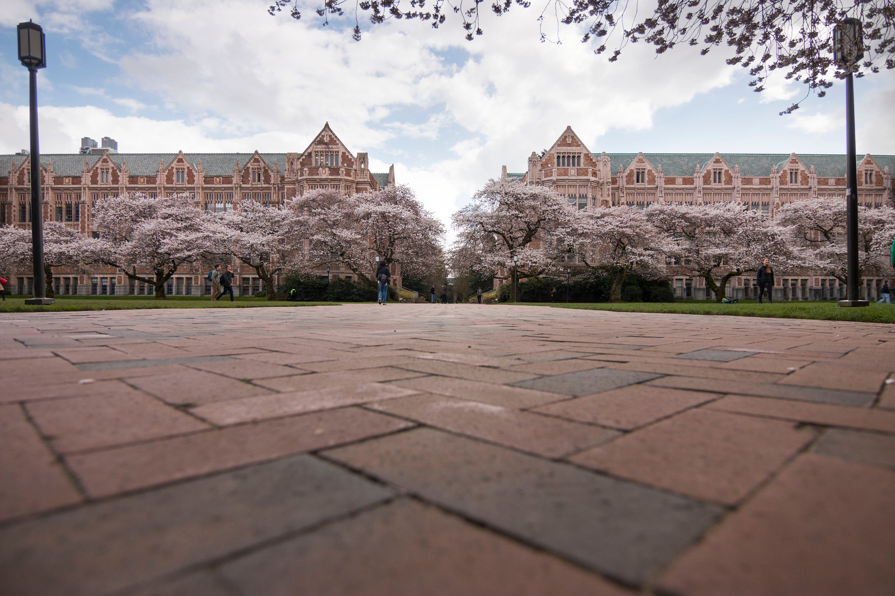
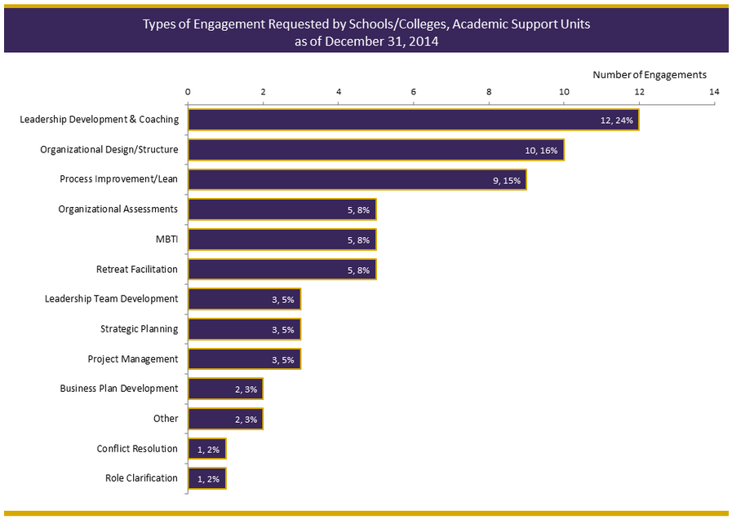
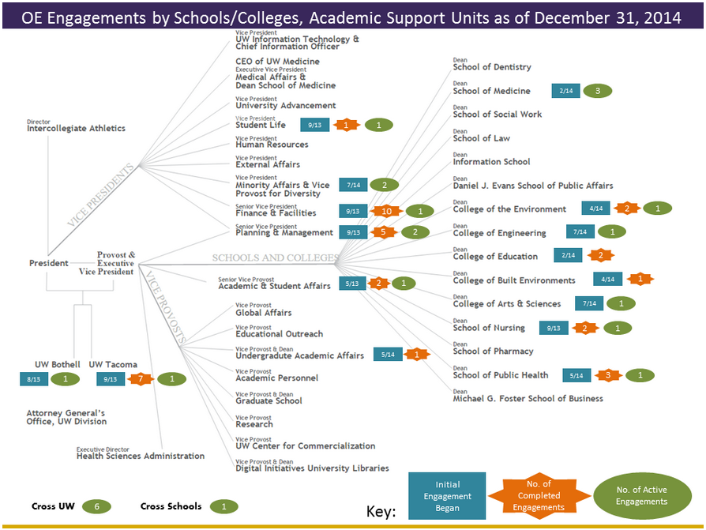
Insert Poster Title Here In 1 or 2 Lines-80-96 Pt Font
Need/Problem/ Opportunity Statement
Next Steps/Results
(Example) Format background and line colors, bullet points, and fonts, and add meaningful graphics or charts to create a unique and interesting poster. Do not reformat the width of the three existing textboxes within the template. They are sized to fit onto the sections of the tri-fold displays when printed and cut.
(Example) Shorten the time from ______________ to _________ so that we can make it easier to_______.
2 – 4 bullet points in 36 – 44 point font.
Process Improved/ Changes Made
Example) The College of _______ created a web-based application to provide easy access to ________ so faculty and staff spend less time on ________.
Statement of Project Here No More Than 2-3 Lines 60-68 Point Easy-to-Read Font
Insert a bulleted summary of the results.
(Example) Each side panel should be 11 inches wide.
2 – 4 bullet points in 36 -44 point font, the same size and font as the other sections.
Future Development
List of other departments, programs, or offices who have already adopted changes or new processes.
A sub title on the line beneath the heading for each section with a date or time reference.
i.e. Summer 2015, or October – December 2015 can be added in a 44 – 54 point font.
Project Goals
List 3 or 4 Main Goals
Size 54 – 66 Point Font
Titles Bolded and in Larger Font Contacts University of Washington – Organizational Excellence http://www.washington.edu/2y2d/oe/ orgexcel@uw.edu

