Slide 1
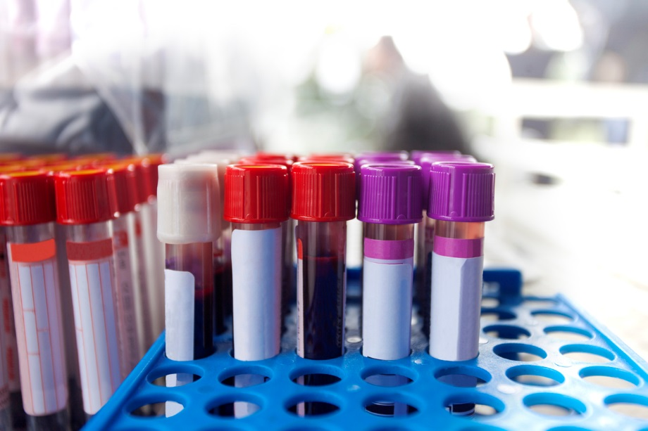
Michael Donahue, Research Coordinator. University of Washington,
Institute of Translational Health Sciences, Seattle, WA
True Blood: A Tracking System for the Identification of Sample Collection Barriers
Description of the Problem
BEST PRACTICE:
Implement a system to track eligible patients and enrollment and sample collection outcomes
Results
This study involved obtaining research blood samples during a scheduled clinical draw. Clinic schedules were screened to identify patients with the diagnoses of interest. The coordinator would then obtain consent from patients during the clinic appointment. After consent, the patient would have a clinical blood draw, and the researcher would collect additional blood to use in the study.
Although there were 94 eligible patients with scheduled appointments; many of whom previously consented for this study, only 26 research samples were collected (far fewer than expected). It was not clear why this number was low, or what the barriers were to collecting samples.
28% of patients determined to be eligible from pre-screening had samples drawn
30% of patients did not have blood drawn, which was far lower than the PI expected
24% of patients cancelled or were a no-show on the day of the appointment, which was greater than expected
Having quantitative data allowed the PI to establish more reasonable expectations for data collection by the research lab
Outcomes of 94 anticipated blood samples
Methods
Created a worksheet to track the number of samples collected, eligible patients, and reasons why samples were not collected. At the end of each clinic day the outcome for each patient identified on prescreening as eligible was recorded. The following data was collected:
Objectives
Better understand why fewer samples were collected than anticipated
Identify barriers between clinicians, research coordinators, and clinic patients
Increase the number of samples collected
Number of patients eligible
Number of samples collected
Patient not having a clinical blood draw
Patient cancelled or was a no show
Coordinator not available to talk to patient
MD did not refer patient to the coordinator
Patient declined
Not a good candidate per MD
Other
Discussion
Tracking helps identify true barriers and bottlenecks to recruitment and data collection
This type of tracking process can be translated to other studies and show value
Acknowledgements
Institute of Translational Health Sciences - UL1 TR002319

