Slide 1
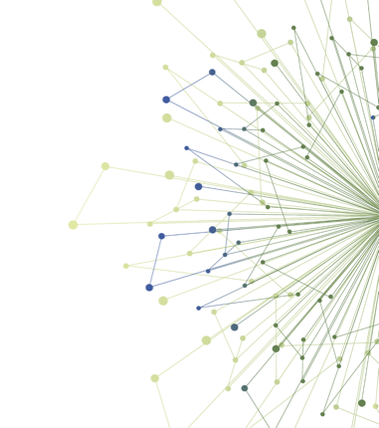
D&I Capstone Presentations

Slide 2
Timeline
2 Day D&I Workshop (Oct 2020)
Introduction to D&I Experiential Opportunities (Dec 2020)
Mid-point check-in (Jan 26, 2021)
Evaluation
Capstone Presentation (Today - Feb 23, 2021)

Slide 3
Three Experiential Opportunities
Stakeholder Assessment
Planning Implementation
Dissemination Plan Development

Slide 4
Capstone Presentations
5-minute
(1 minute warning)
Program Lead Provide Feedback (Mar 2nd)
Peers Submit Questions for presenter to consider in chat box
(no expectation to answer)

Slide 5
Stakeholder Assessment
1. Read a case study and watch a YouTube video example of a stakeholder assessment.
2. Identify at least 3 stakeholders you might need to engage by completing the “Stakeholder Management Log.” Brainstorm questions you might ask each of the potential stakeholders.
4. Based on your assessment, describe in 2-3 sentences who you might need to engage as stakeholders and what you might do to engage them.
3. Use the stakeholder assessment questions to “map” these stakeholders on a “Stakeholder Grid,” given what you know about these stakeholders.

Slide 6
Stakeholder Assessment
Name
Name
Name

Slide 7
INSERT SCHOLAR SLIDES HERE

Slide 8
Dissemination Plan Development
2. Identify appropriate users of your research product/s
1. Identify the research product/s you want to disseminate
3. Identify whether there are disseminating organizations that might best reach your users
4. Develop a marketing “message” for your product/s and tailor it to your users
5. Put together a proposed dissemination plan

Slide 9
Dissemination
Name
Name

Slide 10
INSERT SCHOLAR SLIDES HERE

Slide 11
Planning Implementation
1. Work with the D&I team to select an activity and prepare to complete it
Option 1: Understanding your intervention: Describe the key components of your intervention or innovation
Option 2: Operationalizing implementation: Create an action plan for using one implementation strategy

Slide 12
Planning Implementation
Name
Name

Slide 13
INSERT SCHOLAR SLIDES HERE

Slide 14
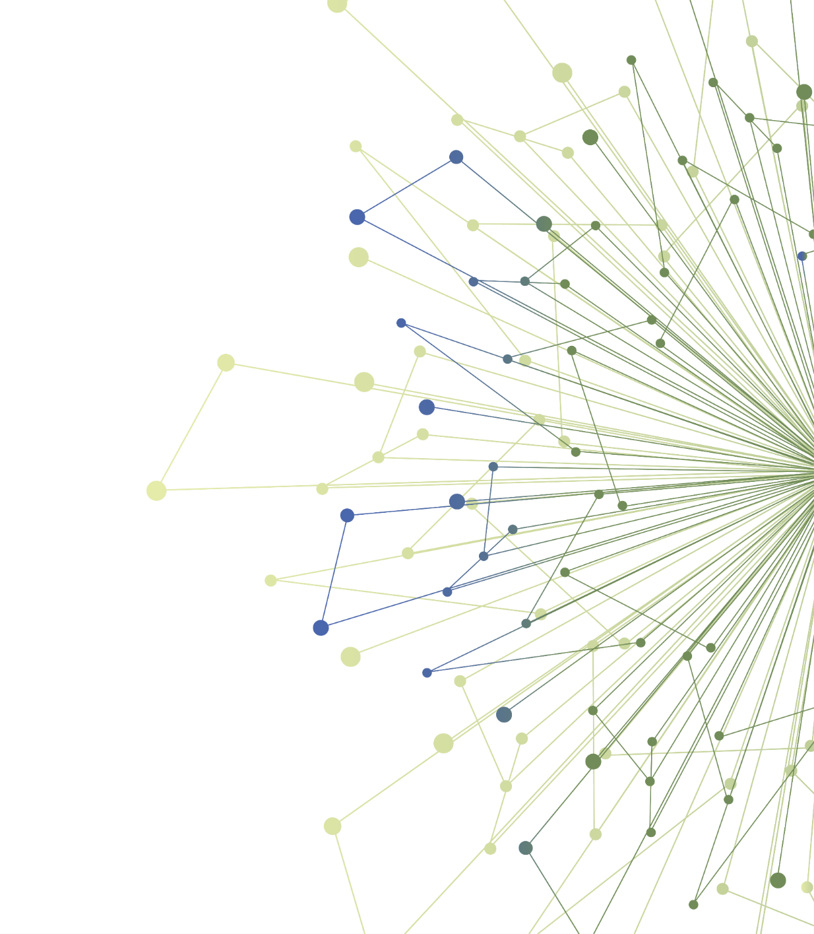
Thank You
ITHS is supported by the National Center For Advancing Translational Sciences of the National Institutes of Health under Award Number UL1 TR002319.
This project was supported by the National Center For Advancing Translational Sciences of the National Institutes of Health under Award Number TL1 TR002318.
The content is solely the responsibility of the authors and does not necessarily represent the official views of the National Institutes of Health.

