Slide 1
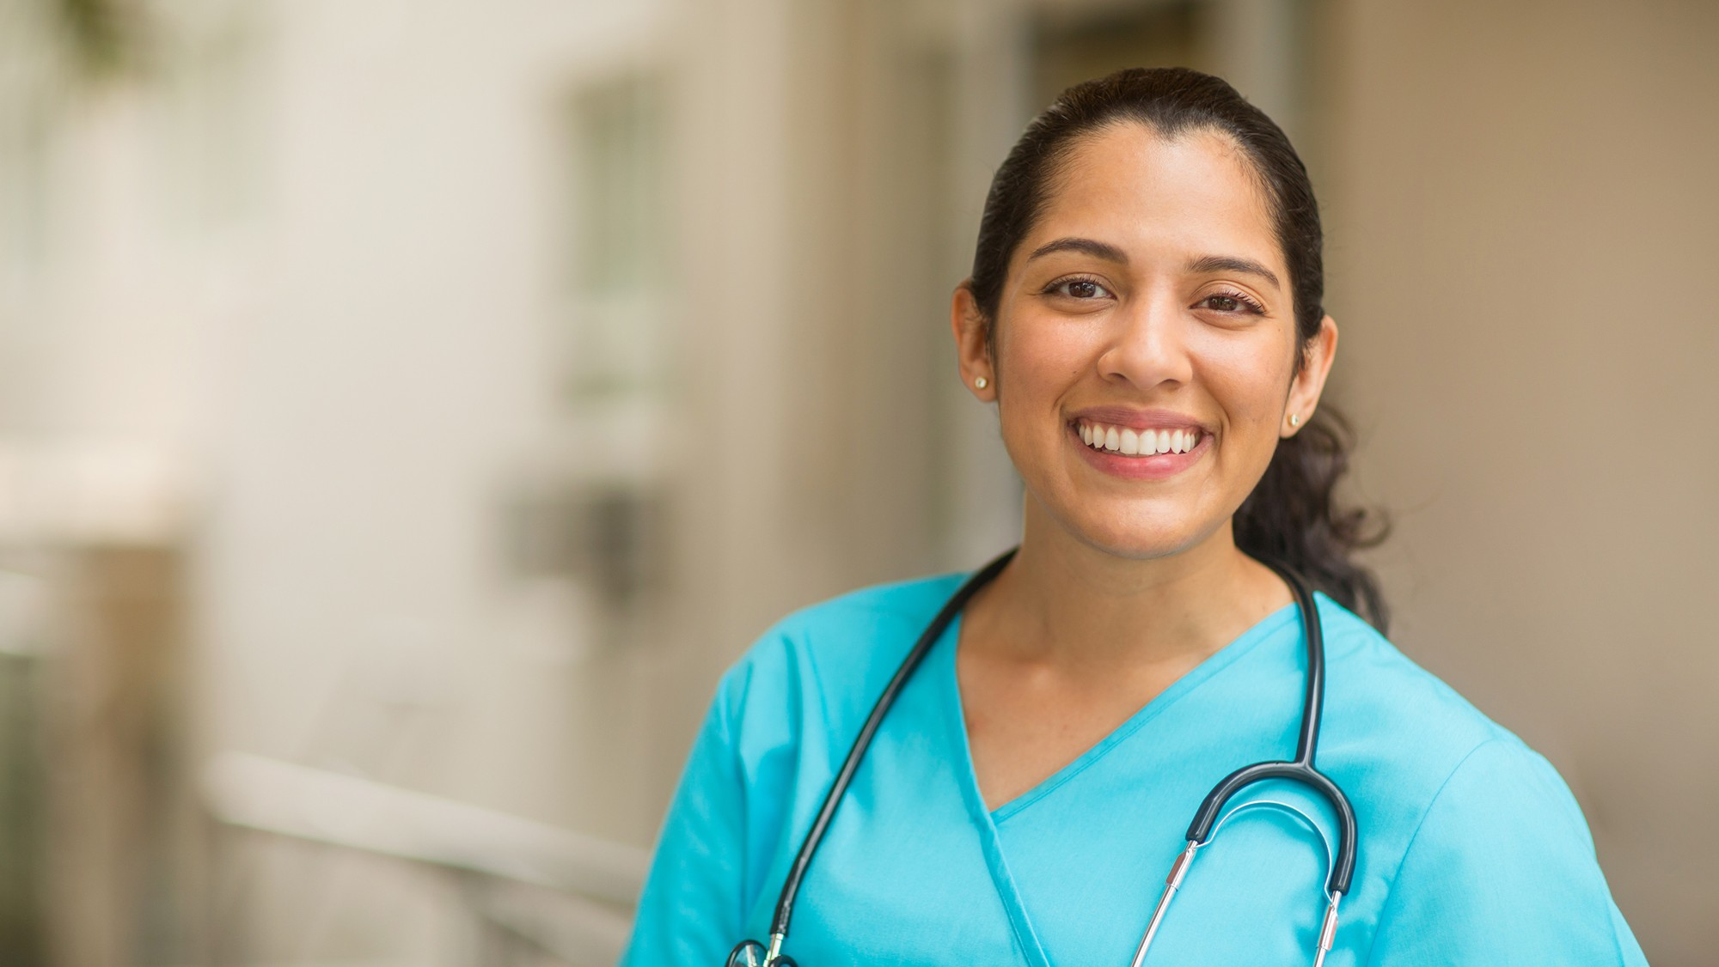

Careers in
Clinical Research
UL1 TR002319

Slide 2
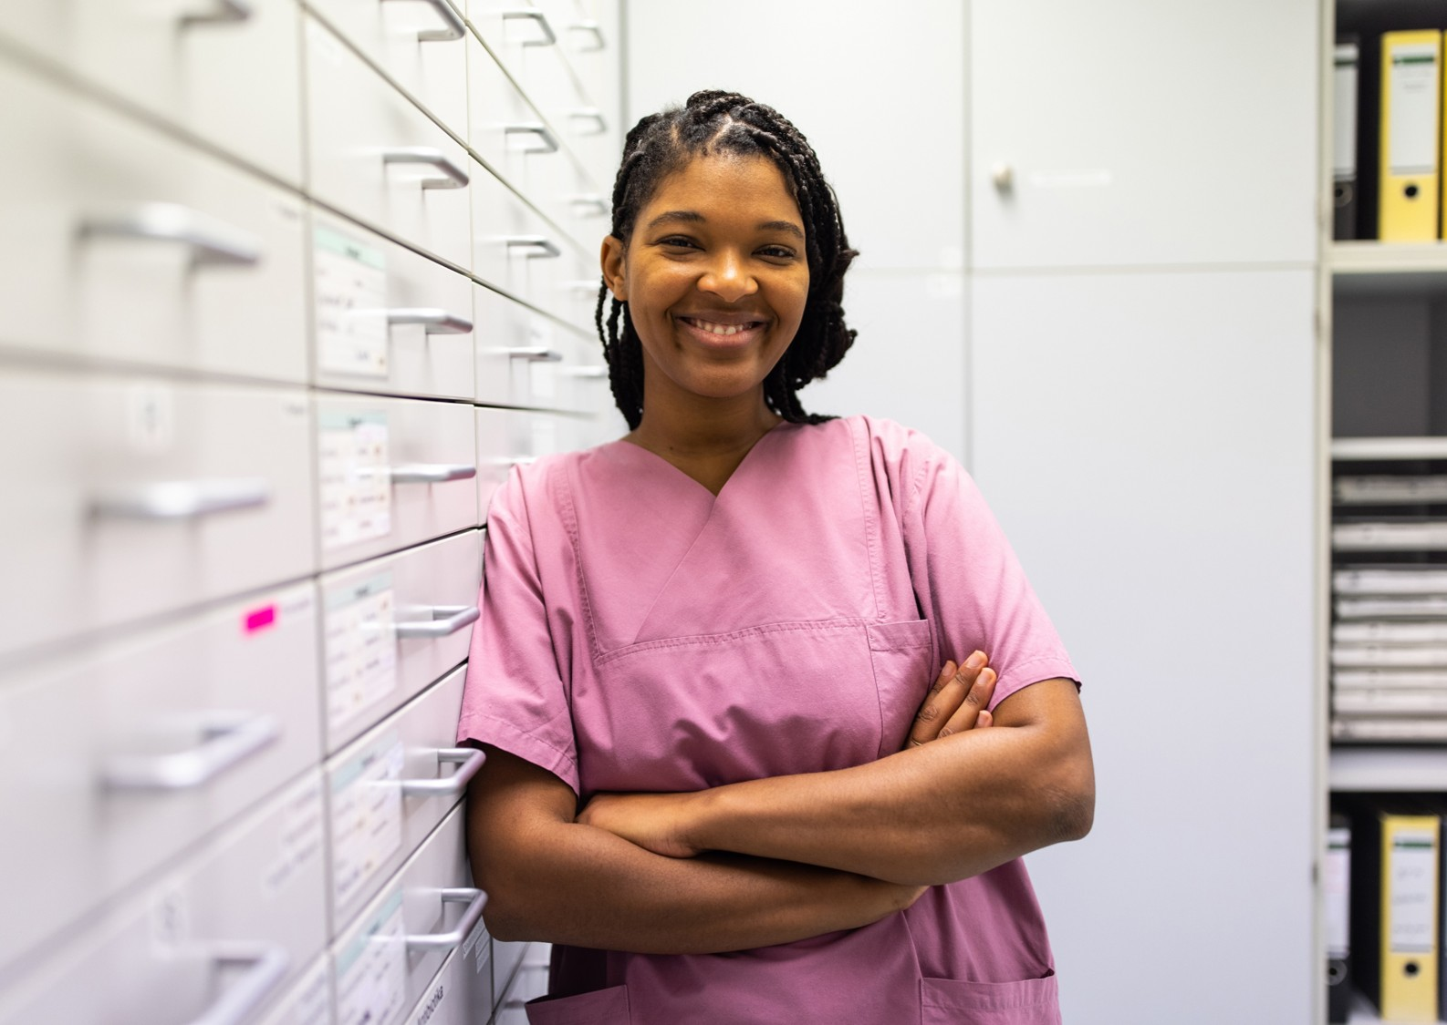
Objectives
Describe Clinical Research
Define a Clinical Trial
Understand Different Clinical Research Roles
Describe Opportunities in Clinical Research
Outline the Career Outlook in the field of Clinical Research

Slide 3
What is
Clinical Research?

Slide 4
Placeholder for Interactivity
Suggested interactivity: Poll the Audience
  Question to ask, “What comes to mind when you think of Clinical Research?”
  The following few slides are examples of interactivity options you may want to incorporate.

Slide 5
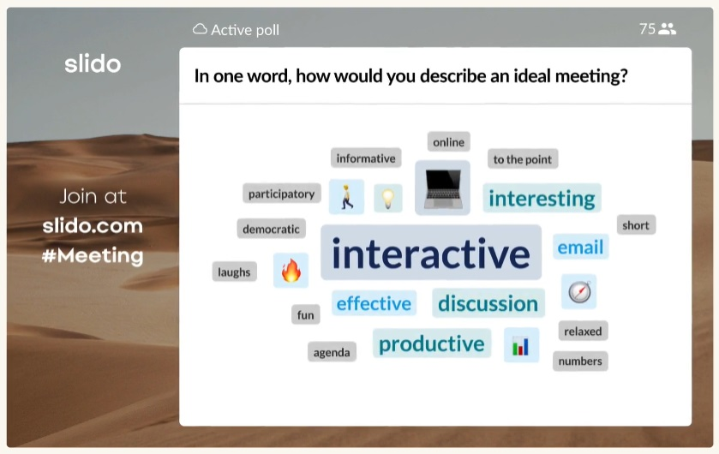
Placeholder for Interactivity Example
Sli.do
Sli.do
  Limited to 100 participants
  Limited to 3 polls per event
  Anonymous responses
  Interactivity Types
    Q&A
    Multiple Choice
    Word Cloud
    Open Text
    Ranking
    Rating
    Quiz
  Integrations
    Google Slides
    PowerPoint
    Microsoft Teams
    Webex
    Zoom
  Join using QR Code or link

Slide 6
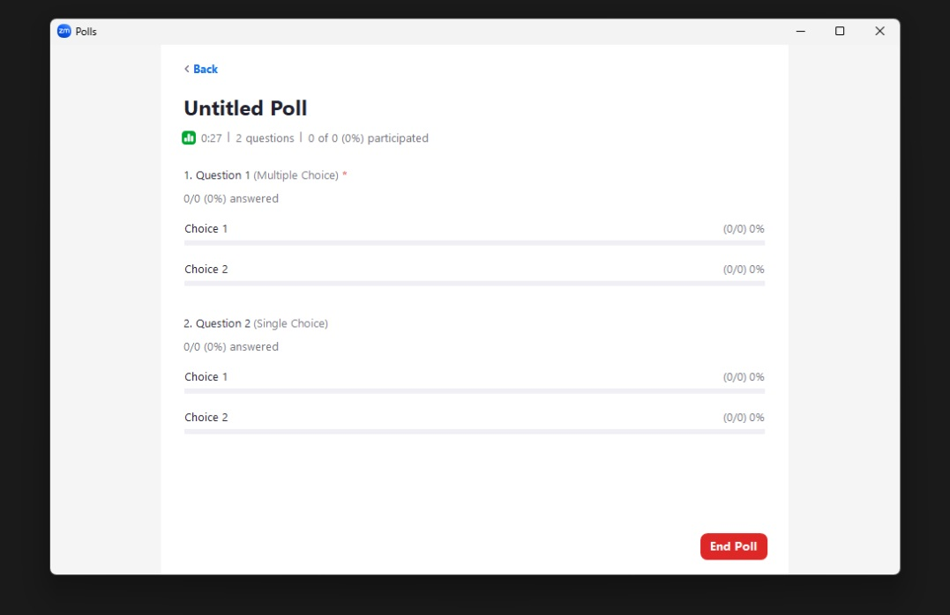
Placeholder for Interactivity Example
Zoom Polls
Zoom
  Single choice or multiple choice
  Limited to 50 polls per event
  Limited to 10 questions per poll
  Can be anonymous
Live-Polling Benefits
  Gauge reactions
  Check understanding
  Quickly gather answers

Slide 7
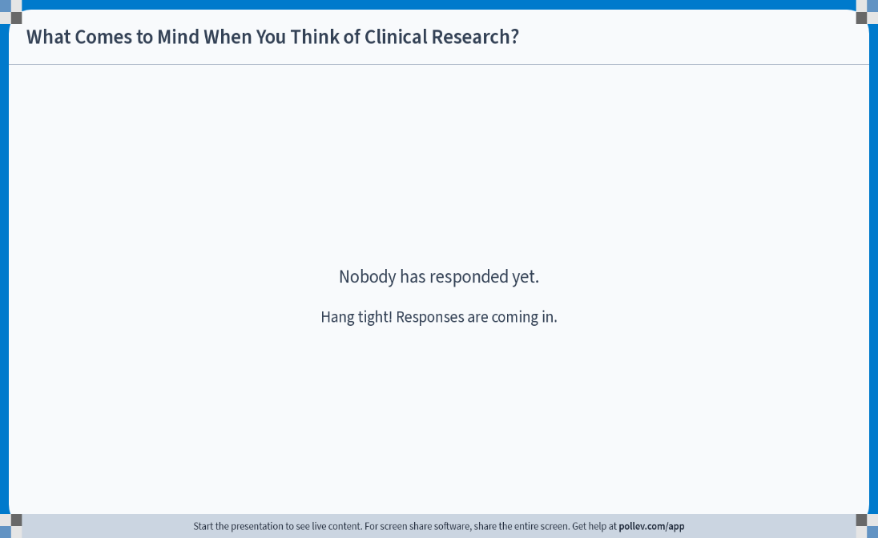
Placeholder for Interactivity Example
Poll Everywhere
Poll Everywhere
  Some features are dependent on type of account
  Types of Poll options:
    Multiple Choice
    Word Cloud
    Q&A
    Clickable Image
    Survey
    Open-Ended
    Competition
    Icebreaker
    Leaderboard
    Emotion Scale
    Presentation Feedback
Live-Polling Benefits
  Gauge reactions
  Check understanding
  Quickly gather answers

Slide 8




Clinical Research
Finds new and better ways to:
Prevent
Diagnose
Treat
Diseases and Conditions
Notes:
Clinical research is how doctors and scientists find new and better ways to prevent, diagnose and treat diseases and conditions. Before new medications or new devices can be marketed or used, they must first go through comprehensive research studies in people to make sure they are safe and effective.
Clinical research trials can include new medications, medical devices, ways to diagnose diseases and ways to care for patients so they have better outcomes.
Clinical research is different than laboratory research. It involves people who volunteer to help to better understand medicine and health.

Slide 9
Field of
Clinical Research
Outlook & Roles

Slide 10





OUTLOOK
Demand
Growth
Opportunities
Accessible
Notes:
As a clinical research professional, you will have the opportunity to make a difference, gain valuable experience in the field of science and medicine and advance your own career.
Clinical Research is a field with high demand and opportunity and is accessible to people with a wide range of skills, backgrounds and education.

Slide 11

Roles in Clinical Research
Investigators
Clinical Research Coordinators
Study Monitors
Research Scientists
Clinical Research Trials need a team of people to run successfully!
Notes:
Investigators: These are doctors who provide oversight for the research study. They have special expertise in the conditions that the is being researched.
Clinical Research Coordinators: Manage the details of running a clinical trial, including scheduling participants and collecting data.
Regulatory Coordinators: Organize the documents for review of the clinical trial by independent ethical review boards.
Study Monitors: Review study records to verify data accuracy and compliance to clinical research rules and regulations.
Research Scientists: Test and develop ideas and products in a laboratory setting.

Slide 12

Investigator Responsibilities
Confirm Eligibility
Obtain Consent
Assess Side Effects
Adhere to Study Plan
ULTIMATELY RESPONSIBLE
FOR STUDY CONDUCT

Slide 13

Clinical Research Coordinator
…supports, facilitates and coordinates the daily clinical trial activities and plays a critical role in the conduct of the study…”​

Slide 14

Clinical Research Coordinator
…supports, facilitates and coordinates the daily clinical trial activities and plays a critical role in the conduct of the study…”​

Slide 15
Communicate
Requirements
Track, document & report status updates
Collaborate on Study Activities
Participant
Management
Data Collection
STUDY MANAGEMENT

Slide 16
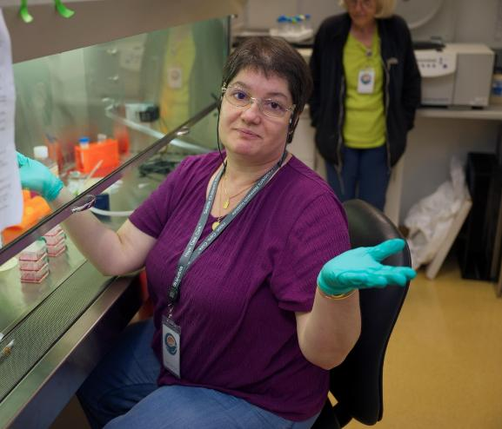
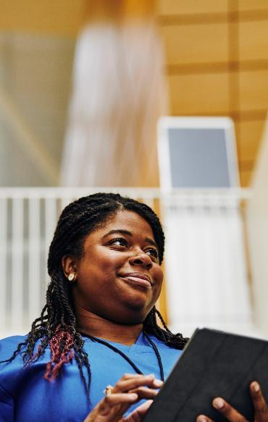
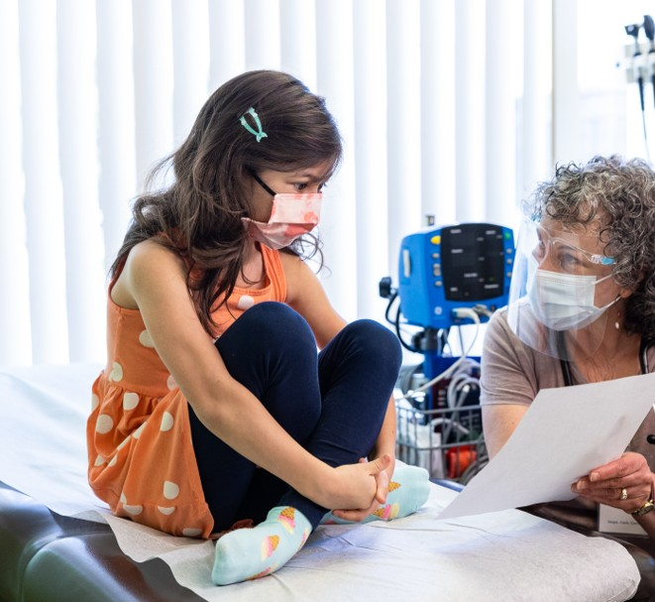
Daily activities vary depending on several things, including the type and complexity of the research trials, the structure of a division, and experience level

Slide 17
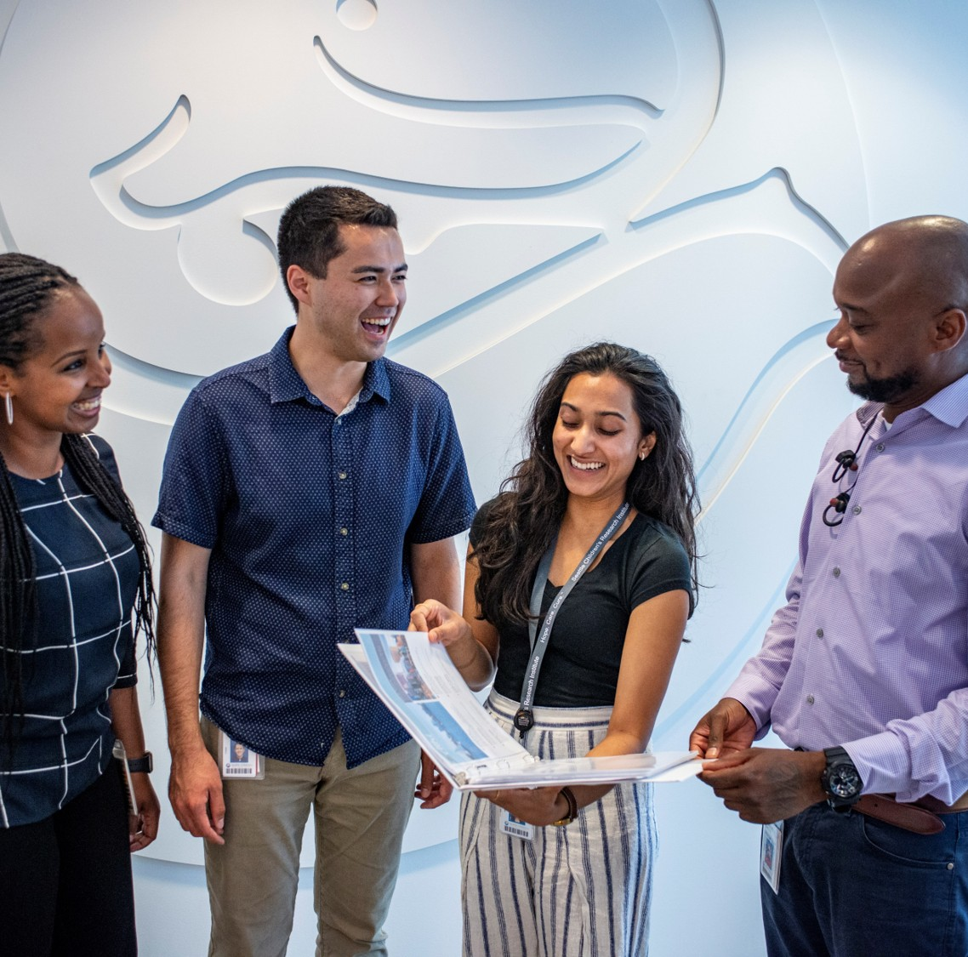
Research Coordinators might also provide oversight or assistance for:
Regulatory submission & maintenance
Budget development & billing compliance
Study contracts & agreements
Sample collection & processing
Study close out & archival of records

Slide 18
Who Makes a Good Clinical Research Professional?

Slide 19
Clinical Research Professionals
DETAILS
PEOPLE
ORGANIZATION
INTEGRITY
COMMUNICATION
Notes:
DETAILS: Managing clinical trials involves tracking and organizing a lot of data points, timelines and milestones.
PEOPLE: You are the face of a clinical research study, often the first and most frequent point of contact for study participants
INTEGRITY: It is important to document everything that happens in clinical research trials and report them honestly.
COMMUNICATION: It is important to be able to communicate well in writing and by speaking with a lot of different types of people
ORGANIZATION: You should be able to organize your time and work well and independently

Slide 20
Clinical Research Professionals
People with backgrounds as medical assistants, health care technicians, and in nonscientific fields can all make excellent research professionals!
Many clinical research roles don't require an advanced degree.
There is room to grow in multiple directions, depending on your interests, including data, clinical, administrative, or regulatory roles.

Slide 21
Clinical Research
Scientific discovery in medicine and medical care
All research professionals are crucial to the success of clinical research trials.
Clinical research professionals are involved in every stage of clinical trials
New ways to prevent, diagnose or treat medical conditions

Slide 22
Who is Hiring?

Slide 23
Pursuing a career in clinical research provides opportunities at medical centers, clinics, non-profit organizations, and pharmaceutical companies

Slide 24

Where To Look
Local hospitals, clinics, medical centers
Pharmaceutical companies
Contract research organizations
Staffing agencies
Nonprofit foundations
Job boards, including Indeed & LinkedIn

Slide 25
Local Opportunities

Slide 26
Earning Potential

Slide 27

Have you seen the price of eggs?!
How much could I make?

Slide 28
Local
Earnings Breakdown
Title | Range

Slide 29
Key Takeaways
Clinical research professionals make a difference
There are career opportunities at all phases and levels in clinical research
Careers in clinical research are accessible: many roles don't require advanced degrees or a scientific background.
Notes:
Clinical research professionals make a difference in the lives of study participants and the community as a whole. They drive the discovery of new ways to diagnose, treat or cure disease and medical conditions.
There are career opportunities at all phases and levels in clinical research from early scientific development, research coordination, data analysis, monitoring and administration, entry level to senior leadership roles.
Careers in clinical research are accessible: many roles don't require advanced degrees or a scientific background.

Slide 30

QUESTIONS

Slide 31
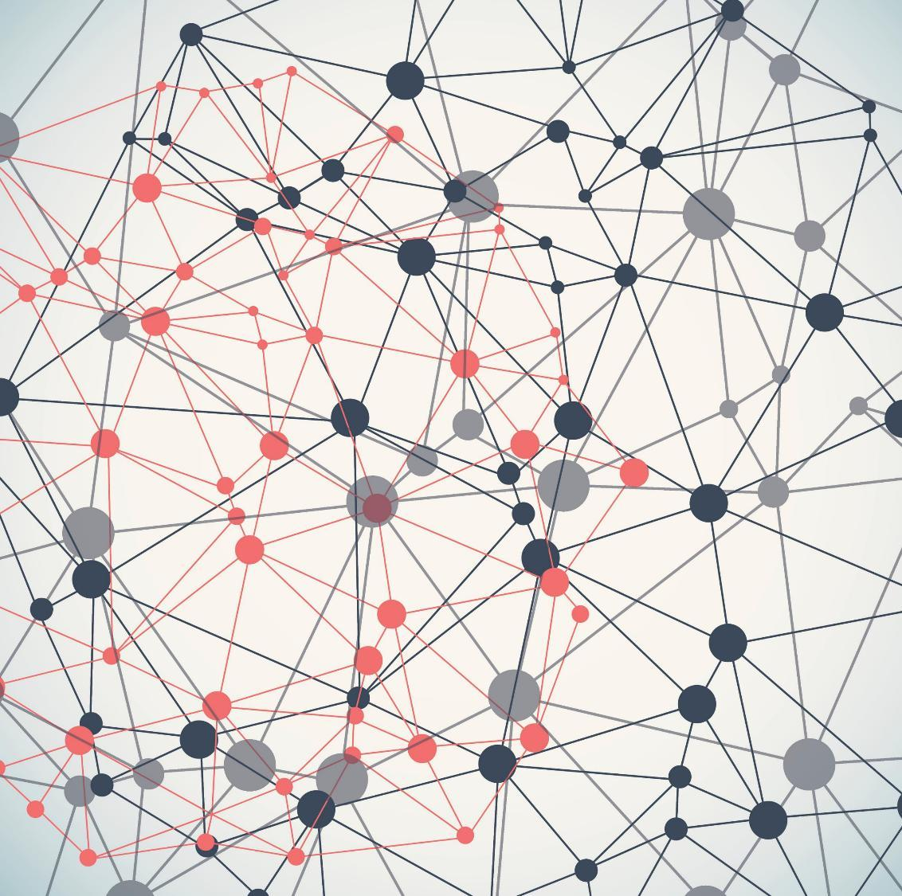
Foundations in Clinical Research Course

