Slide 1
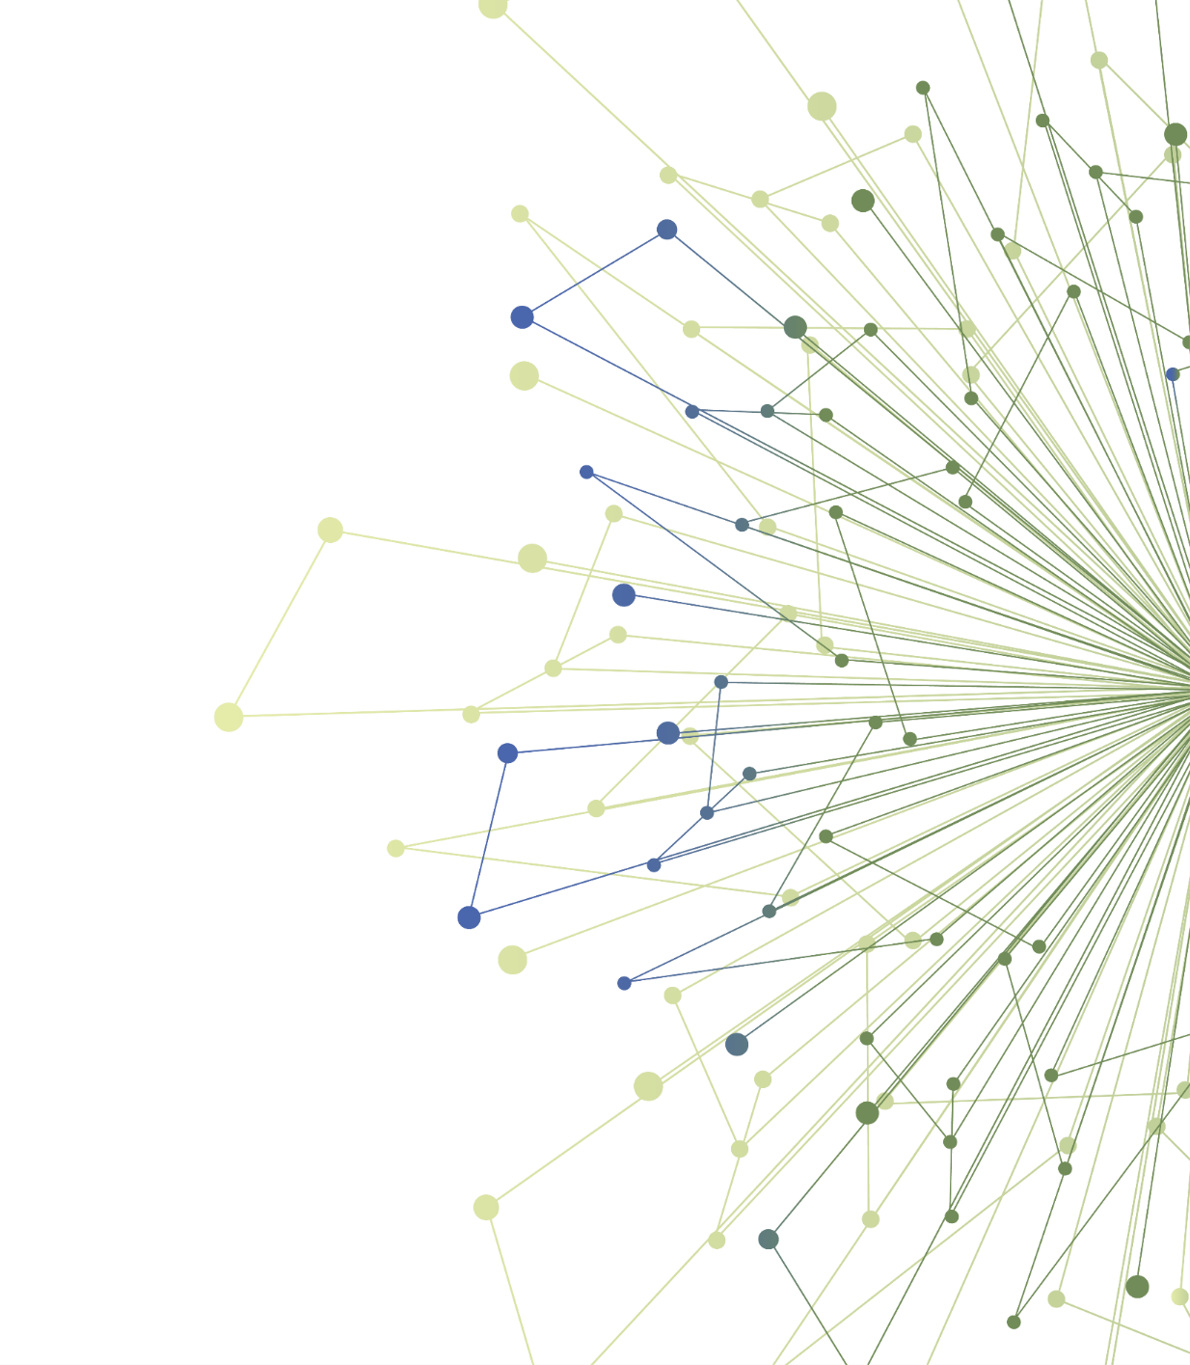
An Introduction to Dissemination & Implementation Research
Allison Cole, MD
Michael Parchman, MD, MPH
Laura-Mae Baldwin, MD, MPH
TL1 Scholars Winter 2022
University of Washington
Kaiser Permanente of Washington Health Research Institute, Seattle

Slide 2
Disclosures/Conflicts of Interest
I have nothing to disclose
I have no conflicts of interest

Slide 3
Schedule
DAY 1
Time | Topic
8:30AM | Icebreaker
8:35AM | Introduction of workshop
8:40AM | Why care about Dissemination &Implementation (D&I) Sciences?
8:50AM | Diffusion of Innovation Theory and CFIR Framework
9:00AM | CFIR Framework Group Activity
9:30AM | Report Out and Next Steps
Notes:
Here is what we will cover today, this is our “Roadmap”

Slide 4
Schedule
DAY 2
Time | Topic
8:30AM | Icebreaker
8:35AM | D&I Sciences Across Translational Science Spectrum
8:45AM | Apply D&I Science principles to TL1 Trainee projects
9:15AM | Facilitator and Trainee Reflection
9:25AM | Report Out
9:45AM | Introduction of Experiential Learning Opportunities
9:59AM | Evaluation
Notes:
And just a sneak peek at what we will cover in our next class…

Slide 5
Take 1 minute to TYPE your answer into the chat box for the following questions. DO NOT hit enter. What made you smile this week?
Ice Breaker –

Slide 6
Take 1 minute to TYPE your answer into the chat box for the following questions. DO NOT hit enter. What does self-care look like for you?
Ice Breaker –

Slide 7
Dissemination and Implementation Science Competencies
1. Describe the role of Dissemination and Implementation Sciences (D&I Science) in translational research
2. Demonstrate application of D&I sciences’ principles to individual translational research projects.

Slide 8
The Translational Research Spectrum
Notes:
It’s important to place dissemination and implementation science within the larger framework of translational science.
Translational science is traditionally divided into phases of work: from basic bench science to human application, into clinical practice and sometimes into population health
Dissemination and Implementation Science is relevant to both the T3 and T4 phases of this translational research spectrum because it addresses the need to get research findings into clinical practice AND make sure that populations who can benefit from the research are reached.
Where along this translational spectrum do you think D&I science might be applicable (foreshadowing Day 2!)

Slide 9
A Continuum: Diffusion-Dissemination-Implementation
Diffusion
Dissemination
Implementation
The passive, untargeted and unplanned spread of new practices
Active spread of new practices to the target audience using planned strategies
The process of adoption, integration and use of new practices within a setting
Notes:
For this later phase of translational research, the work is typically thought of as a continuum:
Passive Diffusion: can you give an example?
Active Dissemination: can you give an example?
Implementation: can you give an example?
LMB: In dissemination, will the use of the term "practices" be clear? Or should we use the term interventions? In the literature it says: "an active approach to spreading evidence-based interventions to a target audience via determined channels using planned strategies." Attributed to the first reference in this paper: https://onlinelibrary.wiley.com/doi/pdf/10.1111/jep.12741
LMB: Also, these definitions are for applied diffusion, dissemination, and implementation rather than research. You probably address this in what you are saying.

Slide 10
Do We Need It?
It takes 17 years to turn 14 percent of original research findings to the benefit of patient care.
Lenfant C. N Engl J Med. 2003
Patients in the U.S. receive 54.9% of recommended evidence-based care for prevention and chronic illness care.
McGlynn EA. NEJM 2003
Two-thirds of health care organizations' efforts to implement change fail.
Damschroder LJ. Implement Science 2009
Notes:
Extensive research over the past 10-20 years has documented significant delays and timelines from the creation of new knowledge and evidence to its widespread use. These evaluations consistently show a 17-year gap from publication of findings to widespread use in clinical practice.
Moreover, evaluations of widespread use of knowledge that has a strong evidence-base shows poor uptake and inconsistent application of knowledge to patient care.
Evaluations of multiple organizations efforts to implement a change in how care is delivered reveal that two-thirds of these efforts are unsuccessful

Slide 11
Examples of Harms from Inadequate Implementation
35% of women with breast cancer receive non-guideline concordant treatment
Non-concordant treatment higher in patients treated at hospitals without Comprehensive Cancer Designation
40-80% of patients with acute myocardial infarction receive recommended medical therapy in the ED
Inappropriate treatment more common in specific geographic region (Southern U.S.)
Tsai, C.‐L., Magid, D.J., Sullivan, A.F., Gordon, J.A., Kaushal, R., Michael Ho, P., Peterson, P.N., Blumenthal, D. and Camargo, C.A., Jr (2010), Quality of Care for Acute Myocardial Infarction in 58 U.S. Emergency Departments. Academic Emergency Medicine, 17: 940-950. doi:10.1111/j.1553-2712.2010.00832.x
Notes:
These failures to successfully translate research into practice has practical consequences for patients across the United States

Slide 12
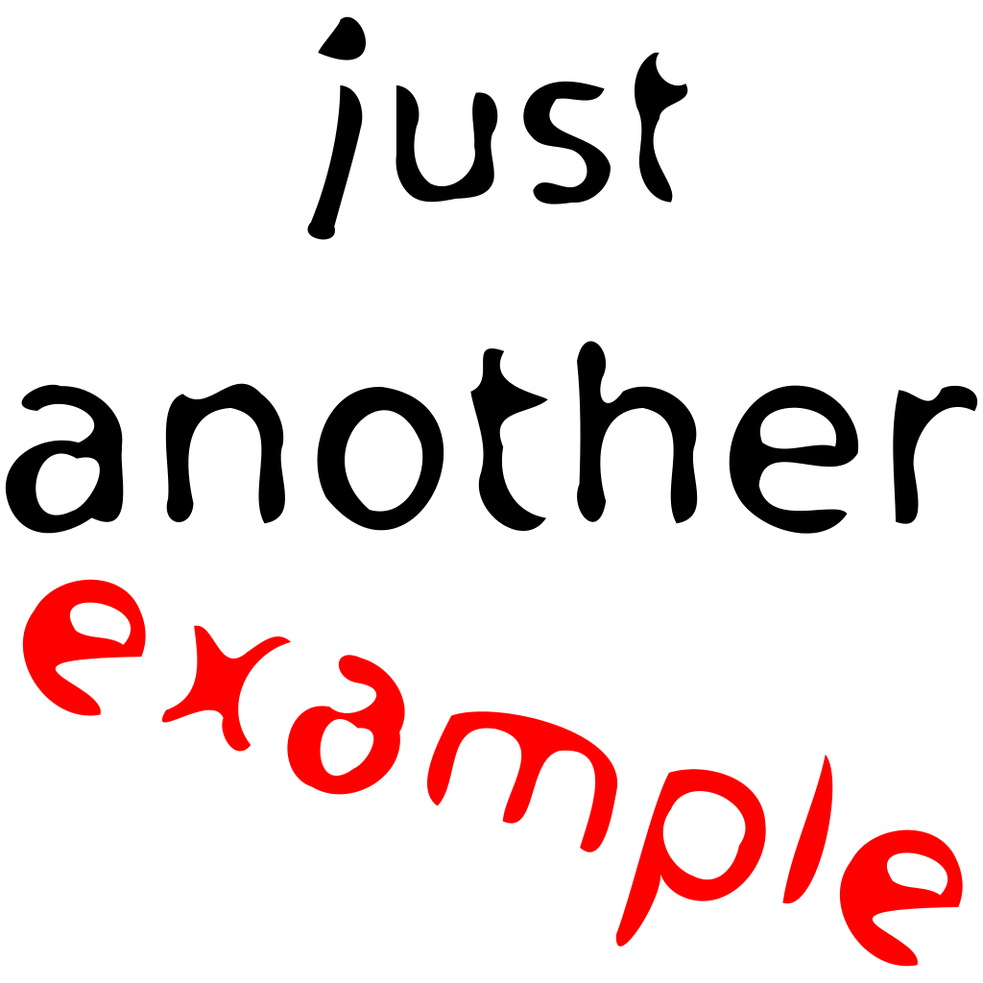
Give Me An Example!
Where have you seen a gap between evidence about what is effective and the health care delivered?
Why does that gap exist?
Notes:
Now its your turn, in your field of healthcare, can you give an example of this gap between what we know is effective and care that is actually delivered?

Slide 13
What is Dissemination Science?
The systematic study of processes and factors that lead to widespread awareness of information about an evidence-based intervention by the target population
Dissemination Question:
Is the combination of academic publication and scientific conference presentation more effective than either one alone when increasing awareness of a new mouse model among research colleagues?
How does use of the design for dissemination model change the design of new interventions?
Notes:
Believe it or not, there is actually a field of scientific study that is beginning to address how we can overcome translational research barriers
Dissemination science addresses questions related to how can we improve the active spread and awareness of new knowledge
Here are two examples of research questions related to dissemination:

Slide 14
Model for Dissemination of Research
https://implementationscience.biomedcentral.com/track/pdf/10.1186/s13012-020-01046-3.pdf
Notes:
CAN SOMEONE PLEASE MAKE THIS SLIDE HAVE THE SAME ITHS FORMAT AS THE OTHER SLIDES? I COULDN'T FIGURE OUT HOW TO DO THAT.
ALLISON, IS THIS SLIDE AND THE CONTENT BELOW ENOUGH FOR THE DISSEMINATION SCIENCE SECTION? I HAVE ALSO ADDED A COUPLE OF SLIDES ON DESIGN FOR DISSEMINATION IF YOU WOULD LIKE. THESE ARE NOT ACTUALLY ABOUT DISSEMINATION RESEARCH THOUGH, SO NOT SURE IF YOU WANT TO INCLUDE THEM. BUT D4D IS A GOOD METHODOLOGY ESP FOR EARLIER STAGE TRANSLATIONAL SCIENTISTS. UP TO YOU REGARDING THE NEXT TWO SLIDES. IF YOU DECIDE YOU WANT THE TWO FOLLOWING SLIDES, I’D BE HAPPY TO WRITE SOME NOTES ABOUT THEM.
The Model for Dissemination of Research, which integrates the Diffusion of Innovations Theory and Social Marketing Theory with the Mathematical Theory of Communication and the Matrix of Persuasive Communication, includes four key components of the research translation process: the source, message, audience, and chan- nel. The source includes researchers who generate evidence. The message includes relevant information sent by the source on a topic. The audience includes those receiving the message via the channel. The channel is how the message gets from the source to the audience. A channel could be, for example, scientific publications, academic presentations, community meetings, or policy briefs.
The question "Is the combination of academic publication and scientific conference presentation more effective than either one alone when increasing awareness of a new mouse model among research colleauges?" Is researching two different channels of dissemination.
The question "How does use of the design for dissemination model change the design of new interventions?" Is researching the researcher's (or source's) use of a model for designing a new intervention (e.g., new device, a behavioral intervention).

Slide 15
Design for Dissemination Model
Designing for Dissemination: A set of processes that are considered and activities that are undertaken throughout the planning, development, and evaluation of an intervention to increase its dissemination potential.
These processes help ensure that the products of research (interventions, materials, and findings) are developed in ways that match well with the needs, resources, workflows, [timeframes] and contextual characteristics of the target audience and setting.

Slide 16
Design for Dissemination Processes and Products

Slide 17
What is Implementation Science?
The scientific study of methods to promote the systematic uptake and use of research findings and other evidence-based practice in routine practice to improve the quality and effectiveness of health care and health care services.
Implementation Questions:
Is audit & feedback more effective than provider education when implementing a new clinical guideline for evaluation of hematuria?
How does the social network of the developer of a new PCR assay influence the likelihood that other researchers will use the assay in their next study?
Notes:
Implementation science takes it a step further to conduct rigorous trials on how can we improve the adoption and actual use of research results at the point of care.
Here are a couple of examples of implementation science research questions. For each of these questions, it is possible to develop a testable hypothesis and design a rigorous study to test each hypothesis

Slide 18
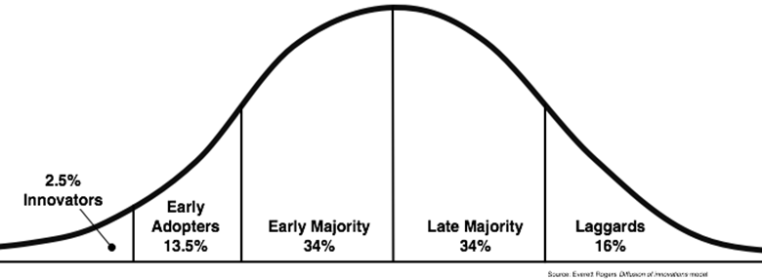
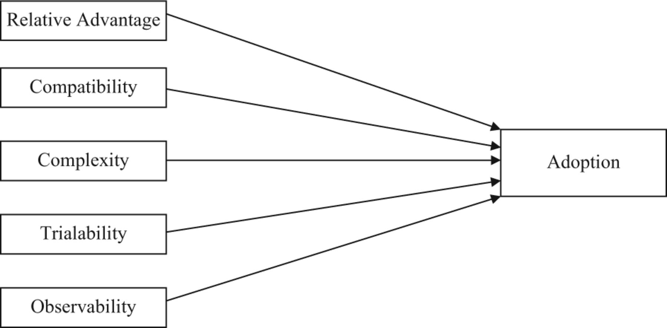
Diffusion of Innovation Theory Everett Rodgers (1962)
Intervention Characteristics
Notes:
Perhaps the godfather of D&I Science, Everett Rodgers developed his Diffusion of Innovation theory when he studied how the Agricultural Extension Service and farmers interacted to adopt new more effective farming practices when the U.S. was recovering from the Dust Bowl & the Great Depression.
He demonstrated that farmers fall into groups based on their willingness to adopt a new practice: innovators, early adopters, etc.
He also described characteristics of the intervention/innovation that tended to predict whether or not a farmer was willing to adopt:
Is it perceived as a significant improvement over prior practices? [relative advantage]
Is it compatible with the setting and resources available?
How complex is it to implement?
Can the farmer test it in a small way without fully committing to it?
Can the farmer clearly observe it being implemented on another farm like theirs?

Slide 19
Consolidated Framework for Implementation Research
A comprehensive framework that consolidates constructs found in the broad array of published theories.
Facilitates the identification and understanding of the myriad potentially relevant constructs and how they may apply in a particular context.
Damschroder L, Aron D, Keith R, Kirsh S, Alexander J, Lowery J: Fostering implementation of health services research findings into practice: a consolidated framework for advancing implementation science. Implement Sci. 2009, 4: 50-10.1186/1748-5908-4-50
Notes:
More recently, an attempt has been made to consolidate the many theories and frameworks that help us understand the process of implementation into one over-arching framework: the CFIR. This was a big advancement in the field as there were a rapidly growing number of proposed theories and frameworks that overlapped. As with any field of science, agreeing on a theoretical basis to guide your research is critical.

Slide 20
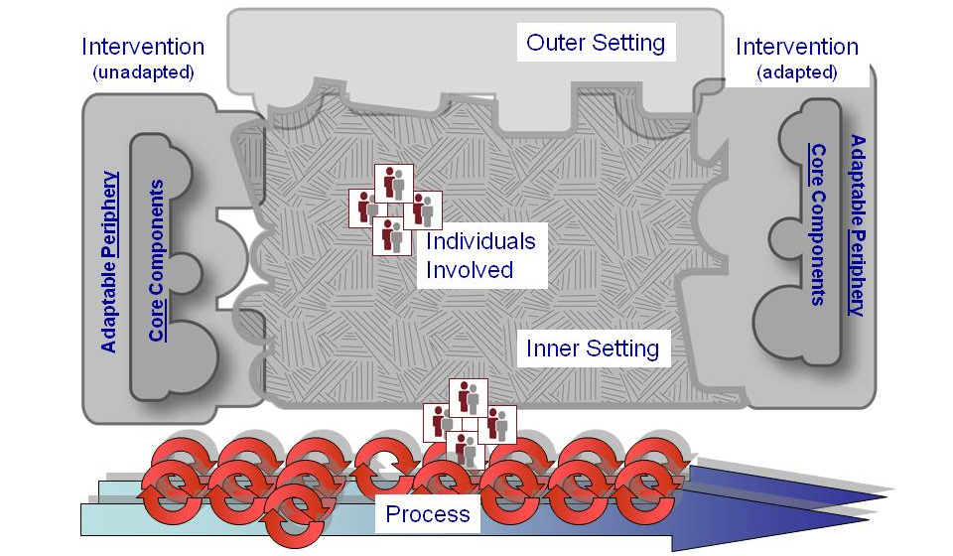
Consolidated Framework for Implementation Research (CFIR)
Notes:
The framework posits five domains that influence successful implementation:
The intervention itself
The outer setting in which the system is embedded
The inner setting of where the intervention is meant to be used
Individuals involved in implementing the intervention (stakeholders)
The processes used to support implementation
Note the “fit” of the intervention on the left-hand side and compare it to the right-hand side of this figure. The framework proposes that all evidence-based interventions have a core set of components without which the intervention will not improve health care outcomes, and an peripheral set of components that can be adapted to better fit with the specific setting where the intervention is implemented.

Slide 21
Five CFIR Constructs
Intervention Characteristics
Inner Setting
Outer Setting
Individual Characteristics
Processes
Notes:
So let’s talk in more detail about each area of this framework…

Slide 22
Intervention Characteristics
Key attributes of interventions influence the success of implementation. There is broad support for this in the literature across many scientific disciplines.
Can you name one?
Notes:
Ask the group to give an example of an attribute of a health care intervention
Example: The new COVID vaccine (attribute is that it requires 2 doses)

Slide 23
Inner Setting
Properties or characteristics intrinsic to the environment where the intervention is intended to be used influence its successful use.
Can you name one?
Notes:
Ask the group to give an example of characteristics of the inner setting where care is delivered that might impact successful implementation
Example: The new COVID vaccine (dose the setting have appropriate cold storage for the vaccine)

Slide 24
Outer Setting
Factors external to the setting where the intervention is implemented can influence the ability of those internal to the setting to be successful in using the intervention.
Can you name one?
Notes:
Ask the group to give an example of how the outer setting surrounding where care is delivered might impact successful implementation
Example: The new COVID vaccine (the State Department of Health dictates stages of who is eligible at any given time)

Slide 25
Individual Characteristics
Organizations are made up of individuals who must change their behaviors. Each of them individually and as a group have characteristics that can influence successful implementation.
Can you name one?
Notes:
Ask the group to give an example of an attribute of individuals within the health care setting that influence successful implementation
Example: The new COVID vaccine (clinic staff beliefs influence if they encourage patients to get the vaccine)

Slide 26
Implementation Processes
The steps, strategies and approaches taken by the organization or group of people to facilitate or assist in making the changes necessary to implement an innovation.
Can you name one?
Notes:
Ask the group to give an example of how the implementation process impacts success
Example: The new COVID vaccine (audit and feedback provide information about inequity of who is receiving the vaccine)

Slide 27
Group Exercise: Stem Cell Transplant for Type 1 Diabetes
Emerging therapy to treat Type 1 DM by transfering islet Beta cells developed from stem cells in patients with Type 1 DM
We’ll consider how the characteristics of the:
Stem cell transplant intervention itself
Settings in which it is administered
Individuals delivering and receiving the intervention
External environment
are important in planning for implementation of the new treatment
Notes:
Now it is your turn, we will further explore this new diabetes treratment, its characteristics, the settings where it might be administered, and the external environment surrounding treatment to understand how implementation science is relevant.

Slide 28
Small Group Instructions
Four small groups: one for each of 4 CFIR constructs
Chat will have pdf of the case study for you to view
Each group has a facilitator with discussion questions
Identify trainee for report out
Meet for 20 minutes then reconvene to report out
Notes:
Divide the class into four small groups, one for each CFIR construct
Each group has a construct specific worksheet to complete
Ask each group to identify one individual who will report back to the class

Slide 29
Small Group Report Out
What surprised you about how the construct you discussed might impact implementation?
What was one important barrier/challenge you discussed?
Did any other CFIR construct come up in your discussion, which one, and why?
Notes:
Reconvene the small groups and ask them these questions.
Pay particular attention and point out to the class how difficult it is to talk about just one CFIR construct without mentioning others. This illustrates how these constructs are “inter-dependent” and how interventions to successfully implement are usually multi-component.

Slide 30
Preview of Day 2
DAY 2
Time | Topic
8:00AM | Icebreaker
8:05AM | D&I Science Across Translational Science Spectrum
8:15AM | Apply D&I Science principles to 3 TL1 Trainee projects – Shift and Share Activity
9:20AM | Facilitator and Trainee Reflection
9:25AM | Report Out
9:45AM | Introduction of Experiential Learning Opportunities
9:59AM | Evaluation
Notes:
Here is what we will cover in our next class

Slide 31
Thank You
ITHS is supported by the National Center For Advancing Translational Sciences of the National Institutes of Health under Award Number UL1 TR002319.
This project was supported by the National Center For Advancing Translational Sciences of the National Institutes of Health under Award Number TL1 TR002318.
The content is solely the responsibility of the authors and does not necessarily represent the official views of the National Institutes of Health.

