Slide 1
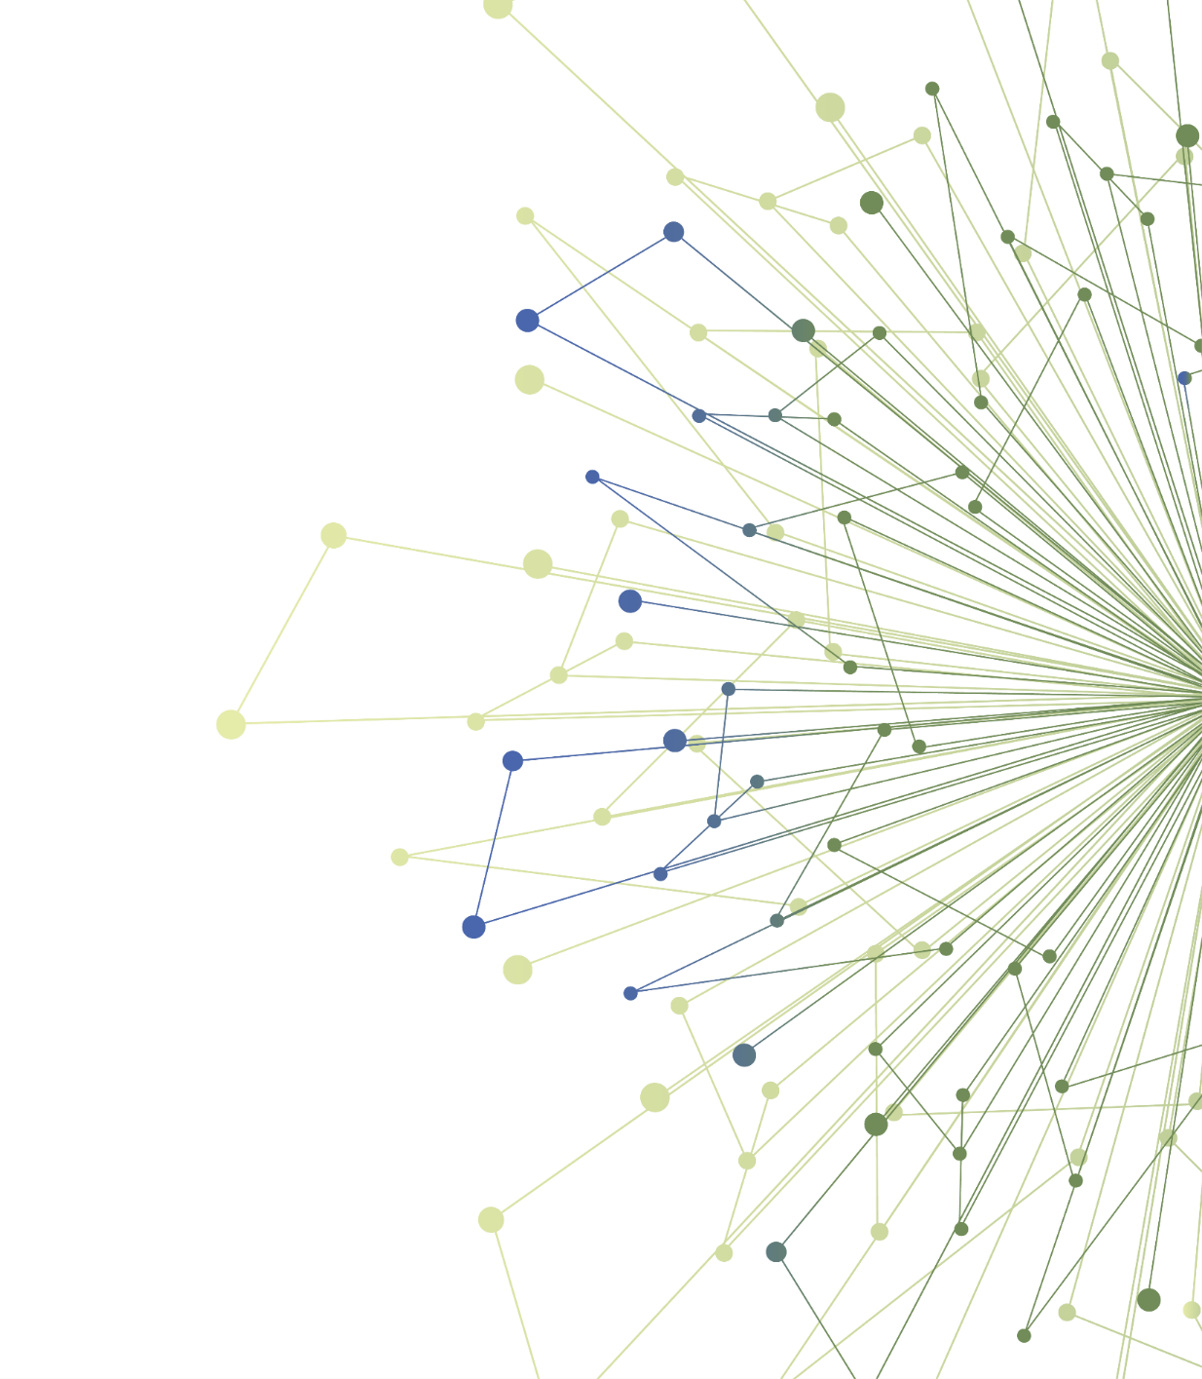
An Introduction to Dissemination & Implementation Research
Allison Cole, MD
Michael Parchman, MD, MPH
TL1 Scholars October 2020
University of Washington
Kaiser Permanente of Washington Health Research Institute, Seattle
Notes:
Use as needed.

Slide 2
Agenda
DAY 2
Time | Topic
8:00AM | Icebreaker
8:05AM | D&I Science Across Translational Science Spectrum
8:15AM | Apply D&I Science principles to 3 TL1 Trainee projects: Shift and Share Activity
9:20AM | Facilitator and Trainee Reflection
9:25AM | Report Out
9:45AM | Introduction of Experiential Learning Opportunities
9:59AM | Evaluation
Notes:
Provide an overview of the activities for the workshop. Timing may vary depending on implementation

Slide 3
Disclosures/Conflicts of Interest
I have nothing to disclose
I have no conflicts of interest

Slide 4
Take 1 minute to TYPE your answer into the chat box for the following question. DO NOT hit enter.
What resonated with you from Day 1 of the D and I Science Workshop?
Ice Breaker
Notes:
Goal is to engage participants in reflecting on activities and lessons learned from previous day’s workshop.
After one minute, facilitator instructs everyone to hit “enter”
Facilitator reflects on responses, highlights ones of interest

Slide 5
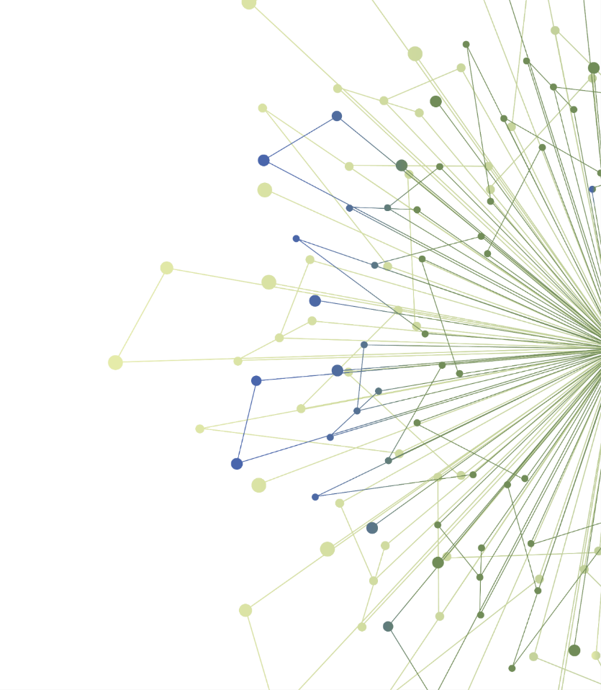
Application of Dissemination and Implementation Science Across the Translational Research Spectrum
Notes:
Title slide

Slide 6
Learning Objectives
By the end of these sessions, you will be able to
Describe how D&I science fits into the continuum of translational research
Provide examples of how D&I science principles apply to translational research projects
Notes:
Review learning objectives

Slide 7
Recap from Day 1: Key Points
Failure to implement evidence-based care and effective interventions contributes to poor healthcare outcomes in the U.S.
The biggest gap in adoption of new interventions is between the “early adopters” and the “early majority.” Implementation science principles can help overcome this chasm.
The CFIR framework provides a useful structure for considering aspects of a clinical environment and an intervention that impact the likelihood of successful implementation.
Notes:
Review key points from first part of workshop series

Slide 8
Core Principles from D&I Science
Context matters and it is multi-level
To improve health, interventions must be both effective and useable
Change happens proactively
Dissemination and Implementation are team endeavors
Notes:
1) Successful dissemination of research knowledge and
implementation of scientific discoveries are profoundly affected
by healthcare policy, organizational and
community culture and climate, and attitudes and
behaviors of key stakeholders
2) We must be equally concerned with whether evidence can
be disseminated to reach key stakeholders and whether
practices can be taken up and delivered in real-world settings.
This compels accompanying lines of inquiry
3) To facilitate the adoption, spread, and sustainment of improved
diagnostics, therapeutic, and service delivery interventions,
strategies must be developed, used, and continually improved
through scientific inquiry
4) Implementation practice requires iterative engagement and
involvement of a range of stakeholders, including patients,
clinicians, administrators, researchers, and policymakers.
Similarly, implementation science is inherently transdisciplinary,
involving treatment developers and researchers, health services
researchers, and experts from closely related fields such as
industrial psychology and communications research

Slide 9
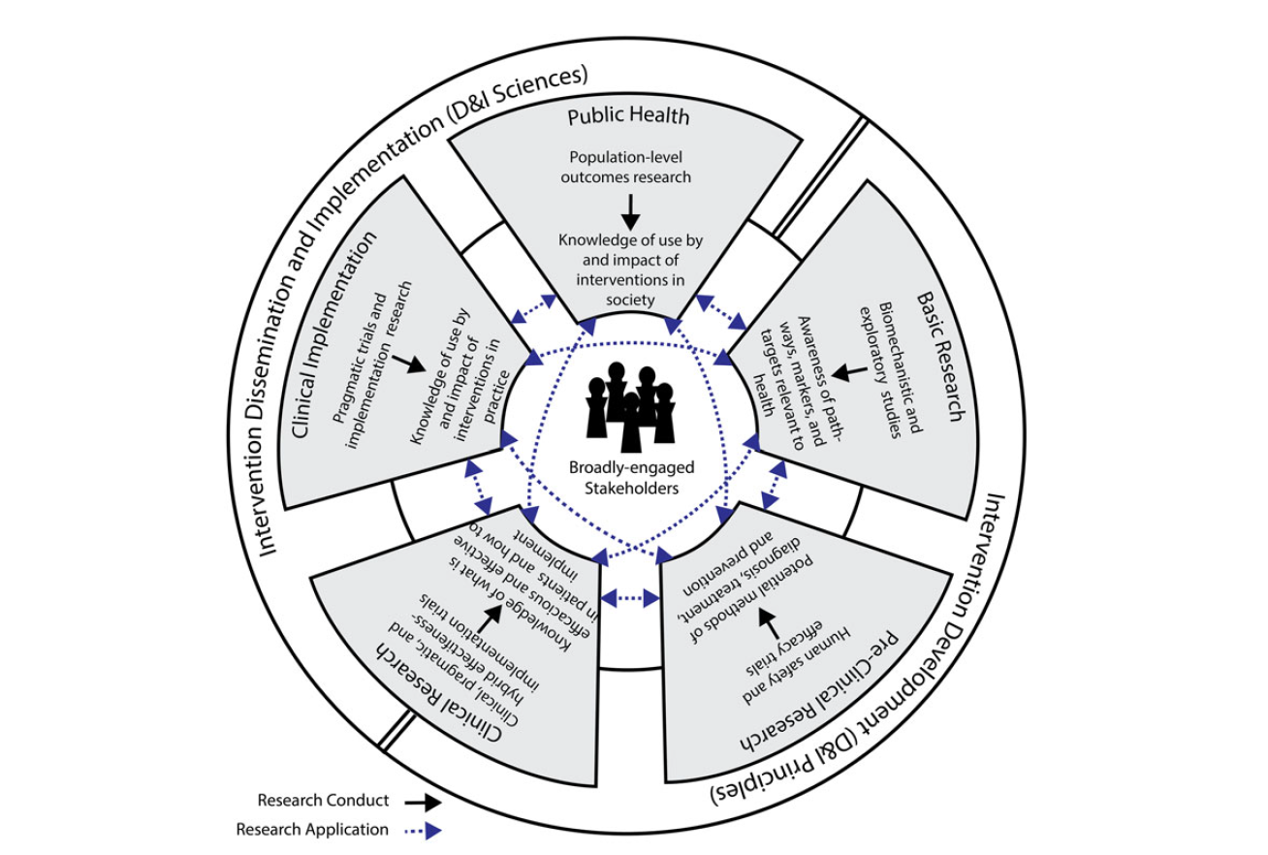
Integrative Framework of Dissemination, Implementation & Translation
Public Health
D&I Sciences
Clinical Implementation
Basic
Research
D&I Principles
Clinical Research
Pre-Clinical Research
Notes:
This is the Integrative Framework of Dissemination, Implementation and Translation. This framework integrates and expands current understanding related to dissemination, implementation and translational sciences to optimize their contributions to translational research.
Research conduct – processes that occur within a translational research stage
Research application – using knowledge to guide the next translational research stage
Consider including a live poll asking workshop participants to report what translational research stage their work falls into. Highlight diversity of participants.

Slide 10
How D&I Science Principles Can Improve the Process of Translation (moving to the next stage)
 | Application of D&I Principles
Basic research to pre-clinical research | Engage stakeholders and understand stakeholder needs for a potential clinical intervention Design a clinical intervention (e.g. drug, device) to meet these needs
Pre-clinical research to clinical research | Identify potential barriers to use of a new clinical intervention Modify the intervention, setting or research design to address barriers
Clinical research to clinical implementation | Select and understand the clinical settings for implementation Plan strategies for successful implementation
Clinical implementation to public health | Compare implementation approaches Develop sustainability plans
Notes:
*Drawn from Leppin, A., Mahoney, J., Stevens, K., Bartels, S., Baldwin, L., Dolor, R., . . . Meissner, P. (2020). Situating dissemination and implementation sciences within and across the translational research spectrum. Journal of Clinical and Translational Science,4(3), 152-158. doi:10.1017/cts.2019.392

Slide 11
Example: Glycomacropeptide-based food for PKU
Clinical problem - Individuals with PKU cannot metabolize phenylalanine, must follow strict diet
Basic science – isolated glycomacropeptide (GMP) as a by-product of cheese making. Discovered it is phenylalanine free.
Stakeholder engagement – outreach to National PKU Alliance, gauge interest in GMP-based food products,
-confirmed future demand for GMP-based food products
Notes:
Drawn from Leppin, A., Mahoney, J., Stevens, K., Bartels, S., Baldwin, L., Dolor, R., . . . Meissner, P. (2020). Situating dissemination and implementation sciences within and across the translational research spectrum. Journal of Clinical and Translational Science,4(3), 152-158. doi:10.1017/cts.2019.392

Slide 12
Example: Glycomacropeptide-based food for PKU
Created a multi-stakeholder Task Force
Multiple stakeholders involved in task force, oversaw all aspects of the program
Mouse studies – demonstrated safety and efficacy
Human studies – demonstrated safety and efficacy
University of Wisconsin Dairy Research Center
Developed palatable GMP-based food products with input from patients and family members of patients with PKU
PKU community supported rapid deployment of clinical trials
University of Wisconsin Foundation provided commercialization support

Slide 13
PKU Outcome
Now a local company manufactures GMP-based foods, which accounts for 10% of food consumed by PKU patients
Increased variety and quality of food offerings for these patients

Slide 14
Applying Principles of Dissemination and Implementation Sciences to TL1 Scholar Projects
Notes:
Now we are going to transition to an interactive session that will allow us to explore how applying D&I science principles can inform translational research, using three TL1 trainee projects.

Slide 15
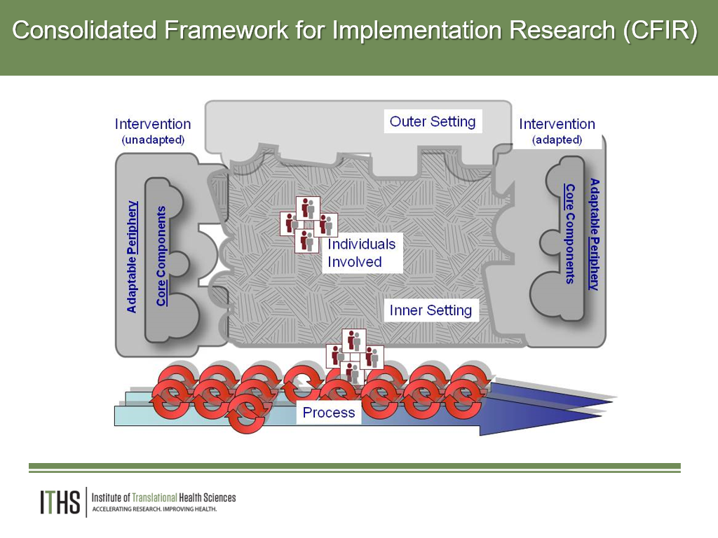
Session Outline
Breakout Sessions
Learn about three TL1 Scholar projects
Participate in facilitated small group discussions with each Scholar
Report back about your discussions with the whole group
Activities and Goals
Brainstorm solutions to potential implementation challenges
Learn about applications of D&I Sciences to solve challenges
Notes:
Review the CFIR and its key components
Drawn from:
Damschroder, L.J., Aron, D.C., Keith, R.E. et al. Fostering implementation of health services research findings into practice: a consolidated framework for advancing implementation science. Implementation Sci 4, 50 (2009). https://doi.org/10.1186/1748-5908-4-50

Slide 16
Shift and Share Presentations
Before the start of the session identify presenters – translational researchers who are willing to present their work briefly and engage in discussion about how implementation science can apply to their work
Divide into 4 groups
-Translational researcher provides 3-4 minute project overview
1. Name, project title
2. Study background, study goal, translational research stage
3. Study methods
4. Potential challenges to translation or clinical implementation
-Facilitator asks group to help identify additional potential challenges
-Facilitator asks group to brainstorm potential solutions, drawing on the approaches shared in Slide 10
Notes:
This is overview of small group activities. Delete this slide for presentation.

Slide 17
An Introduction to Dissemination & Implementation Research
TL1 Scholars October 2020
PROJECT TITLE
SCHOLAR NAME
DEPARTMENT
Notes:
Example translational researcher presentation

Slide 18
Study Background
PROJECT TITLE
Describe
Describe
Study Goal:
Describe
Translational Research Stage:
Describe

Slide 19
Study Methods
PROJECT TITLE
Describe
Describe
Describe

Slide 20
Potential Challenges to Translation or Clinical Implementation
PROJECT TITLE
Describe
Describe
Describe

Slide 21


Shift and Share Discussions
In the breakout group you’ll discuss challenges and brainstorm solutions on each Scholars’ project.
1.
2.
3.
You will be randomly assigned to a breakout group for a discussion with each of the Scholars in turn.
15 minute discussion with Scholar 1
You will be returned to the main call
There will be a 5 minute break and then the report out session will begin
15 minute discussion with Scholar 2
15 minute discussion with Scholar 3

Slide 22
5 Minute Break
Notes:
During this short break, while workshop participants rejoin the large group, each facilitator should spend a few minutes reflecting with the presenting trainee about the challenges that were identified and potential solutions developed. Help the trainee solidify a selection of items to include in the report out.

Slide 23
Report Out!
For each trainee
Did the groups identify any new challenges?
Which challenges do you think are most critical to focus on?
What solutions did you discuss? What made these a good fit?
How did you or could you integrate D&I science principles into the solutions?
Notes:
Each scholar that presented should share a 2 minute summary of the challenges/solutions that were discussed in the groups and provide an example of how D&I science principles could be applied.

Slide 24
Core Principles from D&I Science
Context matters and it is multi-level
To improve health, interventions must be both effective and useable
Change happens proactively
Dissemination and Implementation are team endeavors
Notes:
This is a change for the presenter to reflect on the report out and highlight how any potential solutions applied the core principles of D&I science.
1) Successful dissemination of research knowledge and
implementation of scientific discoveries are profoundly affected
by healthcare policy, organizational and
community culture and climate, and attitudes and
behaviors of key stakeholders
2) We must be equally concerned with whether evidence can
be disseminated to reach key stakeholders and whether
practices can be taken up and delivered in real-world settings.
This compels accompanying lines of inquiry
3) To facilitate the adoption, spread, and sustainment of improved
diagnostics, therapeutic, and service delivery interventions,
strategies must be developed, used, and continually improved
through scientific inquiry
4) Implementation practice requires iterative engagement and
involvement of a range of stakeholders, including patients,
clinicians, administrators, researchers, and policymakers.
Similarly, implementation science is inherently transdisciplinary,
involving treatment developers and researchers, health services
researchers, and experts from closely related fields such as
industrial psychology and communications research

Slide 25
Experiential Learning
Notes:
This section of the presentation introduces the experiential learning exercise that comprises the second component of the D&I science curriculum.

Slide 26

We will present the opportunities today
Over the next week, you will choose one of these activities by completing the survey that is sent to you
Notes:
There are three experiential learning opportunities.
The goal of the session is to present the opportunities so scholars can choose which one is most relevant to their own TL1 scientific project.

Slide 27
Schedule for Experiential Learning
Date | Timeline
Dec 1, 2020 | Orientation to your chosen experiential learning opportunity
Jan 26, 2021 | Shared learning session with others completing the same opportunity (Midpoint check-in)
Feb 23, 2021 | 5-minute Capstone presentations of your work (slide template will be provided)
Notes:
On December 1, you will attend an orientation to your chosen experiential opportunity
You will have two months to complete it
In January there will be a shared learning session for all in your experiential learning group. This session will provide an opportunity to share the progress you've made and troubleshoot any challenges you are having in doing the work.
At a February TL1 Seminar, you will give a Capstone presentation of your learnings to your peers

Slide 28
Apply D&I to TL-1 Trainees’ work
Three experiential opportunities:
  Design a stakeholder assessment
  Plan one step in implementing an intervention in clinical or community-based settings
  Create a dissemination plan for TL1 Trainees’ research product/s
Notes:
The three experiential opportunities are:
Design a Stakeholder assessment
Plan one component of and intervention implementation
Create a dissemination plan for the TL1 trainee study findings

Slide 29
Design A Stakeholder Assessment
Learning objectives:
  Identify stakeholder(s) who might impact or influence the implementation or dissemination of an innovation
  Analyze how the innovation might be impacted or influenced by stakeholder(s)
  Create strategies to engage appropriate stakeholder(s)
Outcome: By the conclusion of this exercise, trainees will be able to identify stakeholders who will need to be engaged if efforts to implement or disseminate a clinical innovation are to be successful.
Notes:
For the stakeholder assessment, trainees will learn how to
Identify stakeholder(s) who might impact or influence the implementation or dissemination of an innovation
Analyze how the innovation might be impacted or influenced by stakeholder(s)
Create strategies to engage appropriate stakeholder(s)
After trainees complete this exercise, trainees will be able to identify stakeholders who will need to be engaged if efforts to implement a clinical innovation are to be successful.

Slide 30
Process For Conducting a Stakeholder Assessment
Trainees will
1. Read a case study and watch a YouTube video example of a stakeholder assessment.
2. Based on your own project, identify at least 3 stakeholders you might need to engage by completing the “Stakeholder Management Log.” Brainstorm questions you might ask each of the potential stakeholders.
3. Use the stakeholder assessment questions to “map” these stakeholders on a “Stakeholder Grid,” given what you know about these stakeholders.
4. Based on your assessment, describe in 2-3 sentences who you might need to engage as stakeholders and what you might do to engage them.
Optional Extensions
1. Ask one of your classmates to role-play one of the stakeholders relevant to your project and do a phone interview with your classmate.
2. Reach out to one of the stakeholders relevant to your project and complete a phone interview.
Notes:
This is the work of the Stakeholder Assessment exercise.
The stakeholder grid is a 2x2 grid that plots stakeholders in terms of their influence over the project and their interest in the project. This helps you identify what kind of action you should take with them.

Slide 31
Plan Implementation of an Intervention
Learning objectives:
  Understand the steps in planning implementation of a health innovation or intervention in clinical or community-based settings
  Apply principles of D&I science to one implementation planning step
Outcome: By the conclusion of this exercise, trainees will be able to apply principles of D&I science to the process of planning implementation of a health innovation in clinical or community-based settings.
Notes:
For planning a component of and intervention implementation, trainees will learn how to
Explain the steps in planning implementation of a health innovation or intervention in clinical or community-based settings
Apply principles of D&I science to one or more implementation planning stages
After trainees complete this exercise, trainees will be able to apply principles of D&I science to the process of planning implementation of a health innovation in clinical or community-based settings.

Slide 32
Process for planning a component of a clinical or community-based intervention implementation
Trainees will use the Implementing Health Innovations in Clinical Practice toolkit to undertake these activities
1. Work with the D&I team to select an activity and prepare to complete it
2. Complete a planning worksheet for your project. Choose one: Understanding your intervention: Describe the key components of your intervention or innovation Operationalizing implementation: Create an action plan for using one implementation strategy
Optional Extension
Complete both planning worksheets
Notes:
This slide talks about the work for this experiential learning activity.
Scholars will use the Implementing Health Innovations in Clinical Practice toolkit for this activity.
They can choose from two activities in the toolkit.
This opportunity is appropriate for scholars who have a clinical or community-based interventions.
They may need guidance in how to use the toolkit to complete their chosen activity.

Slide 33
Create a dissemination plan for your research product/s
Learning objective:
  Apply principles of dissemination to distribute trainees’ research product/s to a target audience
Outcome: By the conclusion of this exercise, trainees will create a real-world dissemination plan for their research product/s
Notes:
This learning opportunity uses a Dissemination Workbook that supports the Scholar to be able to
Apply principles of dissemination to trainees’ research project
After trainees complete this exercise, trainees will be able to create a real-world dissemination plan for their study findings
This opportunity can be used by Scholars at any point along the translational research spectrum.
They can create a dissemination plan for the product of their basic science project (e.g., a new assay) or a public health project (e.g., a community-based intervention). This exercise will help the Scholar take their product to the next step in the translational spectrum.

Slide 34
Process for creating a dissemination plan for your research product/s
Trainees will use an adaptation of the Health Promotion Research Center’s Dissemination Workbook to
1. Identify the research product/s they want to disseminate
2. Identify appropriate users of their research product/s
3. Identify whether there are disseminating organizations that might best reach their users
4. Develop a marketing “message” for their product/s and tailor it to their users
5. Put together a proposed dissemination plan
Optional Extension
1. Implement some element/s of the dissemination plan In real-world settings.
Notes:
This slide talks about the work for this experiential learning activity.
Scholars will use the Dissemination Workbook\ for this activity.

Slide 35
How to decide which learning opportunity to choose
Choose: | If:
Stakeholder Assessment | ….you want to learn who might be your allies and what obstacles there might be in implementing or disseminating your innovation A good choice for scholars working at any translational stage
Planning Implementation | ….you expect to have an intervention ready for implementation A good choice for scholars working at the clinical or public health stages of translational science
Dissemination Plan Development | ...you think you will have a research product that you want to move to the next phase of translation either in research, the clinic, or the community A good choice for scholars working at any translational stage
Notes:
This slide helps the Scholars think through which of the three learning opportunities they should choose.

Slide 36
Next Steps
You will receive a survey asking you to rank your preferences for joining the three experiential learning opportunities. Please respond to the survey by November 5
You can preview the materials for each of the experiential learning opportunities by going to Course Canvas Page
Notes:
After this presentation, we sent each Scholar a short survey asking them to rank these learning opportunities.
Then the group could place the scholars in appropriate learning opportunity groups.
We provided access for the Scholars to the materials (e.g., toolkit, workbook) in case they wanted to review them before ranking the learning opportunities.

Slide 37
Next Steps
By November 10, you will learn which opportunity you will join

Slide 38
For Additional Questions, please email:
NAME
EMAIL

Slide 39
You will receive an email to complete a post-workshop evaluation

Slide 40

Thank You
ITHS is supported by the National Center For Advancing Translational Sciences of the National Institutes of Health under Award Number UL1 TR002319.
This project was supported by the National Center For Advancing Translational Sciences of the National Institutes of Health under Award Number TL1 TR002318.
The content is solely the responsibility of the authors and does not necessarily represent the official views of the National Institutes of Health.

