Slide 1
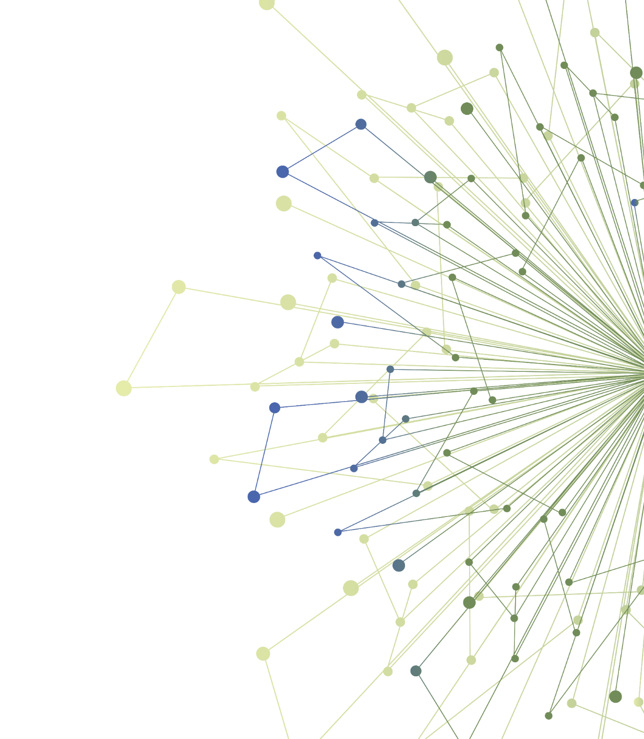
Experiential Opportunity 2:
Conducting a Stakeholder Assessment
[Instructor name and contact info]
Notes:
“Welcome! The purpose of meeting today is to check-in with each of you about your progress on this experiential learning opportunity, your Stakeholder Assessment, and answer any questions you might have. If you have a early draft of your Capstone presentation and want to get feedback from the group you are also welcome to do so today.

Slide 2
Review of Activity
Stakeholder Management Log
Case Study
Your Project
Stakeholder Grid: level of interest v. level of influence
Stakeholder engagement strategies for each
Notes:
Just to review, here are the steps you should complete for this activity…any questions about these steps?

Slide 3
Completing Your Stakeholder Assessment
Discuss progress to-date: challenges, questions?
Review Capstone presentation
Other Questions?
Notes:
What challenges have your encountered? What Question do you have?
[Use a round-robin technique to ask each student these questions]

Slide 4
Next Steps
Finish exercise
Capstone presentation on [date here]
5 min presentation; you should have the PowerPoint template
Questions about Capstone presentation?
Contact me with questions! I am available to meet via Zoom or on email.
Please contact me at [your email address here]
Notes:
Does anyone want feedback on their Capstone presentation today? [allow them to present and ask questions]
Any last questions before we adjourn?

Slide 5
Thank You
ITHS is supported by the National Center For Advancing Translational Sciences of the National Institutes of Health under Award Number UL1 TR002319.
This project was supported by the National Center For Advancing Translational Sciences of the National Institutes of Health under Award Number TL1 TR002318.
The content is solely the responsibility of the authors and does not necessarily represent the official views of the National Institutes of Health.

