Slide 1
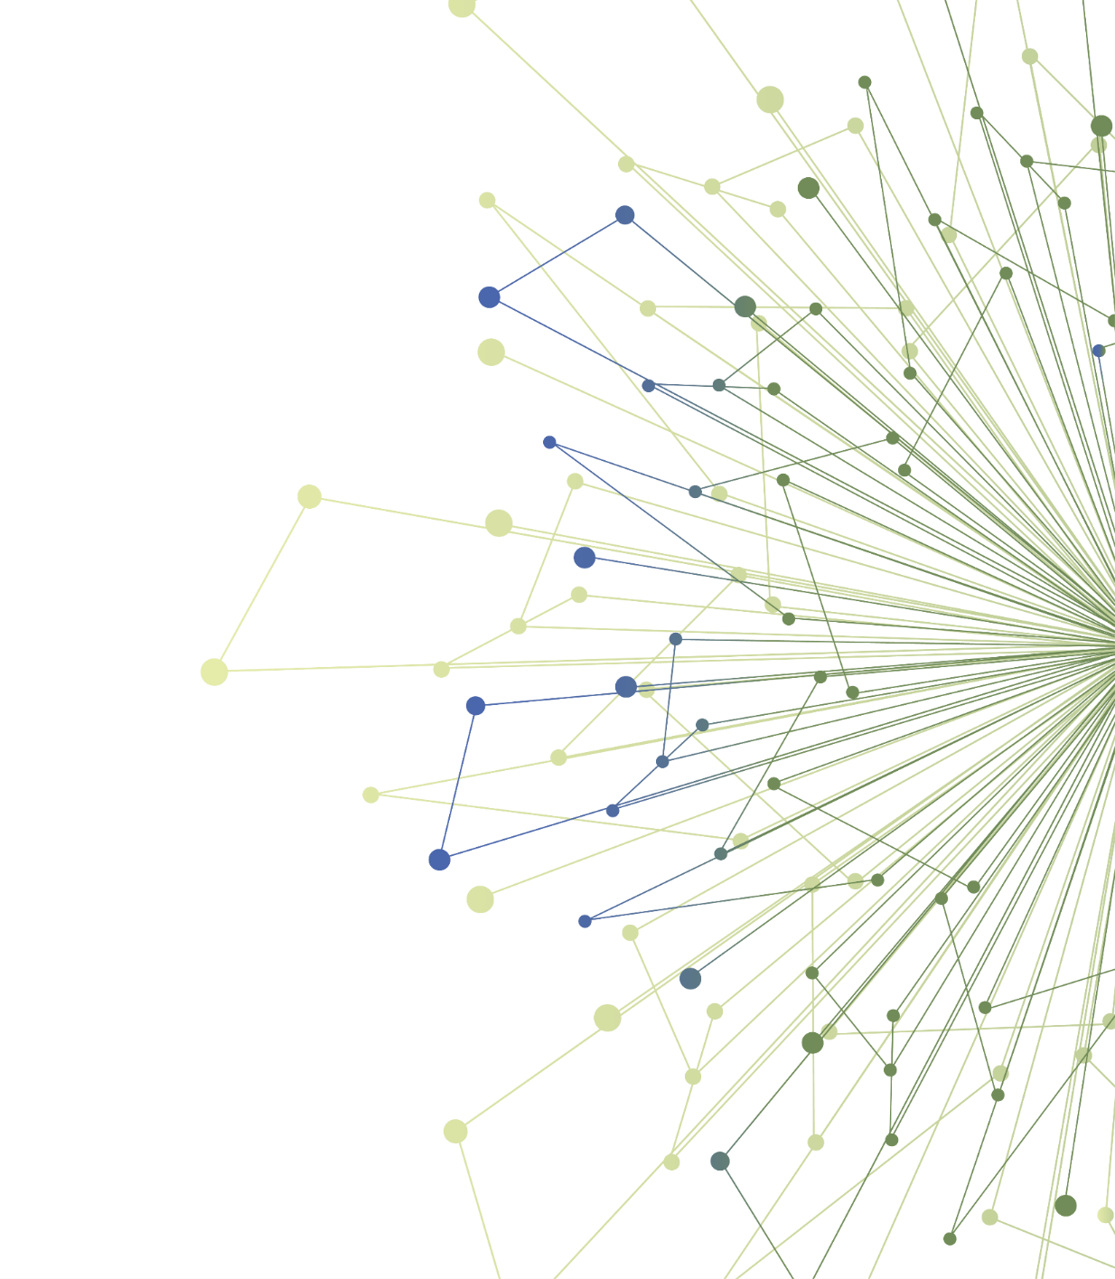
Creating a Dissemination Plan for your Research Product/s
Laura-Mae Baldwin, MD, MPH
Professor, Family Medicine
Senior Advisor, ITHS Dissemination and Implementation Program
Notes:
This slide show was used in the mid-point check-in.

Slide 2
Agenda
Discuss progress to-date
Next Steps
Questions

Slide 3
Steps to Creating a Dissemination Plan:
Steps:
Identify the research product/s you want to disseminate.
Identify appropriate users for your research product/s
Identify whether there are disseminating organizations that might best reach your users
Develop a marketing “message” for your product/s and tailor it to your users
Put together your proposed dissemination plan
Optional Extension
Implement some element/s of the dissemination plan In real-world settings.
Notes:
This slide reviews the work of this learning opportunity.

Slide 4
Discussion
Progress-to-date (in 5 minutes)
Where are you in the process of creating a dissemination plan?
What’s been easy, what’s been challenging?
Feel free to give your 60 second pitch if you would like feedback!
Share whether you are extending your experience in any way (e.g., by giving your pitch to a disseminating organization or potential user.)
What questions do you have?
Discussion, brainstorming, problem solving!
Notes:
These are the questions we asked each Scholar to discuss about their project.

Slide 5
Next Steps
Finish creating your dissemination plan
Keep tracking how much time you spend on this learning opportunity! We’ll ask you to report this on the evaluation.
Submit your Capstone presentation to Milu Worku (mworku@uw.edu) by end of day Feb 19
Give your Capstone presentation on Feb 23
5-minute presentation
Template can be found on your course canvas website UCONJ599.
Contact us with questions! We are available to review your Capstone presentation or to meet via Zoom or on email.
Please contact NAME/EMAIL or Laura-Mae Baldwin at lmb@uw.edu
Notes:
This reminds the Scholars of next steps.

Slide 6
Thank You
ITHS is supported by the National Center For Advancing Translational Sciences of the National Institutes of Health under Award Number UL1 TR002319.
This project was supported by the National Center For Advancing Translational Sciences of the National Institutes of Health under Award Number TL1 TR002318.
The content is solely the responsibility of the authors and does not necessarily represent the official views of the National Institutes of Health.

