Slide 1
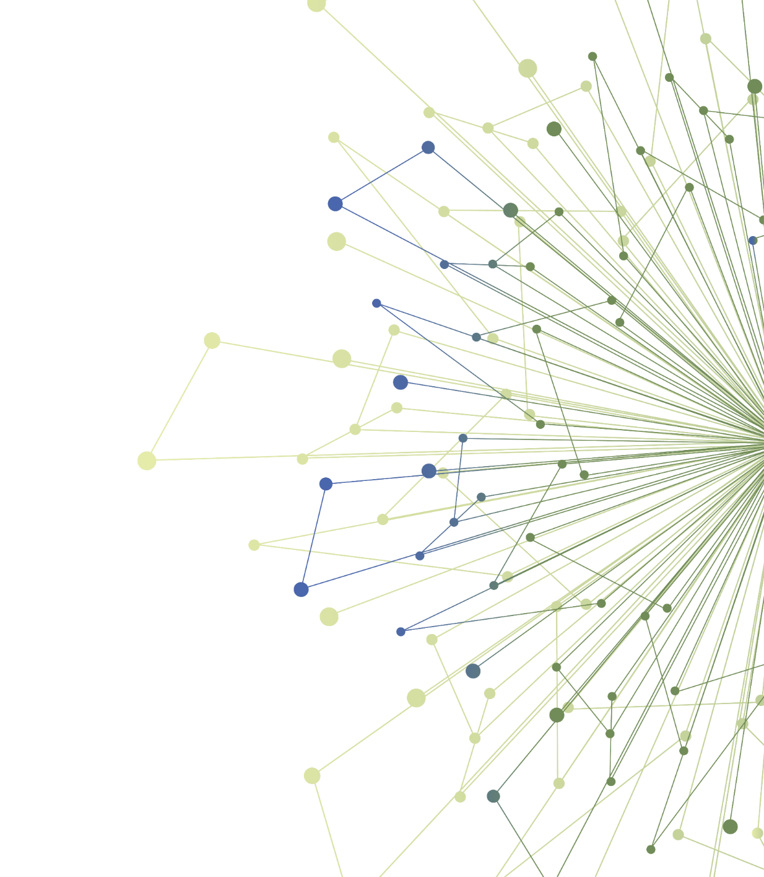
Experiential Opportunity :
Preparing for Implementation of a Health Innovation in Clinical Settings
Allison Cole, MD, MPH
Associate Professor, Family Medicine
Director, ITHS Dissemination and Implementation Program
Notes:
Dr. Allison Cole is a family physician and researcher at the University of Washington. She is also Director of the ITHS’ Dissemination and Implementation program.

Slide 2
Agenda
Discuss progress to-date
Capstone presentation
Questions

Slide 3
Experiential Learning Options
Option 1: Understanding your Intervention
Describe your intervention using Worksheet 1 – Your Intervention
Option 2: Operationalizing Implementation
Choose one foundational implementation strategy.
Describe how you would use the implementation strategy using Worksheet 2 – Action Plan

Slide 4
Discussion
Project overview
Which exercise you chose
Progress-to-date
What’s been easy, what’s been challenging
What questions do you have
Discussion

Slide 5
Next Steps
Finish and finalize your exercise
Capstone presentation on Feb 23
5 min presentation
Capstone templates are located on Canvas under UCONJ 599
Please email Capstone PowerPoint slides to Milu Worku at mworku@uw.edu by February 19th
Questions about Capstone presentation?
Contact us with questions! We are available to meet via Zoom or on email.
Please contact NAME/EMAIL

Slide 6
Implementation Planning Exercise Overview
In this activity you will use a modified version of the Implementation Guide to learn about two important steps in the process of planning for implementation
Understanding your intervention
Creating an action plan for one implementation strategy that is appropriate for your intervention and clinical setting

Slide 7
Understanding your Intervention
The first step in preparing for implementation is to carefully describe your intervention.
This will help you identify the key personnel involved in your intervention and the expected activities and outcomes that will occur.
Focus on the aspects of your intervention that are critical for its success. These are considered the intervention’s core components.
The Guide will guide you through a step-by-step process to examine your intervention

Slide 8
Understanding your Intervention - Overview
Inputs – resources needed to support the intervention. For example, staff, materials, training, existing clinical workflows, funding, equipment
Activities – components of the intervention itself. Activities include both actions to prepare for implementation (e.g. develop new clinical workflow) and actions for implementing and maintaining the intervention (e.g. administering the new treatment)
Short term outcomes – what you expect to occur as a result of the intervention activities. Short term outcomes may reflect modifications or changes in healthcare process (e.g., number of patients contacted) or healthcare service (e.g. number of tests performed)
Long term outcomes – anticipated health outcomes that will occur as a result of the intervention

Slide 9
EXAMPLE: Screening, Brief Intervention and Referral to Treatment (SBIRT) for Alcohol Use Disorder in Primary Care Settings
Intervention characteristics
Inputs – resources needed to support the intervention | Clinical staff to complete screening (medical assistant) Clinical staff to complete brief intervention and referral to treatment (clinician) Standard alcohol use disorder screening tool built into electronic health record Access to alcohol use disorder treatment Workflow to provide and track patient referrals Reimbursement for patient screening, counseling and referral
Activities – components of the intervention itself. Activities include both actions to prepare for implementation and actions for implementing and maintaining the intervention | Health IT team builds screening tool into electronic health record Medical assistants trained on screening Clinicians trained on brief intervention and referral Medical assistants screen, notify clinicians of abnormal screening results Clinicians provide brief intervention and referral Quality improvement leader assesses implementation success
Short term outcomes – what you expect to occur as a result of the intervention activities. Short term outcomes may reflect modifications or changes in healthcare process or healthcare service | Proportion of adult patients attending a visit that complete screening Proportion of adult patients with high-risk alcohol use Proportion of adults with high-risk alcohol use that receive brief intervention Proportion of adults with high-risk alcohol use that receive referral to treatment Proportion of adults with high-risk alcohol use that engage in treatment
Long term outcomes – anticipated health outcomes that will occur as a result of the intervention | Proportion of adults with high-risk alcohol use that reduce or abstain from alcohol Proportion of patients with medical complications related to alcohol use disorder

Slide 10
Overview of Implementation Strategies
An implementation strategy is a “method or technique used to enhance the adoption, implementation, and sustainability of a clinical program or practice.” (Proctor EK, Powell BJ, McMillen JC 2013 https://doi.org/10.1186/1748-5908-8-139)
There are some implementation strategies that appear to be foundational to implementing interventions in primary care clinical practice. They may be applicable to many clinical settings and across many types of interventions.

Slide 11
Foundational Implementation Strategies
Assess for readiness | Throughout implementation, assess aspects of a practice or organization to determine its degree of readiness to implement the intervention
Assess for the presence of barriers that may impede implementation | Assess various aspects of a practice or organization to identify barriers that may impede implementation
Attend to Practice or Organization Culture | Identify and respond to the culture of the practice or organization that you are working with (e.g. openness and communication, general leadership support and/or structure).
Conduct Local Planning Discussions | Plan and conduct discussions that include providers or staff and address choosing and testing changes to support implementation of the intervention
Develop and Support Teams that are Implementing the Intervention | Develop and support teams that are implementing the innovation. This can be accomplished through regular check-ins, which give the teams protected time to reflect on the implementation effort, share lessons learned, and support one another’s learning
Conduct educational meetings | Hold meetings targeted toward different stakeholder groups (e.g. providers, administrators, other practice or organizational stakeholders) to teach them about the intervention
Develop or Implement Tools for Quality Monitoring | Develop, test, or introduce quality monitoring tools and teach practices or organizations use of the quality monitoring tools.

Slide 12
Creating an Action Plan
Outline the elements of an implementation strategy you will use
Who – Who will deliver it
What/How – What are the actions or steps; how will it be carried out
Target of the strategy – Where or to whom is it direct or what is it trying to impact
Goal or expected outcome
Timing – When in the project will it be used
Frequency & Intensity – How often and/or for how long will it be used

Slide 13
EXAMPLE
Action Plan: Strategy #1 for Implementation
Dimension & Description | Strategy # 1 Audit and Provide Feedback Collect and summarize clinical performance data over a specified time period and give it to clinicians and administrators to monitor, evaluate, and modify provider behavior
Who delivers Which individual or individuals will deliver the implementation strategy? Strategies can have a single individual or multiple individuals involved | Health IT staff – will collect Quality data (proportion of patients screened for alcohol use disorder, proportion of patients with a positive screen who received brief intervention and referral to treatment) from electronic health record Clinician champion will share performance reports with primary care teams (medical assistants and clinicians)
What/how How will the implementation strategy be delivered? What are the actions, steps or processes, and ordering of the steps? | The IT team will create monthly reports The performance reports will summarize performance by provider and be updated monthly The clinician champion will share the reports with clinical teams and provide best practices for improving outcomes
Target of the strategy | Primary care teams
Goal What is the goal or expected impact of the implementation strategy? Make sure the level of the goal is matched to the level of the implementation strategy. | Increased delivery of alcohol use disorder screening, brief intervention and referral to treatment by medical assistants and clinicians
Timing When in the project will the implementation strategy be used? | Reports will be shared starting in month two
Frequency and Intensity How often and/or for how long will the implementation strategy be delivered? | Reports will be shared monthly throughout the intervention period

Slide 14
Implementation Planning Exercise
<PUT YOUR INTERVENTION HERE>
<YOUR NAME, SCHOOL, DEPARTMENT>

Slide 15
<Name of your research product/s>: Intervention Characteristics
INPUTS – Resources needed to support the intervention
<LIST INPUTS HERE>

Slide 16
<Name of your research product/s>: Intervention Characteristics
ACTIVITIES – Components of the intervention itself
<LIST ACTIVITIES HERE>

Slide 17
<Name of your research product/s>: Intervention Characteristics
SHORT TERM OUTCOMES – what you expect to occur as a result of the intervention activities
<LIST SHORT TERM OUTCOMES HERE>

Slide 18
<Name of your research product/s>: Intervention Characteristics
LONG TERM OUTCOMES – anticipated health outcomes that will occur as a result of the intervention
<LIST LONG TERM OUTCOMES HERE>

Slide 19
<Name of your research product/s>: Implementation Strategy
<Name and definition of implementation strategy you selected>

Slide 20
<Name of your research product/s>: Implementation Strategy Action Plan
WHO
WHAT/HOW
TARGET OF STRATEGY
GOAL
TIMING
FREQUENCY/INTENSITY

Slide 21
Thank You
ITHS is supported by the National Center For Advancing Translational Sciences of the National Institutes of Health under Award Number UL1 TR002319.
This project was supported by the National Center For Advancing Translational Sciences of the National Institutes of Health under Award Number TL1 TR002318.
The content is solely the responsibility of the authors and does not necessarily represent the official views of the National Institutes of Health.

