Slide 1
Creating a dissemination plan
for your research product/s
Laura-Mae Baldwin, MD, MPH
Notes:
This presentation orients the Scholars who chose this opportunity to the work.

Slide 2
Dissemination
What is dissemination?
The targeted distribution of information and intervention materials to a specific public health or clinical practice audience. The intent is to spread knowledge and the associated evidence-based interventions.
Notes:
This is the NIH definition of dissemination

Slide 3
We are broadening the definition of dissemination
The targeted distribution of information and intervention materials to a specific audience. The intent is to spread knowledge and the associated evidence-based interventions.
Basic scientist: new assay, mouse model
Public health professional: new guideline, population-based intervention (e.g., vaccine)
Notes:
We are broadening dissemination to include any audience.
For example, if you are a basic scientist developing a new assay, you may want to distribute information about your assay to other scientists who might want to use it in their lab.
Or if you are a public health professional, you may want to distribute a new public health intervention to community-based group, health care providers, or public health district.

Slide 4
For this exercise, you will use a workbook:
Notes:
This slide introduces the workbook they will use for this exercise.

Slide 5
By the conclusion of this exercise:
You will create a real-world dissemination plan for your study findings

Slide 6
Please share!
Why did you choose this experiential workshop?
What research product would you like to disseminate?
Notes:
We asked each Scholar attending the orientation to share the answers to these questions so the Scholars could learn from each other and the Lead could get a feeling for the types of research products that the Scholars hoped to disseminate, and what the Scholars hoped to get out of this learning opportunity.

Slide 7
Steps to Creating a Dissemination Plan:
Steps:
Identify the research product/s you want to disseminate.
Identify appropriate users for your research product/s
Identify whether there are disseminating organizations that might best reach your users
Develop a marketing “message” for your product/s and tailor it to your users
Put together your proposed dissemination plan
Optional Extension
Implement some element/s of the dissemination plan In real-world settings.

Slide 8
Identify the research product/s you want to disseminate
This exercise is not about disseminating research results as you would in a journal article or professional presentation.
Identify a product of your research that you want to move into use by other researchers, in the community, in clinical settings.
Notes:
Here we clarify what a disseminatable research projduct might look like.

Slide 9
Follow the guidance of the workbook!
For several steps in the workbook, there are two sections for each: (1) Learn and (2) Apply.
1) In the Learn section, there is general information about how to plan and implement that dissemination step.
2) In the Apply section, the workbook helps you connect this new knowledge to create a portion of your own dissemination plan.
Notes:
This slide talks about how to use the workbook's guidance.

Slide 10
Identify appropriate users for your research product/s
Learn: Characteristics of users or organizations likely to adopt new research product
How do I identify users or organizations likely to adopt new research products?
A user/organization is more likely to adopt a research product if it has…
a mission or strategic priorities that align with the desired outcomes of the research product
the resources needed to adopt the research product (these could include adequate personnel, skilled staff, facilities for implementation, time for training, or financial resources).
one or more internal staff champions that promote the research product within the organization.
a culture that encourages learning and change.
the ability to devote time and attention to the research product, i.e., will prioritize your initiative even if it is engaged with other initiatives.
Notes:
The next series of slides summarizes important sections of the workbook to orient the Scholar to the work.
Step one: Identify appropriate users for the research product. This slide talks about the characteristics of users.

Slide 11
Identify appropriate users for your research product/s
Apply: Identify potential users….
1. What would you like to impact with your research product (e.g., research processes, clinical organizations, specific populations)?
2. What types of individuals or organizations are likely to use your research product? What services do they provide? How would adopting the research product allow them do their work better?
3. What resources does an individual or organization need to adopt the research product ? Which individuals or organizations have these resources?
4. List the specific individuals or organizations that fit the criteria above. These are potential users.
Notes:
This slide asks questions that will help the Scholar identify users for their product.

Slide 12
Identify whether there are disseminating organizations that might best reach your users
Learn: Characteristics of individuals or organizations that can disseminate your research product
What does a disseminator or disseminating organization do? The role of a disseminator or disseminating organization is to promote the research product to target users.
Ideal disseminators or disseminating organizations have:
access to target users. For example, through a research relationship, professional society or contractual obligation.
a solid reputation among target users as trustworthy and credible. Individuals and organizations that are influential opinion leaders in fields relevant to your research product make ideal disseminators or disseminating organizations.
And more in the workbook…..
Notes:
This slide identifies characteristics of possible disseminators or disseminating organizations that might reach users.

Slide 13
Identify whether there are disseminating organizations that might best reach your users
Apply: Identify potential disseminators or disseminating organizations….
1. What types of individuals or organizations have access to your target users?
2. Which individuals or organizations do your target users go to when they need information? What types of individuals or organizations do your target users consider credible and trustworthy?
3. List the specific individuals or organizations that fit the criteria above. These are potential disseminators or disseminating organizations.
Notes:
This slide asks questions that will help the Scholar identify potential disseminators or disseminating organizations for their research product.

Slide 14
Develop a marketing “message” for your product/s and tailor it to your users
Learn: Characteristics of a research product that are more likely to be adopted
Research products are more likely to be adopted if they….
are considered credible by potential adopters.
have a relative advantage compared with current research products.
produce visible benefits.
are compatible with existing resources.
are simple to implement.
can be tested before the user makes a final decision to adopt.
Notes:
We ask the Scholars to develop a marketing message that they can use to get their users (or the disseminating organization) interested in their research product.
This slide shares the kind of information the Scholar will want to include in their marketing message.

Slide 15
Develop a marketing “message” for your product/s
and tailor it to your users
Advantage
Benefit
Compatibility
Simplicity
Testability
Notes:
This slide guides the Scholar in creating their marketing message.

Slide 16
Develop a marketing “message” for your product/s
and tailor it to your users
...and turn them into a pitch
Your answers to the previous questions are selling points you can turn into an elevator pitch. Think about how to convince potential users to adopt a strategy.
Write a 60-second elevator pitch that answers these questions:
What is the research product?
How is it credible?
Why is it better than current practice?
How will it make life easier?
How will it improve research processes or quality of care?
Will it cut costs?
Can it be tested before the user commits?
Notes:
This slide provides more guidance on creating their "pitch."

Slide 17
Marketing Message Madlib
A tool to focus your “elevator pitch”
I’m here today to talk to you about ____________
It’s important because ______________________
My research shows ________________________
Let me give you an example _________________
That’s why I’m asking you to _________________
Notes:
This slide provides a template they can use for the pitch if they would like.

Slide 18
Put together your proposed dissemination plan
Take your work in the steps above, and …….
Create an action plan that involves:
Approaching a specific disseminating organization, if appropriate, with your pitch
Approaching specific users, as indicated, with your pitch
Creating materials that describe your research product/s so that when you identify interest, you can follow up with your ”ask”
Notes:
This slide introduces the last component of this learning opportunity – creating a dissemination plan.
It asks them to take the work they have done and create a step by step action plan to approach their disseminating organization/users, using their pitch.

Slide 19
What this workbook does and does not do….
This workbook helps you share information with appropriate users and/or disseminating organizations.
This workbook does not provide guidance on how to ensure uptake and use of your product/s by those users (implementation).
For resources and consultation on implementation, contact Allison Cole (acole2@uw.edu), Director of the ITHS’ D&I Program.
Notes:
This slide points out that once they have disseminated their product, the user may still need guidance on implementing the product.
This is a different piece of work and we direct them to a resource for this work.

Slide 20
The Community Choice
Blood Pressure Monitoring Campaign
Wanted to increase community access to BP self-monitoring
Used the workbook to:
Identify users for a BP monitor lending library
Develop a pitch for their idea
Worked with a local public library to co-create the lending library program
Had early success and planned to scale up the program to mobile libraries in frontier rural areas
Notes:
This is an example of a group that used the workbook to disseminate BP monitors in the community.
If you'd like to read more about this example, you can find it in the workbook.

Slide 21
Your Next Steps
Work your way through the workbook.
Please track how much time you spend on this learning opportunity! We’ll ask you to report this at a later evaluation.
Come to the mid-point shared learning session to briefly update the group on your progress, discuss challenges, and brainstorm solutions, if needed
Ask for help at any point along the way: contact NAME/EMAIL or Laura-Mae Baldwin: lmb@uw.edu.
Consider extending your experience by giving your pitch to a disseminating organization or potential user.
Give a 5-minute presentation on your learnings at a Capstone TL1 Seminar – we will provide a template for your presentation
Notes:
This details the Scholars' next steps.

Slide 22
Creating a dissemination plan
for <PUT YOUR RESEARCH PRODUCT HERE>
<YOUR NAME, SCHOOL, DEPARTMENT>
Notes:
These final slides are the capstone template slides.
We presented these at the orientation so the Scholars knew what they would be asked to present at the end of this work.

Slide 23
<Name of your research product/s>: Why disseminate?
Here put a few bullets about why you chose this research product to disseminate

Slide 24
Best potential users for
< Name of your research product/s>
Here share the users you chose and why, using the 4 questions from the “Apply” section of the workbook

Slide 25
The “pitch” for my research product
Here share your 60 second “pitch” in written form and verbally with the group

Slide 26
My proposed dissemination plan
Here share the next steps you will take to put your dissemination plan into place

Slide 27
If you have questions or need more support, please contact:
NAME/EMAIL
Laura-Mae Baldwin: lmb@uw.edu

Slide 28
Thank you!

Slide 29
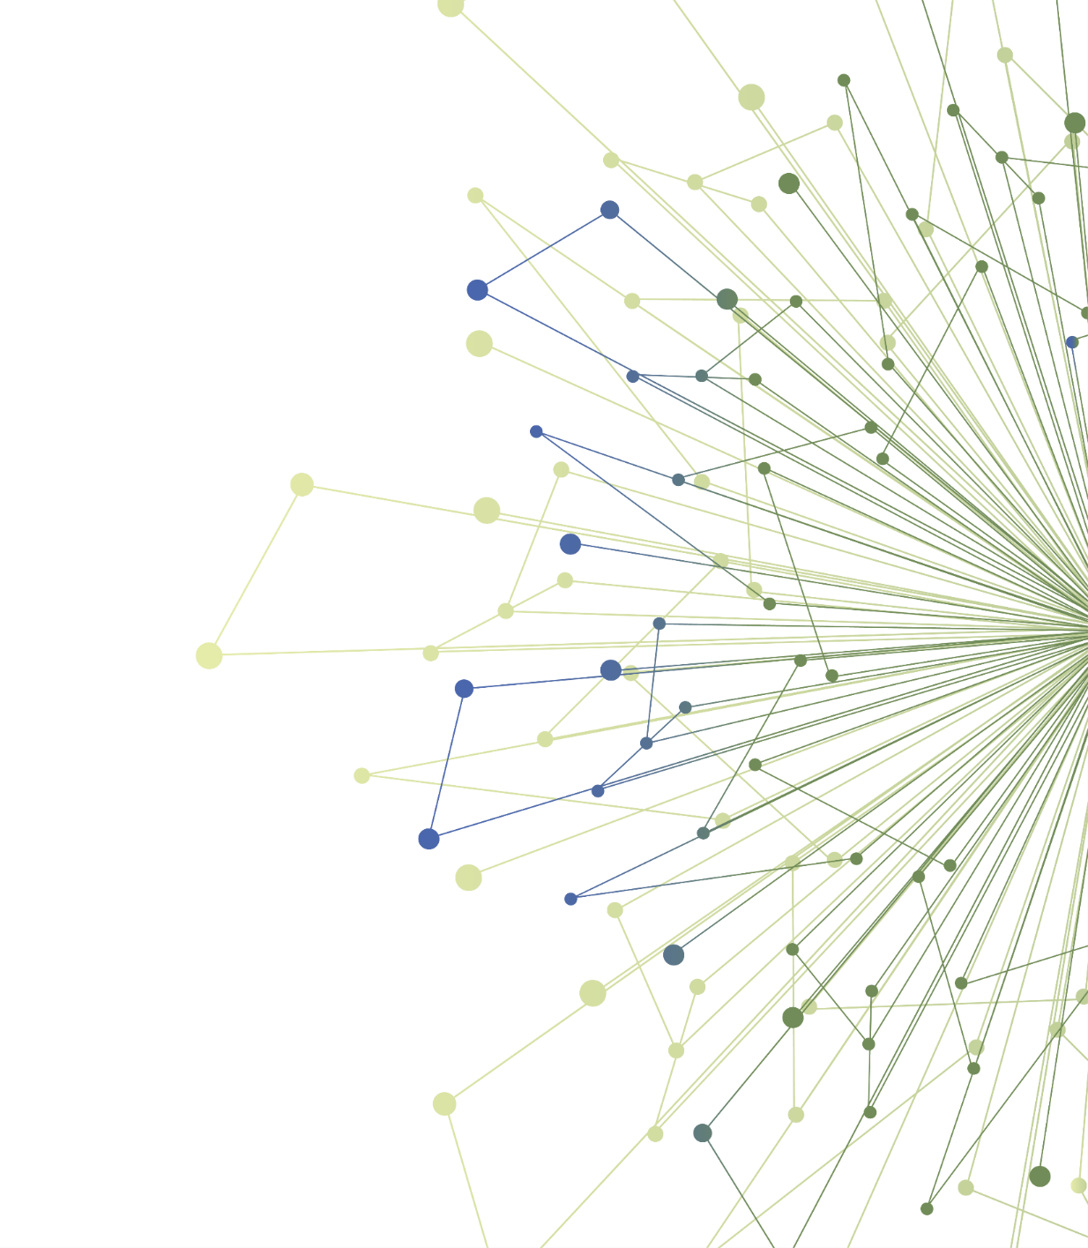
Thank You
ITHS is supported by the National Center For Advancing Translational Sciences of the National Institutes of Health under Award Number UL1 TR002319.
This project was supported by the National Center For Advancing Translational Sciences of the National Institutes of Health under Award Number TL1 TR002318.
The content is solely the responsibility of the authors and does not necessarily represent the official views of the National Institutes of Health.

