Slide 1
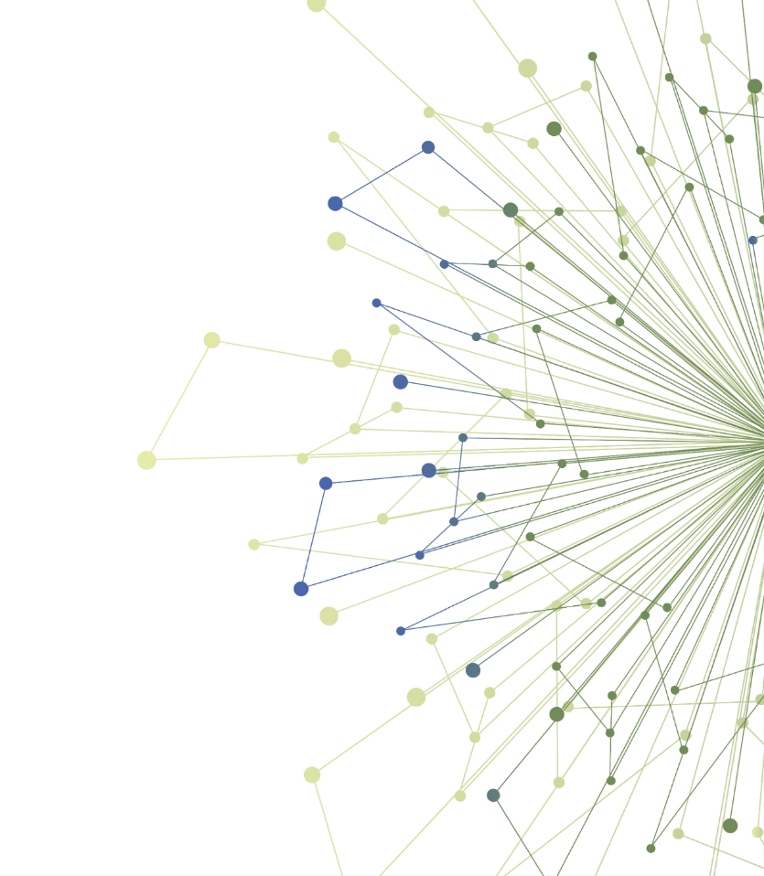
Experiential Learning

Slide 2

Schedule for Experiential Learning
Date | Timeline
Dec 1, 2020 | Orientation to your chosen experiential learning opportunity
Jan X, 2021 | Shared learning session with others completing the same opportunity (Midpoint check-in)
Feb X, 2021 | 5-minute Capstone presentations of your work (slide template will be provided)
Notes:
On December 1, you will attend an orientation to your chosen experiential opportunity
You will have two months to complete it
At a February TL1 Seminar, you will give a Capstone presentation of your learnings to your peers

Slide 3
Design A Stakeholder Assessment
Learning objectives:
  Identify potential stakeholders who might influence successful implementation of your research findings/results
  Understand how implementation might be impacted or influenced by each stakeholder
  Prioritize which stakeholders to engage and create strategies to engage them.
Outcome: By the conclusion of this exercise, trainees will be able to identify stakeholders who will need to be engaged if efforts to implement or disseminate a clinical innovation are to be successful.
Notes:
For the stakeholder assessment, trainees will learn how to
Identify stakeholder(s) who might impact or influence the implementation or dissemination of an innovation
Analyze how the innovation might be impacted or influenced by stakeholder(s)
Create strategies to engage appropriate stakeholder(s)
After trainees complete this exercise, trainees will be able to identify stakeholders who will need to be engaged if efforts to implement a clinical innovation are to be successful.

Slide 4
Process For Conducting a Stakeholder Assessment
Trainees will
1. Read a case study and watch a YouTube video example of a stakeholder assessment.
2. Based on your own project, identify at least 3 stakeholders you might need to engage by completing the “Stakeholder Management Log.” Brainstorm questions you might ask each of the potential stakeholders.
3. Use the stakeholder assessment questions to “map” these stakeholders on a “Stakeholder Grid,” given what you know about these stakeholders.
4. Based on your assessment, describe in 2-3 sentences what you might do to engage each of them.
Optional Extensions
1. Ask one of your classmates to role-play one of the stakeholders relevant to your project and do a phone interview with your classmate.
2. Reach out to one of the stakeholders relevant to your project and complete a phone interview.
Notes:
Stakeholder grid is 2x2 that looks at relative influence in organization and supporter/naysayer of innovation.

Slide 5
Stakeholder Case Example
“Optimizing Vascular Access to Prevent Patient Harm”
This case study of a stakeholder assessment is meant to provide you with an example of the process of identifying who the stakeholders are, why they have an interest in your project/study results, who you should prioritize for engagement and some ideas about how to engage them.
Use the case study to help you think about your own project: Who are your stakeholders, Why are they interested, How much influence do they have, How will you engage them?
Notes:
For planning a component of intervention implementation, trainees will learn how to
Explain the steps in planning implementation of a health innovation or intervention in clinical or community-based settings
Apply principles of D&I science to one or more implementation planning stages
After trainees complete this exercise, trainees will be able to apply principles of D&I science to process of planning implementation of a health innovation in clinical or community-based settings.

Slide 6
Completing a Stakeholder Management Log
First, complete the section on the left in the Table below from the case study you just finished reading.
Then, as you think about your project, identify potential stakeholders you will need to assess and engage with (the right-hand side of the Table)
Case Study Example |  |  | Your Project
Who? | Why Interested? | How much Influence? | Who? | Why Interested? | How Much Influence?
Notes:
For planning a component of intervention implementation, trainees will learn how to
Explain the steps in planning implementation of a health innovation or intervention in clinical or community-based settings
Apply principles of D&I science to one or more implementation planning stages
After trainees complete this exercise, trainees will be able to apply principles of D&I science to process of planning implementation of a health innovation in clinical or community-based settings.

Slide 7
Mapping Stakeholders on a Grid
Create a two-by-two grid like the one below, then place the names of your stakeholders in the appropriate spot on the grid.
Watch this Video: https://youtu.be/z0u6g8xmNkE
Influence
Interest
Notes:
For planning a component of intervention implementation, trainees will learn how to
Explain the steps in planning implementation of a health innovation or intervention in clinical or community-based settings
Apply principles of D&I science to one or more implementation planning stages
After trainees complete this exercise, trainees will be able to apply principles of D&I science to process of planning implementation of a health innovation in clinical or community-based settings.

Slide 8
Your Stakeholder Engagement Action Plan
Prioritize Who You Need to Engage and Why
THEN
Plan Activities that might include:
Identifying and prioritizing stakeholder interests that need to be discussed.
Overcoming resistance by identifying the benefits.
Developing discussion questions that are grounded in the perceptions, experiences, and interests of stakeholders.
Reviewing research findings and suggesting next steps for implementation.
Disseminating and using study findings for improving the fit of your intervention.
Notes:
For planning a component of intervention implementation, trainees will learn how to
Explain the steps in planning implementation of a health innovation or intervention in clinical or community-based settings
Apply principles of D&I science to one or more implementation planning stages
After trainees complete this exercise, trainees will be able to apply principles of D&I science to process of planning implementation of a health innovation in clinical or community-based settings.

Slide 9
Optional Activities
Ask one of your classmates to role-play one of the stakeholders you identified as relevant to your project and do a phone interview with them. Ask them these questions and take notes. Write up a short (500 word) summary of the conversation.
What do they perceive as the purpose of the results of your project?
• What concerns, if any, do they have about implementing the findings from your project their setting?
• What have they heard from others about the results your project?
• What areas do stakeholders think are important to address first before introducing the results of your project?
OR
Reach out to one of the actual stakeholders relevant to your project and complete a phone interview. Ask them the above questions and take notes. Write up a short (500 word) summary of the conversation
Notes:
For planning a component of intervention implementation, trainees will learn how to
Explain the steps in planning implementation of a health innovation or intervention in clinical or community-based settings
Apply principles of D&I science to one or more implementation planning stages
After trainees complete this exercise, trainees will be able to apply principles of D&I science to process of planning implementation of a health innovation in clinical or community-based settings.

Slide 10
Your Next Steps
Please track how much time you spend on this learning opportunity! We’ll ask you to report this at a later evaluation.
Come to the mid-point shared learning session to briefly update the group on your progress, discuss challenges, and brainstorm solutions, if needed
Ask for help at any point along the way: contact NAME/EMAIL or Michael Parchman: michael.x.parchman@kp.org.
Consider extending your experience by interviewing a classmate or a real-life stakeholder.
Give a 5-minute presentation on your learnings at a Capstone TL1 Seminar – we will provide a template for your presentation (reviewed at mid-point check-in)

Slide 11
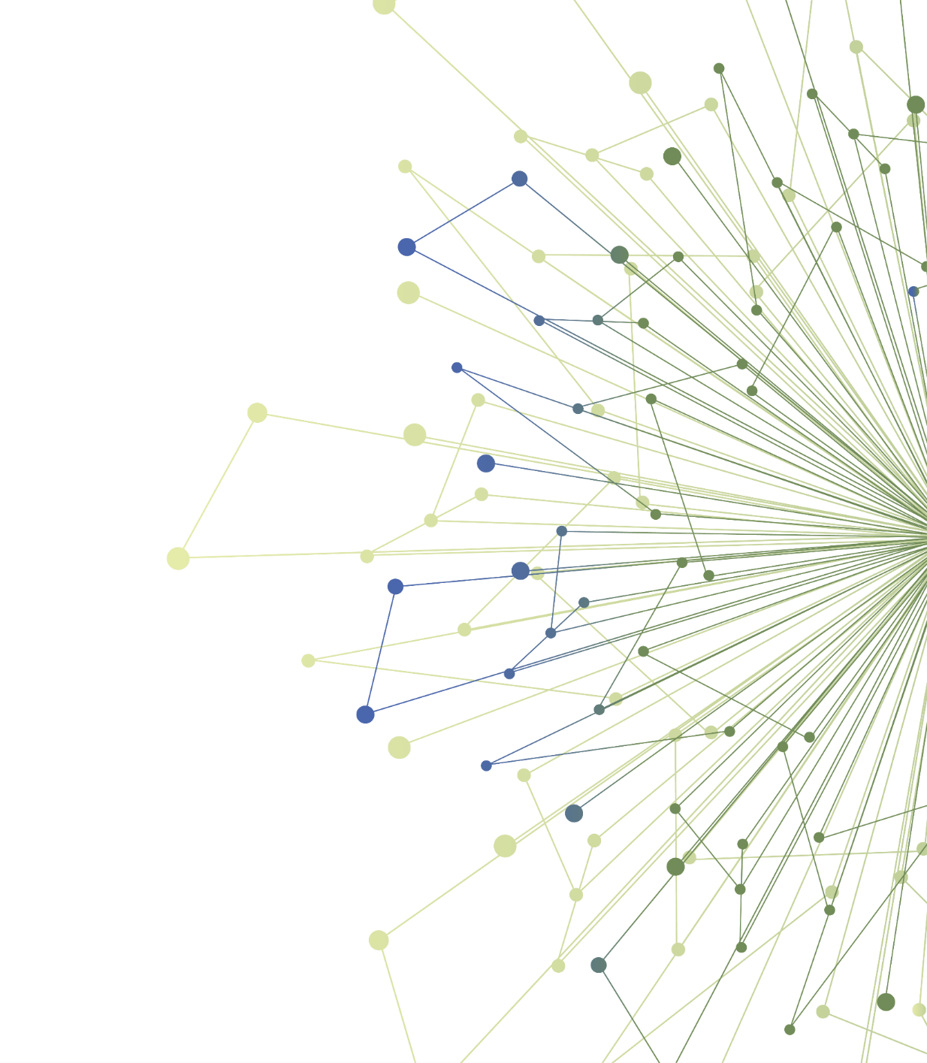

Thank You
ITHS is supported by the National Center For Advancing Translational Sciences of the National Institutes of Health under Award Number UL1 TR002319.
This project was supported by the National Center For Advancing Translational Sciences of the National Institutes of Health under Award Number TL1 TR002318.
The content is solely the responsibility of the authors and does not necessarily represent the official views of the National Institutes of Health.

