Slide 1
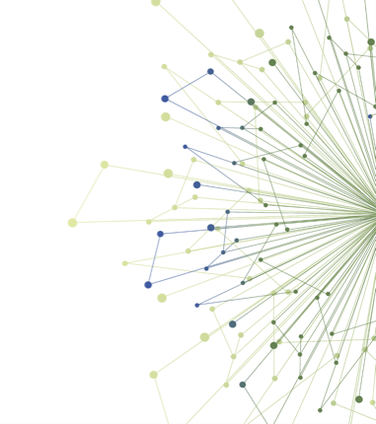
Mid-point D&I Check-in

Slide 2
Timeline
2 Day D&I Workshop (Oct 2020)
Introduction to D&I Experiential Opportunities (Dec 2020)
Mid-point check-in (Today – Jan 26, 2021)
Evaluation
Capstone Presentation (Feb 23, 2021)
Notes:
This slide reviews the experiential learning opportunity timeline, and where the mid-point check in is situated in that timeline.

Slide 3
Capstone Presentation
February 23, 2020
5 minutes per trainee
Capstone templates are located on Canvas under UCONJ 599
Send PowerPoint slides to Milu by Friday, February 19
Notes:
This slide reminds the Scholars that they have an upcoming capstone presentation, how long they have for their presentation, and where to find the template for their presentation.
We asked the Scholars to submit their presentations a couple of days in advance so we could put all presentations in a single slide show for efficiency on the day of the presentations.

Slide 4
Breakout Groups
Progress
Successes
Challenges
Notes:
This slide introduces the fact that each learning opportunity group was going into a breakout room (the check-in was virtual due to COVID), and each group member would discuss progress on their work, and the successes and challenges they have had.

Slide 5
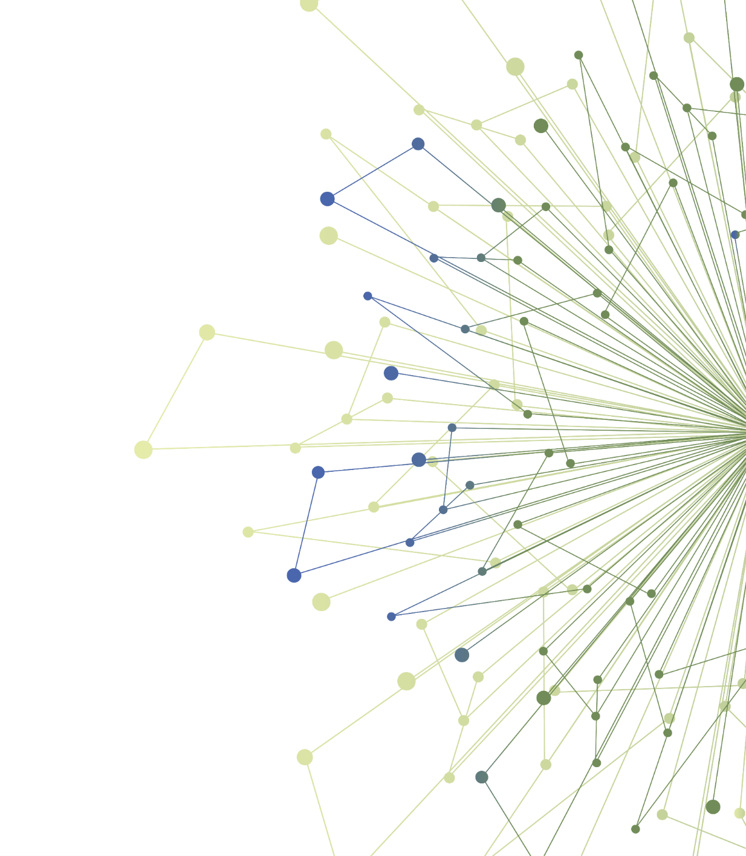
Thank You
ITHS is supported by the National Center For Advancing Translational Sciences of the National Institutes of Health under Award Number UL1 TR002319.
This project was supported by the National Center For Advancing Translational Sciences of the National Institutes of Health under Award Number TL1 TR002318.
The content is solely the responsibility of the authors and does not necessarily represent the official views of the National Institutes of Health.

