Slide 1
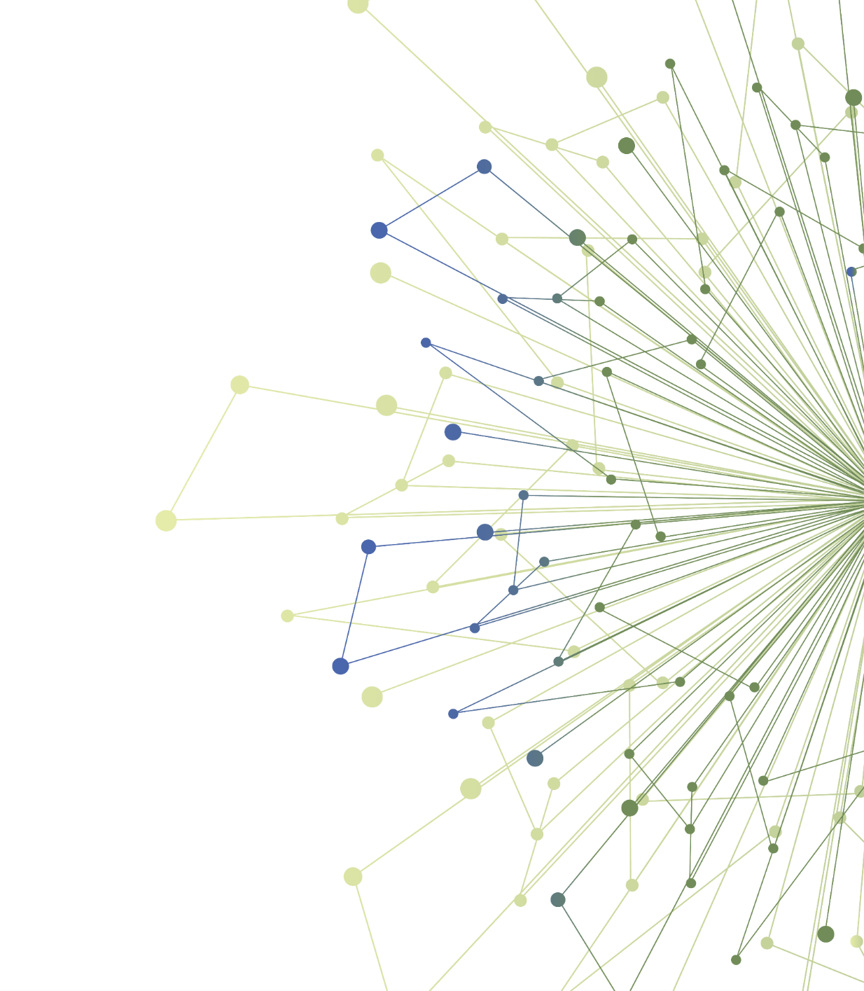
Dissemination and Implementation Science in Translational Research:
Launching your Experiential Learning Opportunity
Laura-Mae Baldwin, MD, MPH

Slide 2
Disclosures/Conflicts of Interest
I have nothing to disclose
I have no conflicts of interest

Slide 3
Schedule for Experiential Learning
Date | Timeline
Dec 1, 2020 | Orientation to your chosen experiential learning opportunity
Jan 26, 2021 | Mid-point Check-in: Shared learning session with others completing the same opportunity
Feb X, 2021 | 5-minute Capstone presentations of your work (slide template will be provided)
Notes:
On December 1, you will attend an orientation to your chosen experiential opportunity
You will have two months to complete it
At a February TL1 Seminar, you will give a Capstone presentation of your learnings to your peers

Slide 4
Apply D&I Science to Your Work
Three experiential opportunities:
Design a stakeholder assessment
Plan one step in implementing an intervention in clinical or community-based settings
Create a dissemination plan for your research product/s
Notes:
The three experiential opportunities are:
Design a Stakeholder assessment
Plan one component of intervention implementation
Create a dissemination plan for the TL1 trainee study findings

Slide 5
Apply D&I Science to Your Work
You received a notification about which of the three experiential learning opportunities you have been assigned.
You can find the materials for each of the experiential learning opportunities by going to TL1 Course Canvas Page

Slide 6
Assignments
Stakeholder | Implementing | Dissemination
Michael | Allison | Laura-Mae
You can find the materials for each of the experiential learning opportunities by going to TL1 Course Canvas Page
Notes:
This slide shows the assignments of the TL1 Scholars to the three learning opportunities

Slide 7
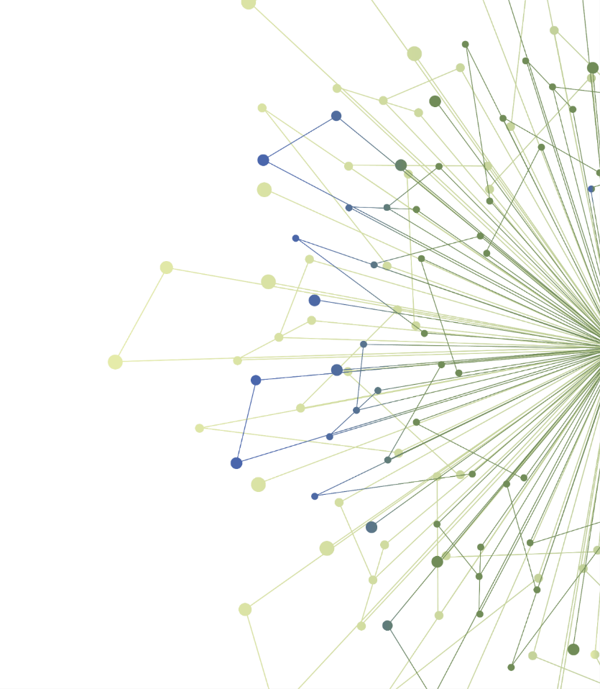
You will now be moved to your breakout room associated with the experiential opportunity you have been assigned.

Slide 8
Thank You
ITHS is supported by the National Center For Advancing Translational Sciences of the National Institutes of Health under Award Number UL1 TR002319.
This project was supported by the National Center For Advancing Translational Sciences of the National Institutes of Health under Award Number TL1 TR002318.
The content is solely the responsibility of the authors and does not necessarily represent the official views of the National Institutes of Health.

