Slide 1

FUNDAMENTALS OF CLINICAL RESEARCH

Slide 2

OBJECTIVES
Define roles & responsibilities of research team members
Describe tools used in study conduct
Explain key concepts in clinical research
Identify institutional resources for study implementation

Slide 3
Research Team
Investigators
Study Coordinator
Study Monitor
Hospital & Clinic Service Areas

Slide 4

Clinical Research Coordinator
Provides oversight & management for all aspects of research studies or trials

Slide 5
Clinical Research Coordinators
Ensure protocol requirements are met, study start up to close out
Study Management
Communication
Documentation
Implementation

Slide 6
Study Management
Track & document study milestones, deadlines & reporting timelines.
Identify, document, report & help correct areas that could compromise participant safety or data integrity.
Study participant management: identification, recruitment, consenting, enrollment and schedule management.
Facilitate data collection, per the objectives of the protocol.

Slide 7

Communication
Communicate study requirements, updates or changes to the study team.
This includes:
  Principal Investigator (PI)
  Sub Investigators
  Service areas that do study activity
  Study participants

Slide 8

Documentation
Document and report regular status updates to stakeholders
This could include:
  Sponsors
  Investigators
  Institutional Review Board (IRB)
Some information may need to be escalated or reported promptly, including safety events, protocol deviations, or participant concerns

Slide 9

Implementation
Collaborate with research support offices, systems, & members of the study team.
Initiate study start up, activation, implementation, & close-out of protocol activities.

Slide 10

Clinical Research Coordinators might also oversee or assist:
Regulatory submission & maintenance
Budget development
Billing compliance
Study contracts & agreements
Sample collection & shipping
Study close out & archival of records

Slide 11

Investigator
Responsibilities
Confirm Eligibility
Obtain Informed Consent
Assess Adverse Events
Adhere to protocol
Follow IRB directives
ULTIMATELY RESPONSIBLE FOR STUDY CONDUCT

Slide 12
INSTITUTIONAL RESOURCES

Slide 13

Research Ethics
1947: Nuremberg Code
The Nuremberg Military Tribunal’s decision in the case of the United States v Karl Brandt et al. includes what is now called The Nuremberg Code, a ten-point statement outlining what is permissible in medical experimentation on human subjects.
According to this statement, human experimentation is justified only if the results benefit society and if the study is carried out with basic principles that “satisfy moral, ethical, and legal concepts.”
1979: The Belmont Report
Written by the National Commission for the Protection of Human Subjects of Biomedical and Behavioral Research, The Belmont Report identifies basic ethical principles and guidelines that address ethical issues arising from the conduct of research with human subjects.
The Belmont Report describes the importance of the distinction and boundaries between standard medical practice and research.
1964: Declaration of Helsinki
Developed by the World Medical Association (WMA), The Declaration of Helsinki is a formal statement of ethical principles to guide the protection of human participants in medical research.
The Declaration of Helsinki was adopted in 1964 by the 18th WMA General Assembly, and has been revised several times, most recently in 2013.
These three documents provide guidance and inform our current ethical codes and research standards.
They aren't regulations or binding legal requirements.
Understanding of these documents and the historical events surrounding them will help you understand current regulations and legal requirements of human subjects' research.

Slide 14
TOOLS/DOCUMENTS
Protocol
Consent/Assent
Study Manuals
Investigator Brochure
1572
Case Report Form (CRF)
Source Documents
Delegation of Authority Log

Slide 15
Delegation of Authority Log
This documents delegation of certain tasks by the investigator.
The investigator agrees by delegating responsibility that they will maintain proper oversight of study conduct.
Delegation logs are not addressed in the regulations and are not a regulatory requirement.
Guidance supports creation and maintenance of delegation of authority logs as good practice
Notes:
FDA Guidance: The investigator should maintain a list of the appropriately qualified persons to whom significant trial-related duties have been delegated. This list should also describe the delegated tasks, identify the training that individuals have received that qualifies them to perform delegated tasks and identify the dates of involvement in the study.
ICH E6 Good Clinical Practice: The investigator should maintain a list of appropriately qualified persons to whom the investigator has delegated significant trial-related duties.

Slide 16
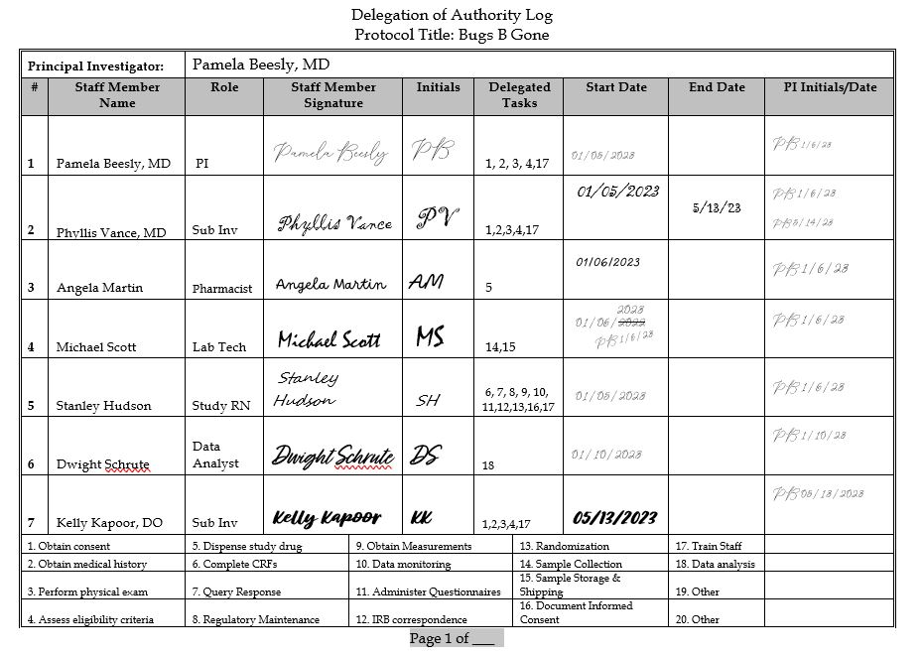
Notes:
Stay Consistent: Dr. Beesly goes by "Pam", yet her license says "Pamela". Be sure to stay consistent for names of all study staff across your regulatory documents, including CVs, 1572s, Financial Disclosures and Study Logs. PI as delegate: Even though Dr. Beesly is a PI, she should delegate responsibility to herself. This documents which study responsibilities she is assuming, and which she is delegating to other staff. For example, she is not delegated to perform sample collection, storage or shipping. Updates: Dr. Vance retired. Update your log in a timely manner as new personnel are added, personnel leave, and/or study roles change. Corrections: Dr. Beesly made a mistake here. That's OK! Direct her to line through the incorrect data, add the correction, initial and date the correction. Don't attempt to fix the "2" to make a "3" or make the correction for her. Adequate Coverage: Every task should have a delegate, with no gaps in coverage Drop Test: As with all study documents, if your study logs contain multiple pages, be sure they are labeled so that they could be identified and refiled if all your documents were dropped and scattered.

Slide 17
The Belmont Report
The underlying ethical framework for how research involving human subjects should be conducted.
Describes the ethical principles of Respect for Persons, Beneficence, and Justice as being essential for ethical research involving human subjects.

Slide 18

Respect for Persons
Individuals should be treated as autonomous agents.
Those with diminished autonomy are entitled to additional protection.
Rules derived from this principle require:
Individuals voluntarily consent to research.
Researchers to present all required elements of consent, allow participants opportunity to ask questions and have those questions answered to make a fully informed decision.
Research subjects’ privacy be respected.

Slide 19
Beneficence
Minimize harm and maximize benefits within the constraints of sound research design.
Rules derived from this principle require:
Procedures that increase benefits and decrease risks or harm.
Researchers able to oversee and perform research procedures and address risks.
The prohibition of research that is without a favorable risk-benefit relationship.

Slide 20
Justice
Requires us to treat people fairly and design research so that burdens and benefits are shared equitably.
Rules derived from this principle require:
Participants to be selected equitably.
No systematic exclusion of subjects who may benefit from the research.
Vulnerable populations or populations of convenience aren’t exploited.

Slide 21
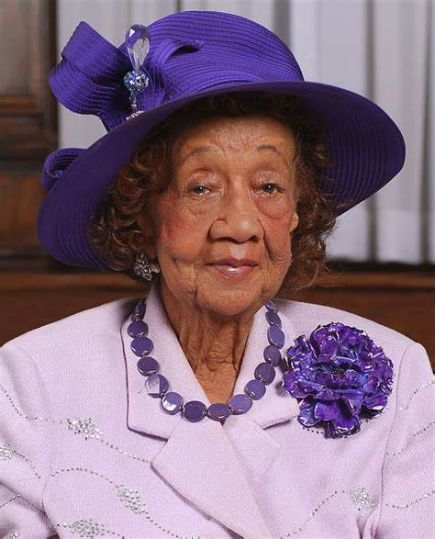
" One of the things that the Commission stressed was the importance of keeping the relationship between risks and benefits at a minimum, at some kind of a balance...it's full respect that each person has a right to determine whether she wants to take that risk."
Dorothy I. Height, Ph.D.
Member, National Commission for the Protection of Human Subjects of Biomedical and Behavioral Research & one of the Belmont authors

Slide 22
Further Study and Reading
"The Research Clinic"(opens in a new tab)
Interactive training video from Office of Research Integrity
Timeline of Laws Related to the Protection of Human Subjects
Nuremberg Code
Belmont Report
Declaration of Helsinki

Slide 23
HIPAA
The Health Insurance Portability and Accountability Act of 1996

Slide 24
HIPAA
The Office for Civil Rights manages the HIPAA privacy rule.
Protects confidentiality and security of personally identifiable information created and maintained when providing health care.
PHI within a covered entity, is called use of the information. Sharing PHI outside the covered entity is called disclosure.
HIPAA establishes the conditions which PHI may be used or disclosed by covered entities.

Slide 25
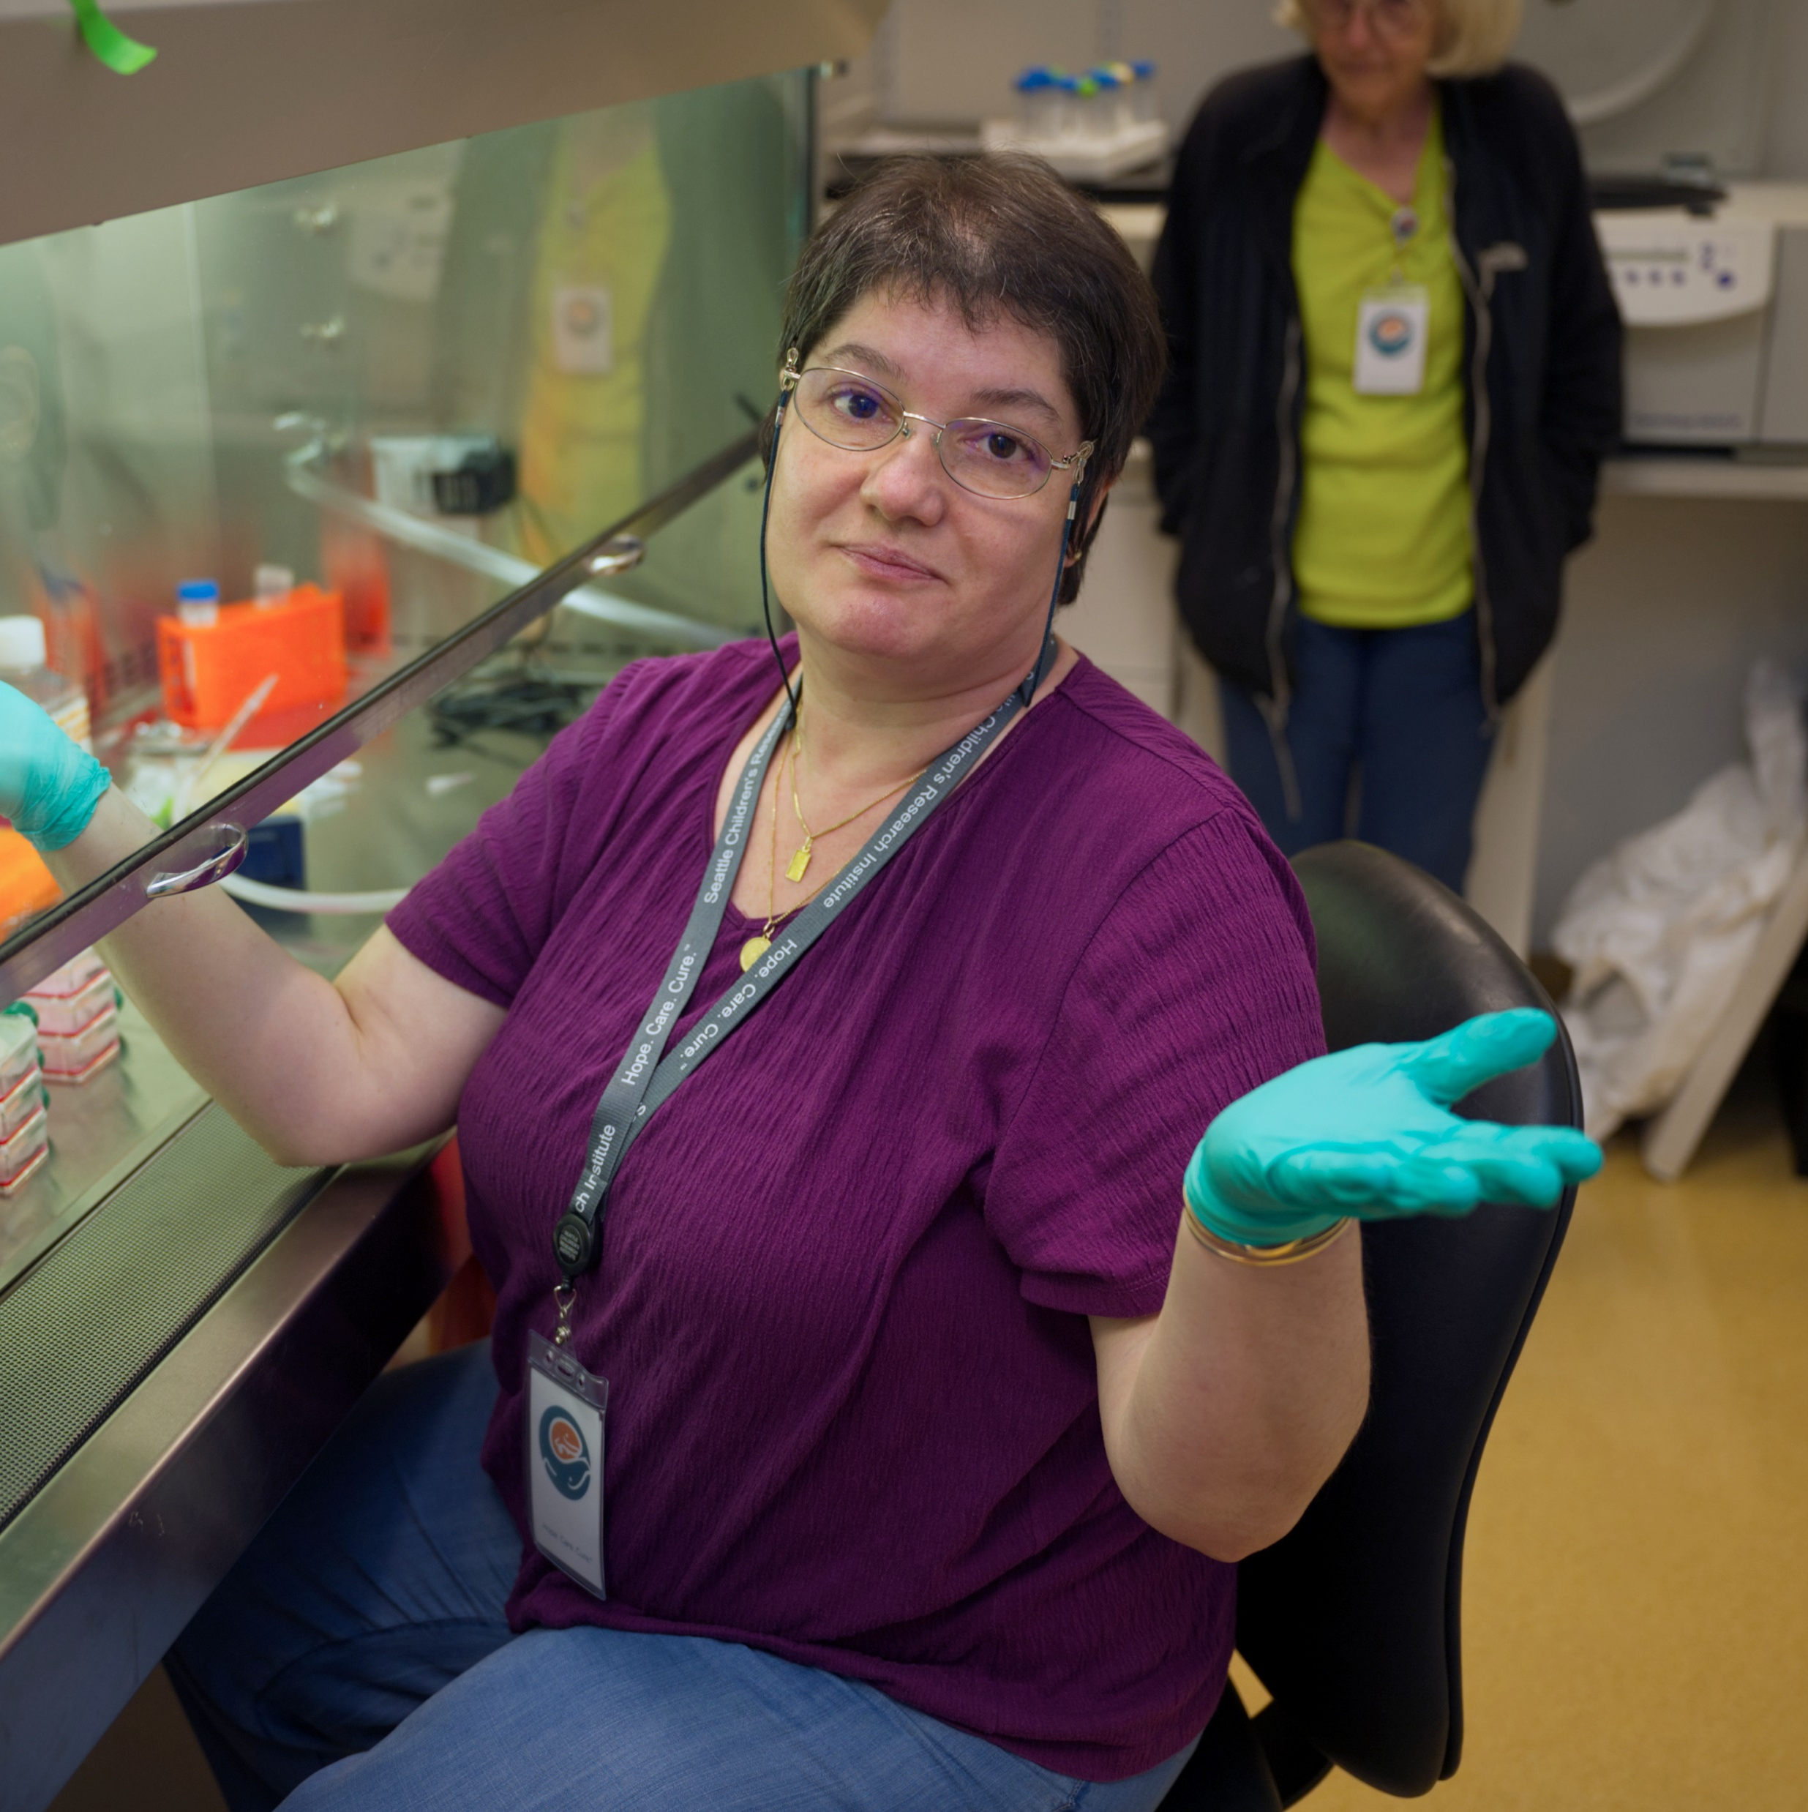
So What?
HIPAA keeps Protected Health Information (PHI) from being inappropriately disclosed, which can negatively affect insurability or employability.
HIPAA affects research activities, and it’s important to know a few terms that the law defines.

Slide 26

Privacy, Identity, and Confidentiality
Private
Privacy
Privacy is about people. It’s about the extent, timing, and circumstances under which they sharing information about themselves.
Identity
Identifiable
Information that allows someone to either ascertain or associate another person’s identity.
Confidentiality
Information
Confidentiality is about information intended to be kept private: how others handle, manage, and disseminate identifiable private information.

Slide 27
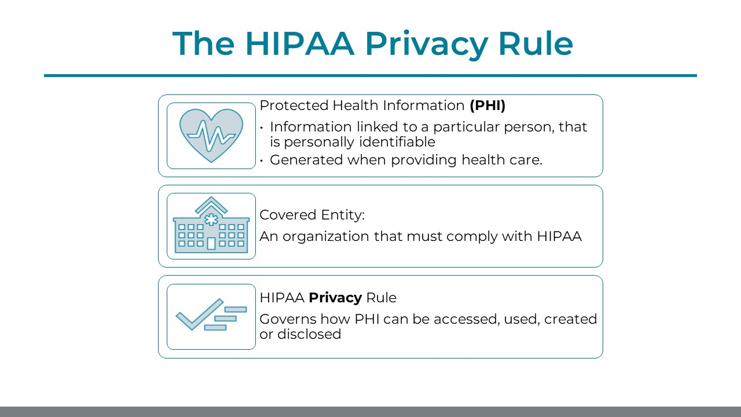

Slide 28
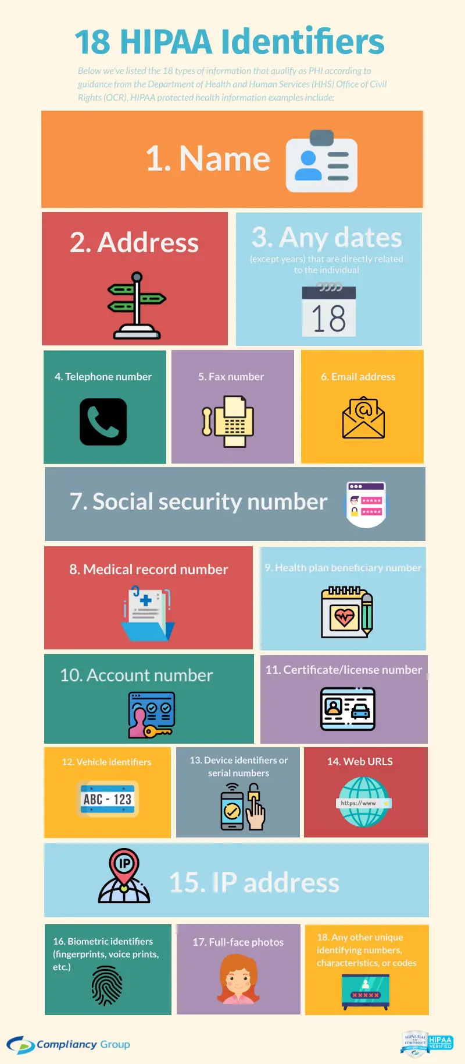
The Department of Health and Human Services (HHS) lists 18 HIPAA Identifiers
Notes:
The 18 Protected Health Information (PHI) Identifiers include:

Slide 29
HIPAA IDENTIFIERS
If you intend to create, access, use, OR disclose any of the 18 identifiers (PHI) it is covered by HIPAA privacy rules and regulations
If data or biospecimen contain or are labeled with any of the 18 HIPAA identifiers (even the date it was collected) then it can't be called "deidentified"
Access and use of PHI for research includes review of existing medical records and research that creates new medical information

Slide 30

HIPAA
Privacy Rule
Establishes the conditions under which protected health information may be used or disclosed by covered entities for research purposes
Protected Health Information (PHI) individually identifiable health information in any form, electronic or non-electronic, that is held or transmitted by a covered entity
Regulations that include protections to help ensure the privacy of subjects and the confidentiality of information

Slide 31
STUDY DOCUMENTATION
Demonstrates protocol and regulatory compliance
Allows for verification of study data
Supports continuity in study operations

Slide 32
Document in study records
Your recruitment efforts, including screen fails
Meetings & correspondence with PI
Conversations with study participants
Study team meetings, communication & correspondence
Training study staff
Sponsor and monitor correspondence
Proper study documentation is a gift to your future self.
Don't rely on your memory to explain something that happened, document your hard work!

Slide 33
To be considered verifiable source, documentation needs to meet standards referred to as
ALCOA-C
Attributable
Traceable to a person, date & visit
Contemporaneous
Recorded as it happened
Original
First place the data is recorded
Legible
Accurate
Honest, correct, and thorough
Complete
Clear enough to read
Correct and up to date
Notes:
Good documentation practice in clinical research
https://www.ncbi.nlm.nih.gov/pmc/articles/PMC3121265/
To make sure you're following these standards, your research team must have a working Delegation of Authority (DOA)
We’ve all encountered documents with text that's impossible to make out. Is that a 6 or an 8? Many research sites run into these compliance risks when managing handwritten regulatory and source documents.
ALCOA-C
CORRECTIONS
Study Logs

Slide 34
Additional Standards not covered in
ALCOA-C
Enduring: Durable and easy to access and read after they're created
Available: to study monitors and reviewers
Consistent: Documents demonstrate all required attributes consistently.
Credible: Data comes from reliable scientific observation.
Corroborated: Data is backed up by additional evidence.

Slide 35
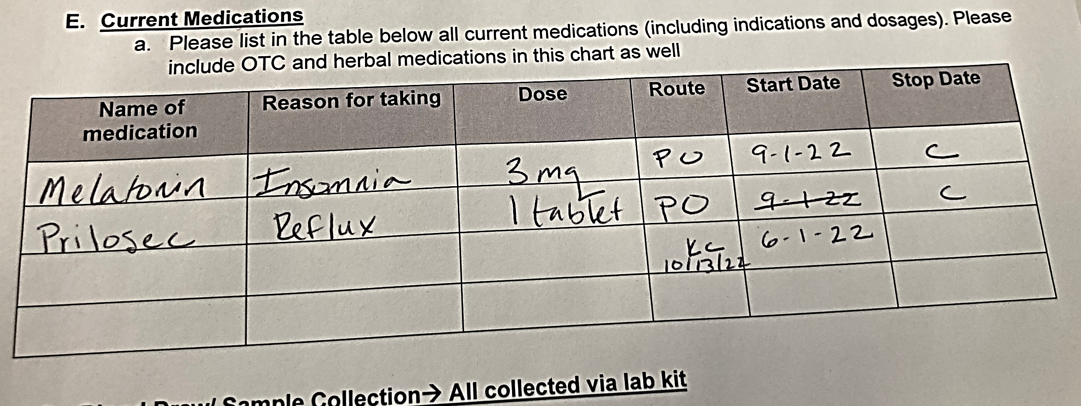


Data Corrections
MESSY IS OK!
WHITE-
OUT
WHAT was corrected
WHO made the correction
WHEN the correction was made
DON’T:
  Obscure, alter or erase original data
  Use pencil, white-out to record data
  Alter past dated documentation
  Alter records created by someone else
  “Back Date” data or records

Slide 36
Source(s) of Truth
PROTOCOL
STUDY MANUALS
Requires IRB approval
All changes must be reviewed and approved
Information not related to study implementation
Comprehensive overview
Do not require IRB approval
Provide detailed guidance for study operations
Can be specific to service areas
Usually limited to study implementation

Slide 37
DATA COLLECTION TOOLS
SOURCE DOCUMENTS
CASE REPORT FORMS
Subject specific records that support data collected
Where data first recorded
Must support ALCOA-C
Data collection tools developed by the study team or sponsor
Record information collected on each subject during a study

Slide 38
SUBJECT RECORDS
Medical Records
Research Records
Accessed through the electronic health record
May be accessed for research
Don’t typically provide verification for all research data points
All documents related to an individual’s study participation
Provide verification for each data point
Also called a “Shadow” Chart

Slide 39
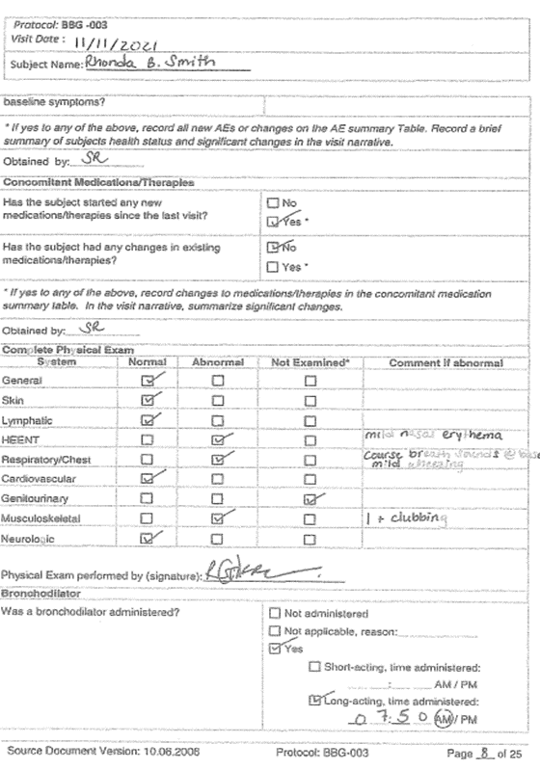
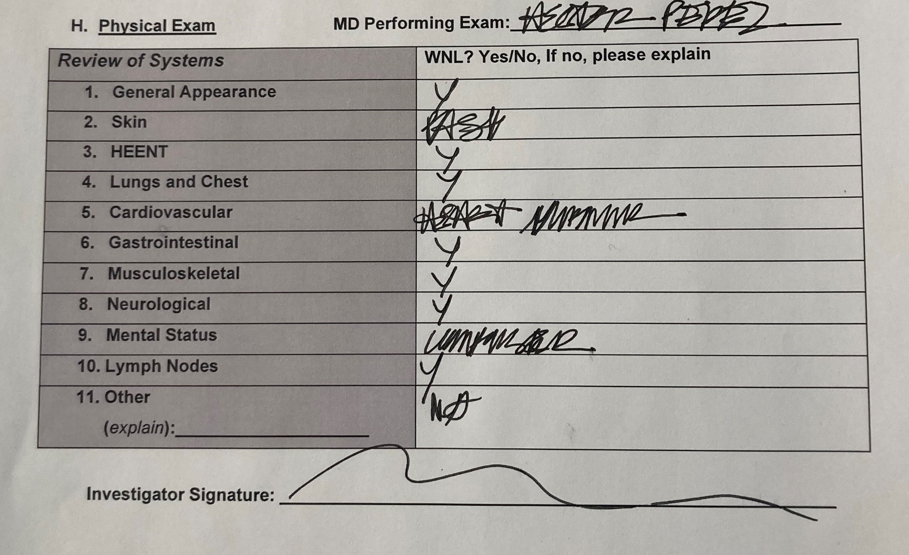
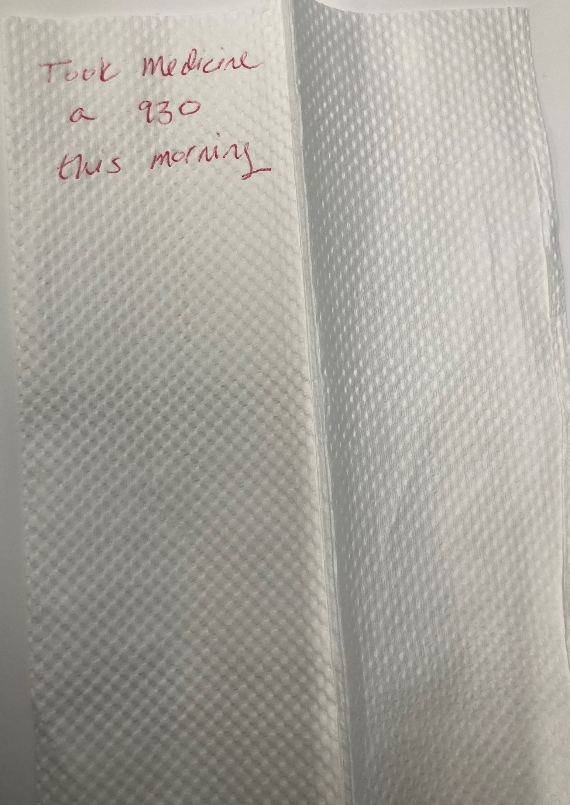
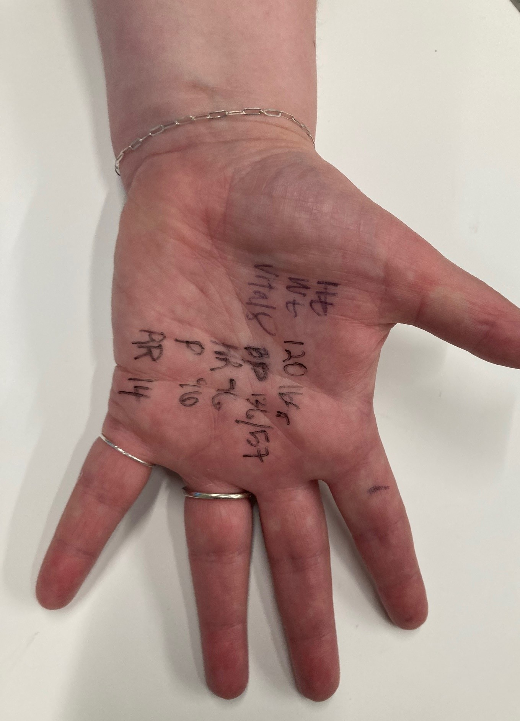
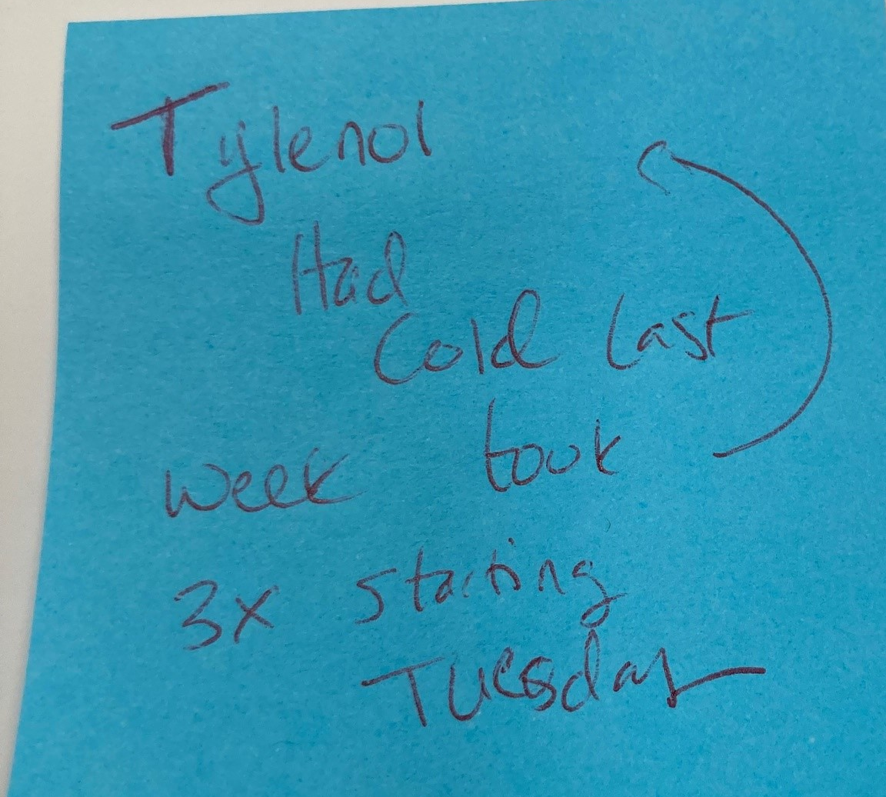
Examples
Meets ALCOA-C
Does NOT meet AlCOA-C

Slide 40

“If it isn’t documented,
it didn’t happen”

Slide 41

Informed Consent

Slide 42

Learning Objectives
Understand historical context
Review some best practices
Discuss challenges

Slide 43
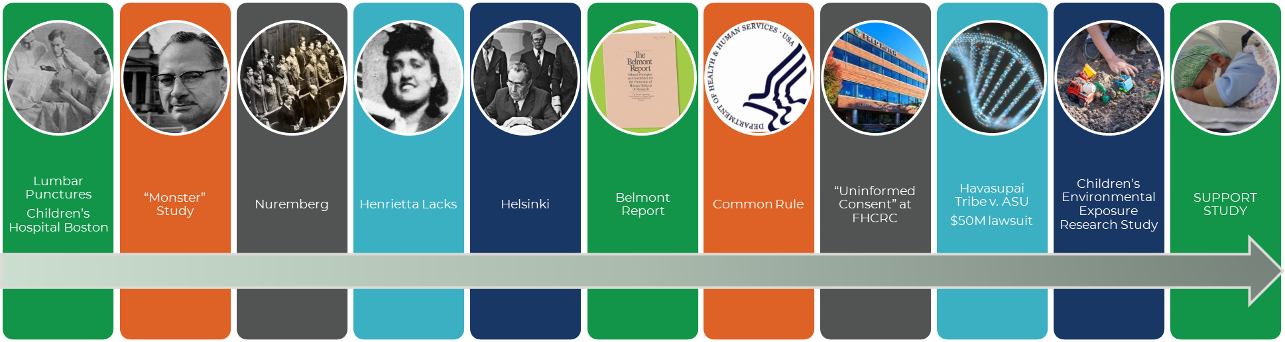
HISTORY
1896 1939 1947 1951 1964 1979 1991 2001 2004 2004 2012
1974 National Research Act
1956 Willowbrook 1971
1943 Radiation on institutionalized children 1973
1932 Tuskegee Syphilis Studies 1972

Slide 44
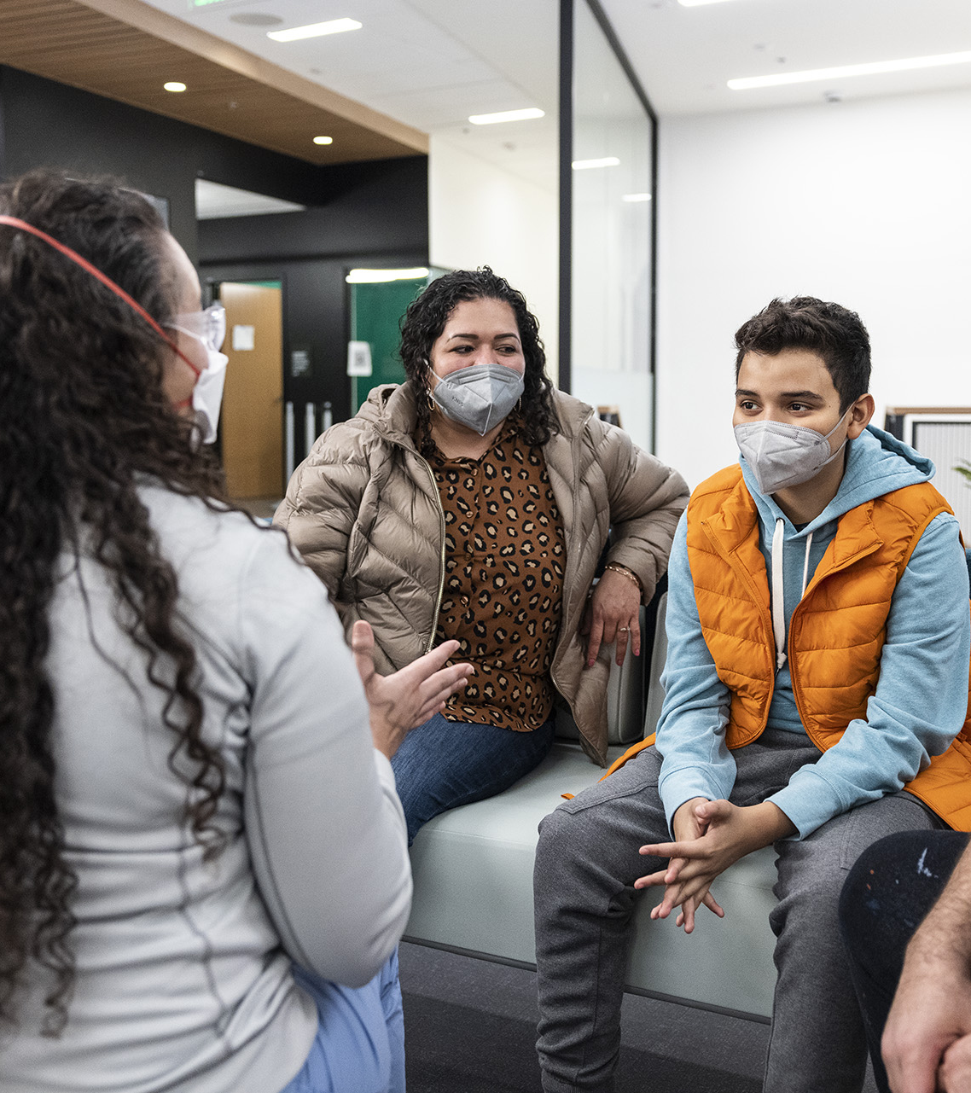
INFORMED CONSENT
Discloses Information
Facilitates Understanding
Promotes Voluntariness
Prospectively Obtained

Slide 45

WRITING CONSENT FORMS
Choose the correct templates
Simplify the language
Obtain sponsor approval before IRB submission
Notes:
Navigate to Click IRB

Slide 46

WRITE FOR YOUR AUDIENCE
TO READ
First person, active voice
One point per paragraph
Format for readability
Short sentences, vary lengths

Slide 47

Simplify Language
“Simplified language reaches past barriers with communication that respects the audience”
Notes:
There are two measurements, easily available in Microsoft Word, that you can use to see how easy it is to read a document.
They are a rough measurement with some limitations.
Consents = 8th grade
Assents= 3rd grade

Slide 48
Flesch-Kincaid: Reading Ease & Level
One part of your plain language tool kit
Doesn’t measure formatting
Good tool for the big picture
Notes:
There are two measurements, easily available in Microsoft Word, that you can use to see how easy it is to read a document.
They are a rough measurement with some limitations.
Consents = 8th grade
Assents= 3rd grade

Slide 49
Flesch-Kincaid: Reading Ease & Level
Reading ease levels:
90 –100 = Very easy
80 – 89 = Easy
70 – 79 = Fairly easy
60 – 69 = Standard
50 – 59 = Fairly difficult
30 – 49 = Difficult
0 – 29 = Very confusing
Reading Level:
American school grade levels
Average American adult reads at 7th to 9th grade
Uses length of sentences & words to measure readability

Slide 50

Plain Language
Easily understood
Engaging
Clear
Notes:
keep content on point and remove
extraneous details.

Slide 51
Medical Interpreters
Provide Ample Time
Set The Stage
Optimize Your Speech
Notes:
Prior to the interaction, take time to brief the Interpreter
Allow extra time for dialogue
Introduce everyone to one another
Position yourself to look at and speak directly to the patient and family
Speak in short sentences, pause frequently
Avoid idioms, acronyms, jargon, humor
Document use of an Interpreter

Slide 52
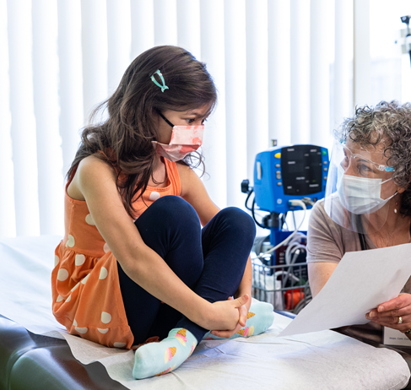
ASSENT
Address issues of interest to the child
Stay age appropriate
Be clear about where the child has choices
Notes:
Active affirmative agreement to participate in research
Requirement may be waived only if the IRB determines that either:
Subject not capable of providing assent (age, maturity, physical state) or
Intervention or procedure holds out prospect of direct benefit that is important to child’s health and welfare and is available only within the context of research

Slide 53

DISSENT
Respect physical & verbal dissent
Watch for cues that could indicate future noncompliance
Escalate concerns to your PI
Waiving assent does not imply that dissent can be ignored
Notes:
Real life stories
I don’t want to do this stupid study
Patient who eloped
“I don’t like water”

Slide 54

BEFORE YOU CONSENT
Submit all patient-facing material for IRB review
Review approved consent documents
Ensure all study staff are trained & delegated
Document training & delegation on study logs
Notes:
Once you receive IRB approval, take time to review your study documents to familiarize yourself. Be sure you are able to easily access your approved study documents by accessing them from your approval source (IRB website)
Training of your study staff includes human subject’s protection training, and training on your protocol and other study documents, including study consent forms. All study staff obtaining consent forms should review the forms for their understanding and to ensure complete consent documentation. Only documents with an IRB approval stamp should be used for study purposes- including consents, surveys & questionnaires.

Slide 55

CONSENT PROCESS
Prepare in advance
Know your role
Protect the process
IF IT ISN’T DOCUMENTED,
IT DIDN’T HAPPEN

Slide 56
Resources & Links
Program for Readability In Science & Medicine (PRISM)
Declaration of Helsinki
Belmont Report
NIH Clear Communication

Slide 57
The Stuttering Doctor's 'Monster Study' - The New York Times (nytimes.com)
Fred Hutch- Uninformed Consent: Seattle Times
Wright v. Fred Hutchinson Cancer Center: Maintaining Patient and Public Trust in Clinical Research | Journal of Ethics | American Medical Association (ama-assn.org)
Havasupai Tribe v. ASU
Indian Tribe Wins Fight to Limit Research of Its DNA - NYTimes.com
Genetic Research among the Havasupai: A Cautionary Tale | Journal of Ethics | American Medical Association (ama-assn.org)
Havasupai Case Highlights Risks in DNA Research - The New York Times (nytimes.com)
Indian Tribe Wins Fight to Limit Research of Its DNA - The New York Times (nytimes.com)
Lessons Learned From the Children’s Environmental Exposure Research Study | AJPH | Vol. 97 Issue 3 (aphapublications.org)
Lessons from the controversy over the SUPPORT study - PMC (nih.gov)
March 7, 2013 - University of Alabama, Birmingham (hhs.gov)
Enduring and Emerging Challenges of Informed Consent | NEJM
Recommended Reading

Slide 58

Regulatory

Slide 59

Learning Objectives
Define human subjects’ research
Identify roles & responsibilities in the protection of human subjects
Describe regulatory submission process & maintenance practices

Slide 60


Institutional Review Board
Protects the rights & welfare
of the participants who participate in research conducted at ______ and affiliated research organizations.
What is an IRB?
Notes:
Active affirmative agreement to participate in research

Slide 61

RESEARCH
SYSTEMATIC INVESTIGATION
DESIGNED TO CONTRIUBUTE TO GENERALIZABLE KNOWLEDGE
HUMAN SUBJECTS
LIVING INDIVIDUAL(S) ABOUT WHOM AN INVESTIGATOR CONDUCTS RESEARCH
IRB REVIEW REQUIRED

Slide 62


RESEARCH
Involves a test article and one or more human subjects, AND either must meet the requirements for prior submission to the FDA, or the results of which are intended to be later submitted to the FDA as part of an application
HUMAN SUBJECT
An individual who is or becomes a participant in research, either as a recipient of the test article or as a control
IRB REVIEW REQUIRED

Slide 63



Regulatory Agencies
IRB APPLIES APPROPRIATE DEFINITION & REGULATIONS

Slide 64
Roles & Responsibilities
INSTITUTIONAL COMMITTEES
IRB
STATE GOVERNMENT
STUDY SPONSORS
FDA
HIPAA/ OCR
OHRP
Study Participants
RESEARCH COMPLIANCE
STUDY TEAM
PI

Slide 65
Regulatory Resources

Slide 66

REGULATORY FILES
Also called essential documents or investigator site file (ISF)
Demonstrates compliance with regulatory requirements
Find essential document checklists on ITHS website
Documents which individually and collectively permit evaluation of the conduct of the clinical trial and the quality of the data produced
Notes:
Demonstrates compliance with regulatory requirements.
The CLICK IRB portal, your email, or your personal folders aren't regulatory files.
Well maintained regulatory files help the study team stay organized, identify approved documents, and support continuity in cases of turnover.
Must be accessible to study monitors

Slide 67
Regulatory Submission
Notes:
Add institutional specific process

Slide 68

Following IRB Approval
REVIEW APPROVAL DOCUMENTS
LABEL, ORGANIZE & FILE
ONLY USE APPROVED DOCUMENTS
Notes:
Keep version control of documents.

Slide 69
Post Approval
ORGANIZATION
DOCUMENTATION
COMMUNICATION

Slide 70
Modifications
TRAIN STUDY STAFF
UPDATE CLINICAL SERVICES
USE CURRENT DOCUMENTS

Slide 71

Reporting Information
Have a Plan
Complete
Timely
Make sure you know the reporting requirements for your study !

Slide 72
Study Closure
CONFIRM STUDY IS READY TO CLOSE
FOLLOW REVIEWING IRB PROCESS
ARCHIVE STUDY DOCUMENTS
Notes:
Study Closure Checklist

Slide 73

Implementation

Slide 74

OBJECTIVES
IDENTIFY STUDY DESIGN
SUPPORT DATA COLLECTION
ASSESS S RESOURCE REQUIREMENTS
IMPLEMENT STUDY REQUIRMENTS THROUGH PROTCOL LIFECYCLE

Slide 75
TYPES OF TRIALS
INTERVENTIONAL
RETROSPECTIVE
OBSERVATIONAL

Slide 76

Pre-Start Up
Agreements
Resources
Feasibility
Site Qualification
Scientific Success

Slide 77
Start Up Overview
Notes:
Add institutional specific steps

Slide 78
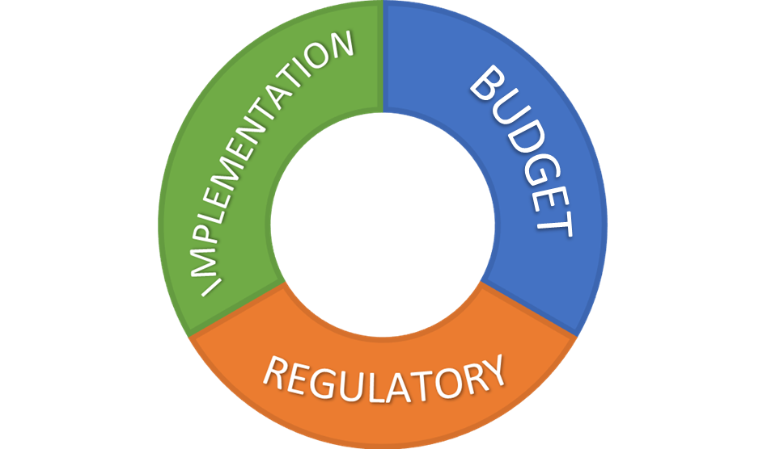
Ask your PI:
Implementation
What resources will you need (supplies, services, staff, storage)
Do you have the support of the division
What is the burden of participation for our participants
Budget
What is your funding source
Is there adequate funding to cover what we’ve identified above
Regulatory
What IRB are we using
Who are they study team members
Are they appropriately trained and delegated

Slide 79
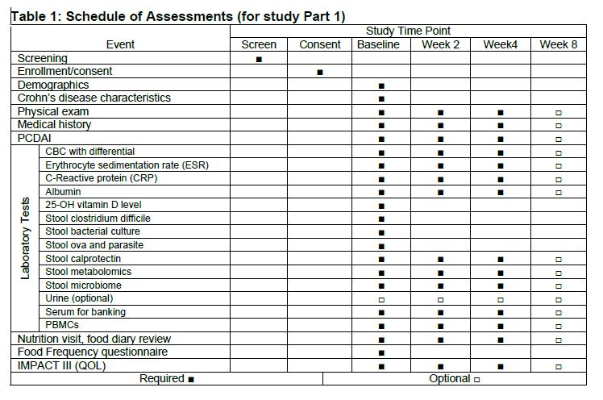
RESOURCE REQUIRMENTS

Slide 80

IDENTIFY AND TRAIN STUDY TEAM
WHY
WHO
WHAT
WHEN
WHERE
HOW

Slide 81

Develop Your Tools
STUDY OBJECTIVES
CASE REPORT FORMS
VISIT CHECKLISTS
STUDY LOGS
DATABASE
STUDY MANUALS

Slide 82
REFINE YOUR PROCESS
PLAN
DO
CHECK
ACT
MEET WITH PI REGULARLY
IDENTIFY AND REPORT ISSUES
TRAIN STAFF IN CHANGES
UPDATE LOGS & STUDY FILES
IF IT ISN’T DOCUMENTED, IT DIDN’T HAPPEN

Slide 83

Budgets and Agreements

Slide 84
Budget & Agreement Resources

Slide 85
Budget & Agreement Process

Slide 86

RESOURCES
Add Institutional Specific Resources

Slide 87


HELP
Notes:
Add institutional specific escalation pathways here

