Slide 1
LPM Part 2
Creating the Plan

Slide 2
What is the Process to Reach your Objectives?
Considerations:
Data collection
Piloting
Identify problems + root cause
Establish consistent process
Develop solutions & materials

Slide 3
Tools
Flowcharting
Brainstorming
Contribute
Clarify
Evaluate
Notes:
Facilitation: As a large group
Getting to class on time example

Slide 4
Team Exercise
Flow Project Steps – Project Charter Section I
Create a flow chart for your project
Notes:
Facilitator
Time 10 mins
Assist with writing on post its.
Steps:
Starting point
Ending point
Brainstorm steps that occur between two points
Clarify steps
Evaluate or remove duplicates
Put in order

Slide 5
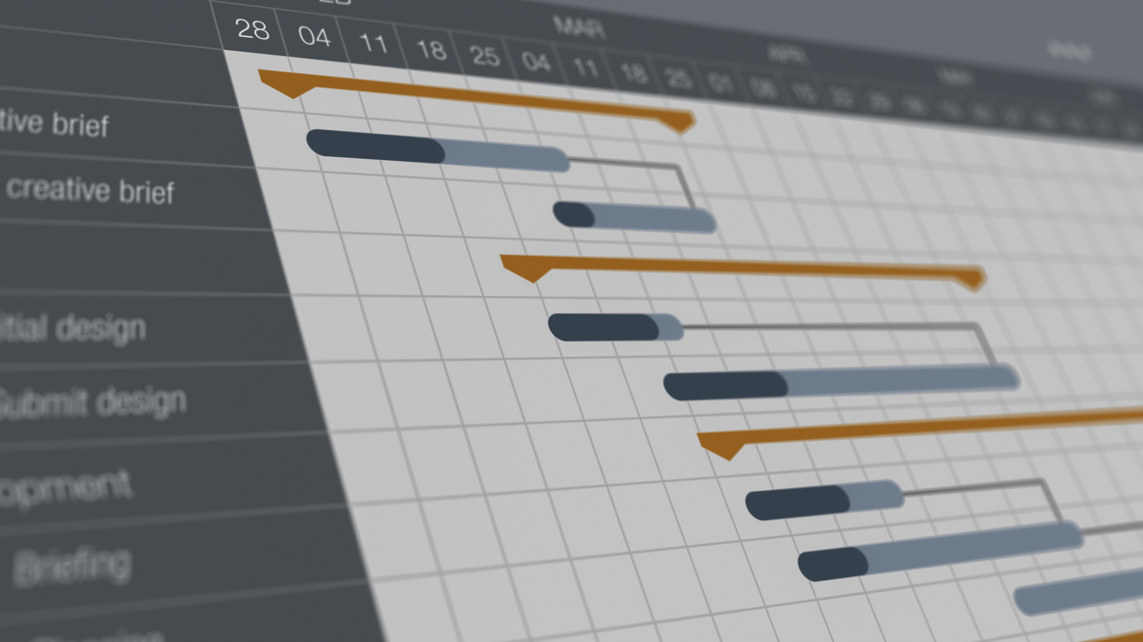
Work Plan
Project Charter Section I
Project duration pashed to 3 months
Milestones listed by month(s)
Phases (if not milestones) should provide indication of success

Slide 6
Exercise – Map it Out
Map it Out
Break it Down
Develop milestones
List tasks
Determine start/end date(s)
Find predecessors
Identify primary person for each
Select 1 of the projects & develop the groups of work that will need to be done to accomplish your project
Notes:
Use Affinity Diagram:
Brainstorm steps or activities that need to be accomplished for this projects
Using Affinity diagram, group those tasks that are related to a similar end
Then plot the beginning, duration end date and responsible party for the task on the template provided.
See next slide and sample template
Select 1 of the projects & develop the groups of work that will need to be done to accomplish the project
Map It Out:
Work Breakdown Structure- Develop milestones to ensure the project is done on time.
Project Plan:
Open the Project Plan to enter the milestones & tasks from the work breakdown structure. For each task add the primary person responsible for completion of the task (resource), start date, duration & predecessors (tasks that must be completed prior to beginning this task).

Slide 7
Team Exercise
Milestones
Complete Section I of Charter
Notes:
Facilitators
Reference prior flowchart that team created
Are there additional steps or larger bodies of work that need to be taken- brainstorm
Use Affinity Diagram:
Brainstorm steps or activities that need to be accomplished for this projects
Using Affinity diagram, group those tasks that are related to a similar end
Then plot the beginning, duration end date and responsible party for the task on the template provided.
See next slide and sample template

Slide 8
Communication Plan
Components:
Purpose
Message
Audience
Frequency
Modality
Creator
Distributor
Notes:
Handouts: black form & example

Slide 9
Team Exercise - Risks
Complete Charter Section J
Determine your greatest risks
Identify how you will address those risks
Notes:
Facilitators
10 mins
Can you force field analysis or simply brainstorm
Facilitators capture notes on flipchart

