Slide 1
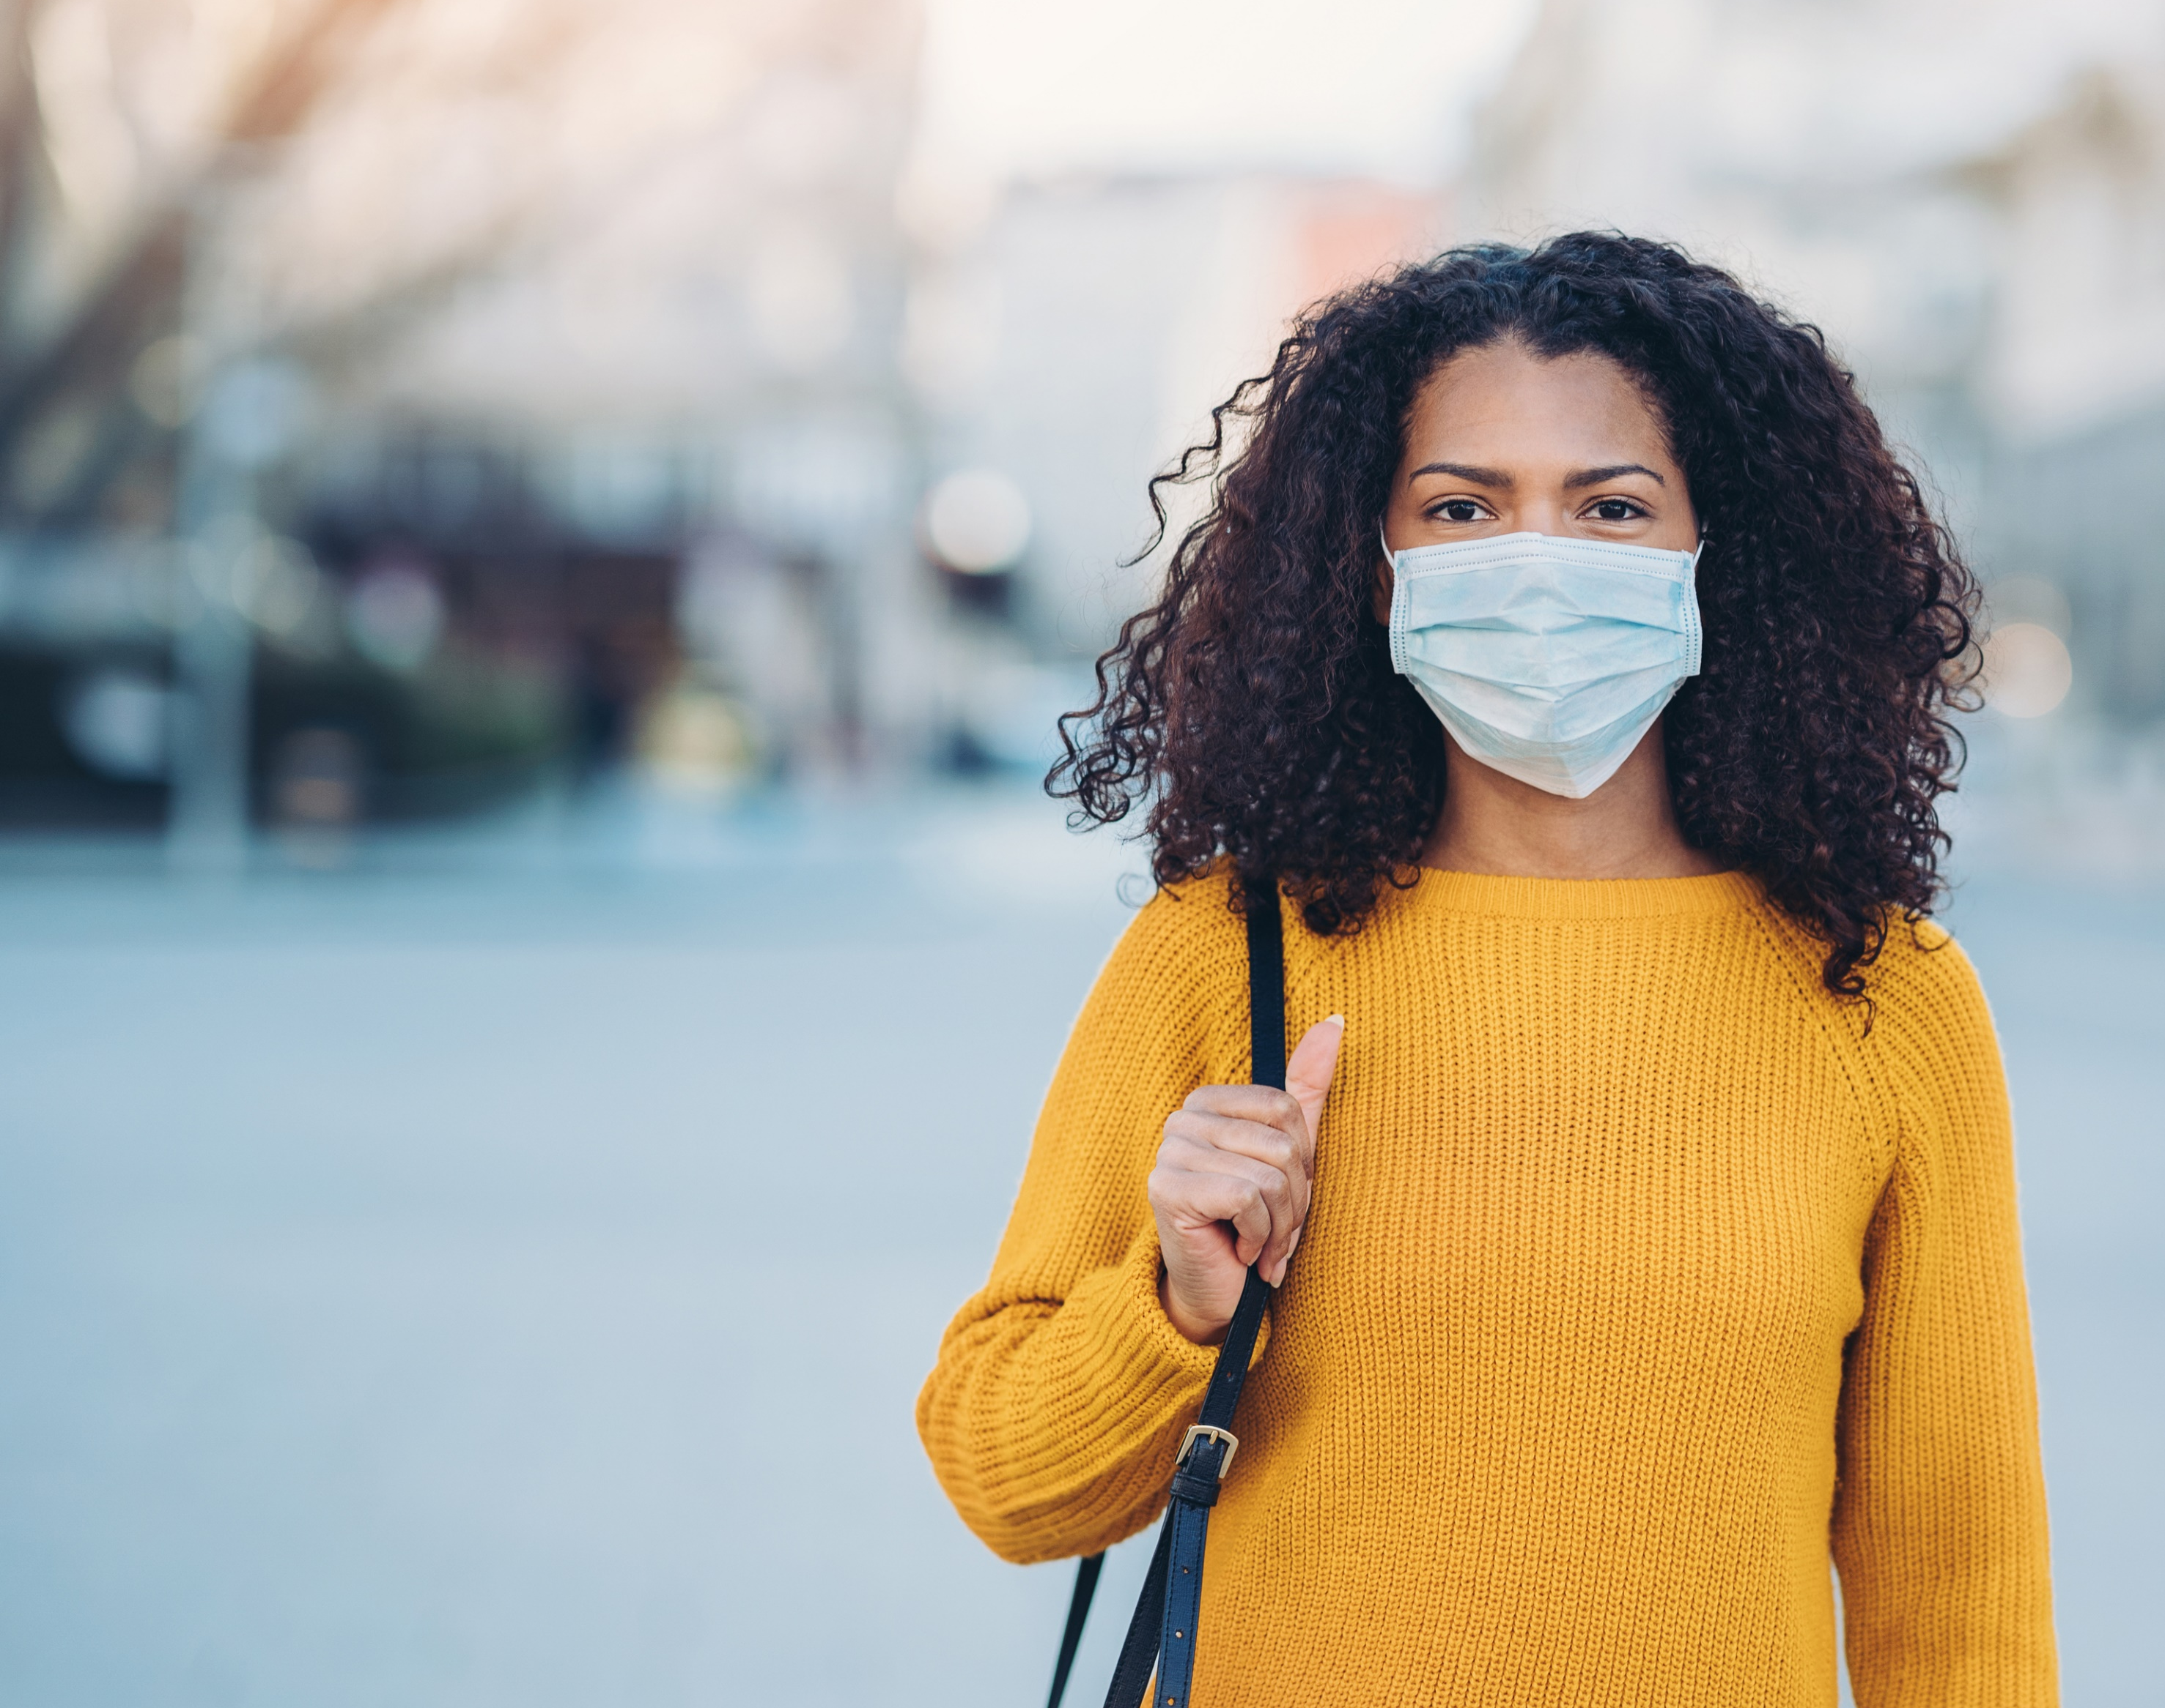
Careers in
Public Health Research

Slide 2

Objectives
Define Public Health Research
Understand Different Roles in Public Health Research
Describe Opportunities in Public Health Research
Outline the Career Outlook in the field of Public Health Research

Slide 3
What is
Public Health Research?

Slide 4
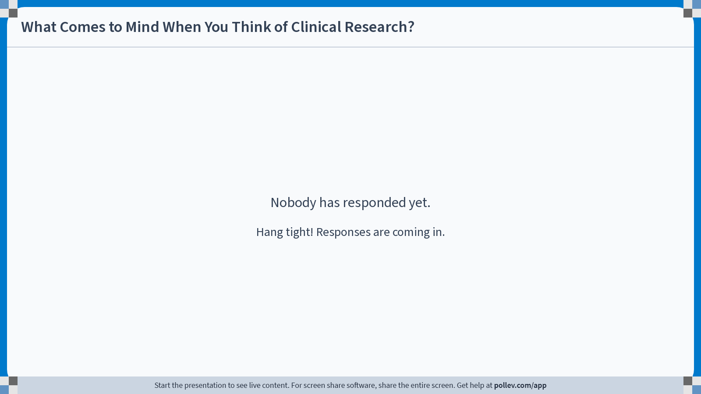
Notes:
Poll Title: Do not modify the notes in this section to avoid tampering with the Poll Everywhere activity.
More info at polleverywhere.com/support
What Comes to Mind When You Think of Clinical Research?
https://www.polleverywhere.com/free_text_polls/weFVa3e7xZvkdebQFD8Gp

Slide 5




Public Health Research
Engages Communities, Patients & Families
Equal Partners
Decision Makers​
Beneficiaries​
Learn More about Conditions Important to Communities ​
Notes:
Public health research uses community-engaged research processes to investigate the world’s biggest health problems, such as infant and child mortality, quality nutrition, infectious diseases like COVID, and rural access to health care. Public health research starts with partnerships with communities experiencing health issues to understand the factors that impact their health and collaboratively develop solutions to those problems.

Slide 6
Field of
Public Health Research
Outlook & Roles

Slide 7





OUTLOOK
Demand
Growth
Opportunities
Accessible
Notes:
As a research professional, you will have the opportunity to make a difference, gain valuable experience in the field of science and public health and advance your own career.
Public Health Research is a field with high demand and opportunity and is accessible to people with a wide range of skills, backgrounds and education.

Slide 8

Roles in Public Health Research
Investigators
Research Coordinators
Community health workers
Research Scientists
Public Health Research studies need a team of people to run successfully!
Notes:
Investigators: These are scientists and doctors who provide oversight for the research study. They have special expertise in the health issues and conditions that are being researched.
Research Coordinators: Manage the details of running a public health study, including scheduling participants and collecting data.
Community Health Workers: Connect directly with communities in the field, organizing study activities, and conducting study procedures
Research Scientists: Test and develop ideas and products in a laboratory setting.

Slide 9
Roles in Public Health Research
Investigators
Research Coordinators
Community health workers
Research Scientists
Public Health Research studies need a team of people to run successfully!
Notes:
Investigators: These are scientists and doctors who provide oversight for the research study. They have special expertise in the health issues and conditions that are being researched.
Research Coordinators: Manage the details of running a public health study, including scheduling participants and collecting data.
Community Health Workers: Connect directly with communities in the field, organizing study activities, and conducting study procedures
Research Scientists: Test and develop ideas and products in a laboratory setting.

Slide 10

Investigator Responsibilities
Confirm Eligibility
Obtain Consent
Assess Study Impacts
Adhere to Study Plan
ULTIMATELY RESPONSIBLE
FOR STUDY CONDUCT

Slide 11

Research Coordinator
…supports, facilitates and coordinates the daily research activities and plays a critical role in the conduct of the study…”​

Slide 12
Research Coordinator
…supports, facilitates and coordinates the daily research activities and plays a critical role in the conduct of the study…”​

Slide 13
Communicate Requirements
Track, document & report status updates
Collaborate on Study Activities
Participant
Management
Data Collection
STUDY MANAGEMENT

Slide 14


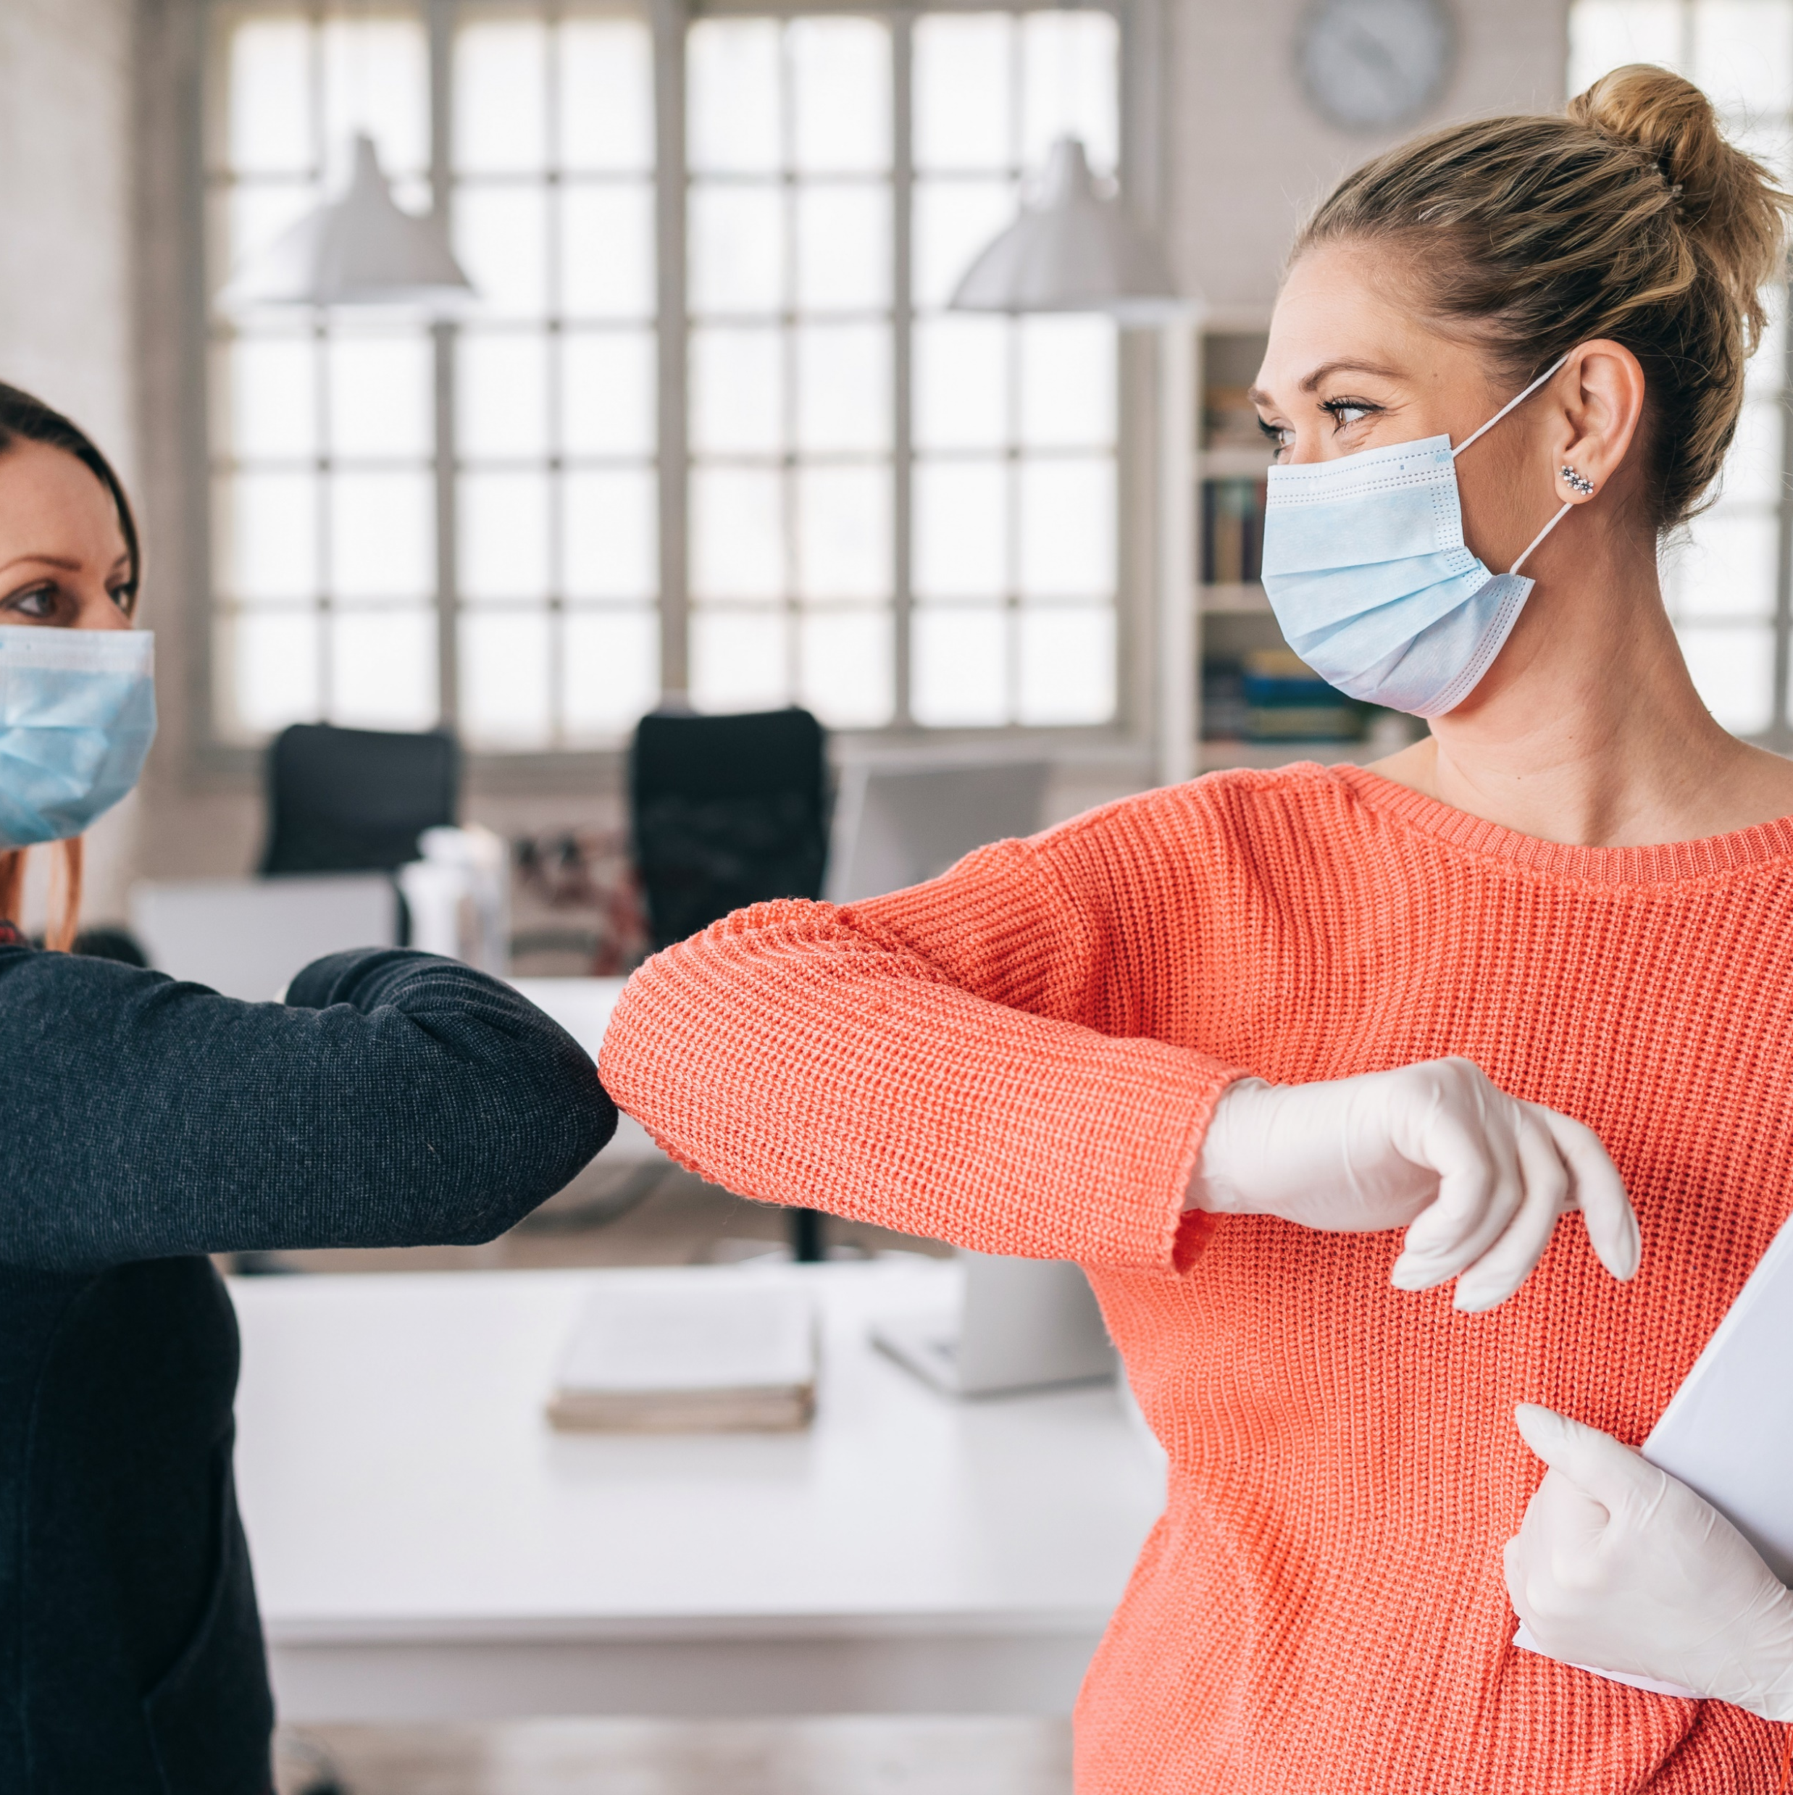

Daily activities vary depending on several things, including the type and complexity of the research study, community infrastructure, and experience level of the research team

Slide 15
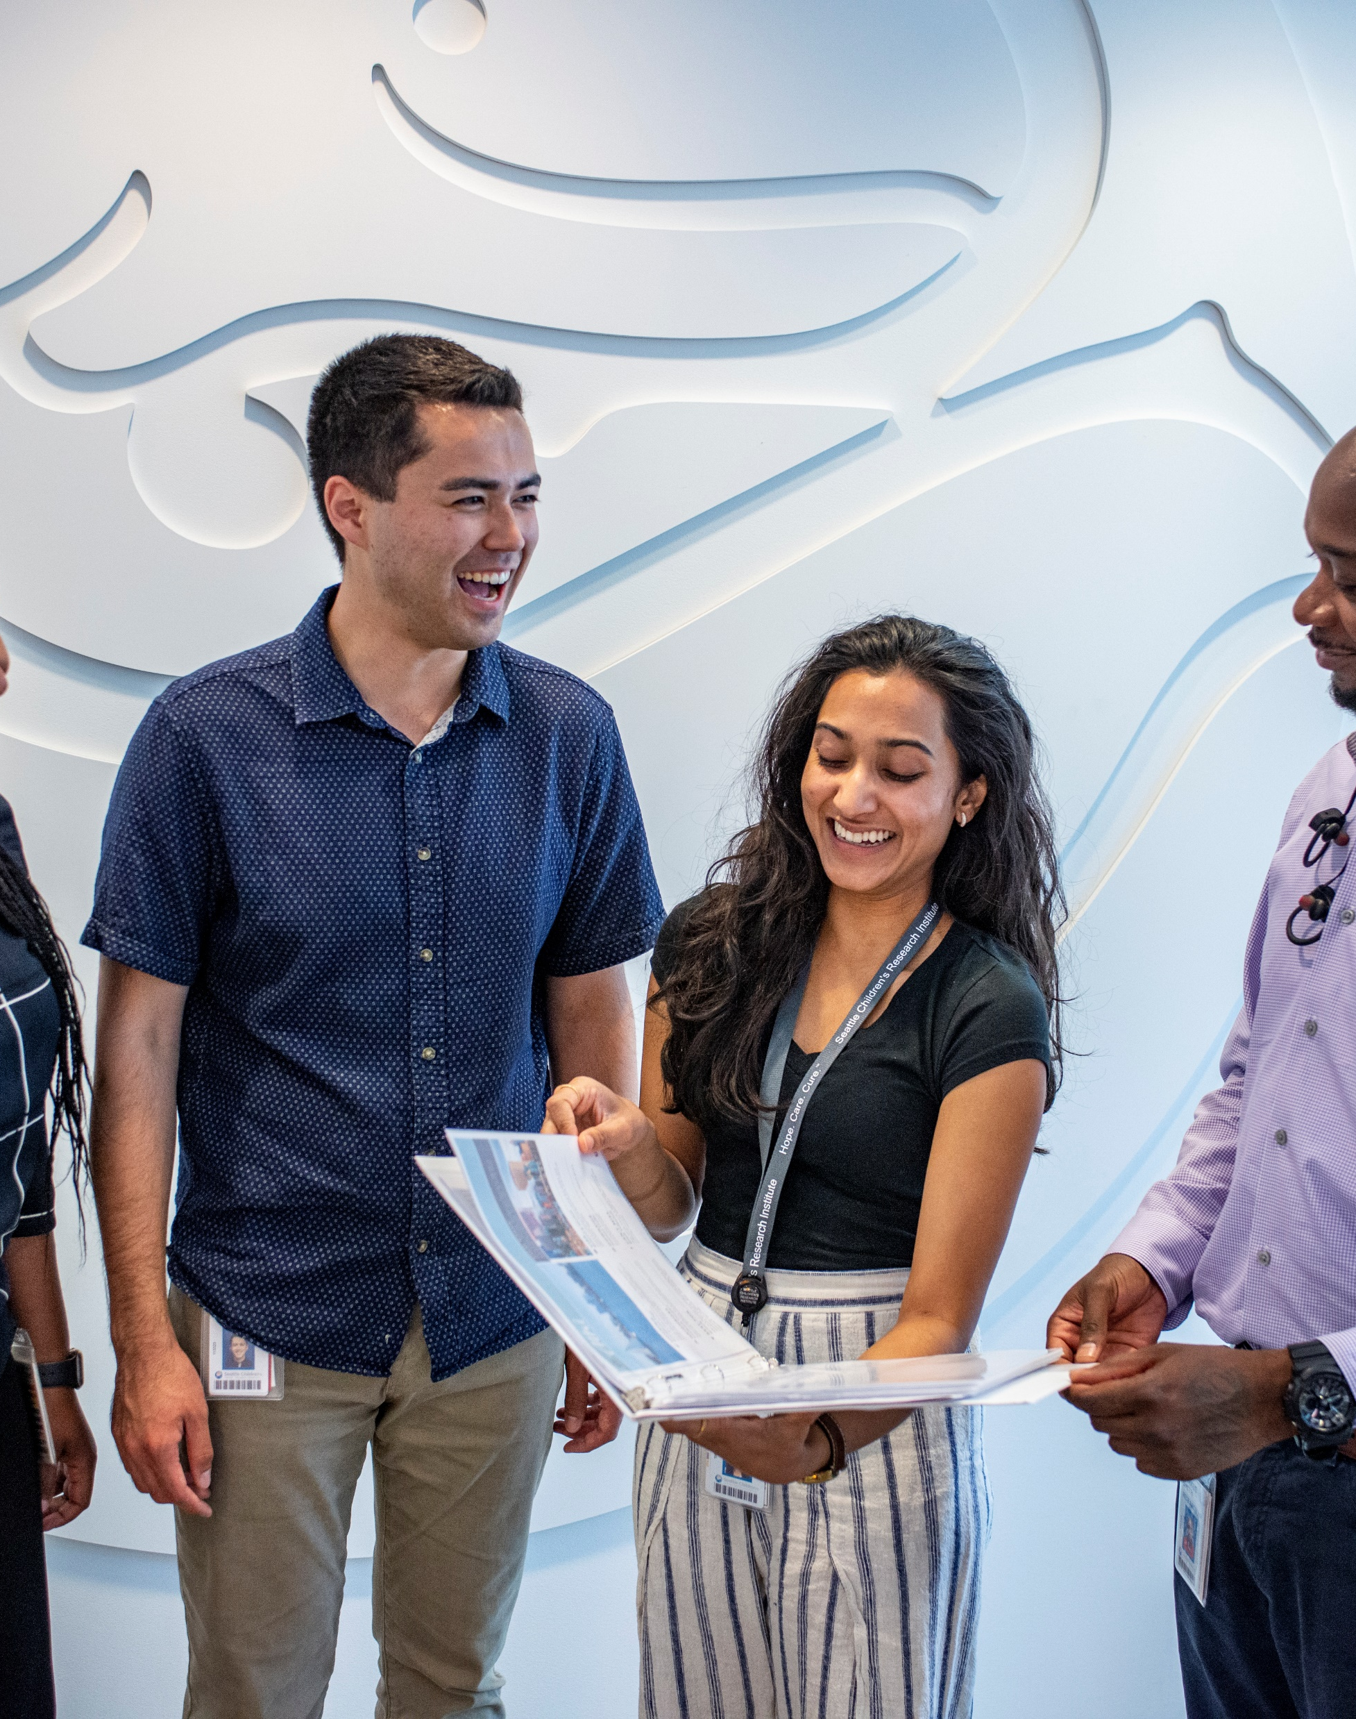
Research Coordinators might also provide oversight or assistance for:
Regulatory submission & maintenance
Budget development & billing compliance
Study contracts & agreements
Sample collection & processing
Study close out & archival of records

Slide 16
Who Makes a Good Public Health Research Professional?

Slide 17
Public Health Research Professionals
DETAILS
PEOPLE
ORGANIZATION
INTEGRITY
COMMUNICATION
Notes:
DETAILS: Managing research studies involves tracking and organizing a lot of data points, timelines and milestones.
PEOPLE: You are the face of a research study, often the first and most frequent point of contact for communities and study participants
INTEGRITY: It is important to document everything that happens in research studies and report them honestly.
COMMUNICATION: It is important to be able to communicate well in writing and by speaking with a lot of different types of people
ORGANIZATION: You should be able to organize your time and work well and independently

Slide 18
Research Professionals
People with backgrounds as medical assistants, community health educators, and in nonscientific fields can all make excellent research professionals!
Many research roles don't require an advanced degree.
There is room to grow in multiple directions, depending on your interests, including data, clinical, administrative, or regulatory roles.
People with a commitment to help others.

Slide 19




Public Health Research
Scientific discovery in public health and health care
Address communities’ most pressing health concerns
All research professionals are crucial to the success of research studies
Public health research professionals are involved in every stage of research

Slide 20
Who is Hiring?

Slide 21
Pursuing a career in public health research provides opportunities at universities, community clinics, non-profit organizations, and research foundations

Slide 22
Pursuing a career in public health research provides opportunities at universities, non-profit and community-based organizations organizations, and public health agencies.

Slide 23

Where To Look
Local universities & research centers
Local & national public health agencies
Staffing agencies
Nonprofit foundations
Job boards, Indeed & LinkedIn

Slide 24
Local Opportunities

Slide 25
Earning Potential

Slide 26

Have you seen the price of eggs?!
How much could I make?

Slide 27
Local
Earnings Breakdown
Title | Range

Slide 28
Key Takeaways
Public health research professionals make a difference
There are career opportunities at all levels in public health research
Careers in public health research are accessible
Many roles don't require advanced degrees or a scientific background
Notes:
Public health research professionals make a difference in the lives of study participants and the community as a whole. They drive the discovery of new ways to solve the most pressing issues impacting health.
There are career opportunities at all levels in public health research from early scientific development, research coordination, data analysis, monitoring and administration, entry level to senior leadership roles.
Careers in public health research are accessible: many roles don't require advanced degrees or a scientific background.

Slide 29

QUESTIONS

Slide 30

More Information

Slide 31
Acknowledgements
Funding was provided by the Institute of Translational Health Sciences (UL1TR002319) in collaboration with the Seattle Children's Research Institute and the Montana IDeA Network for Biomedical Research Institute.

